Slide 1
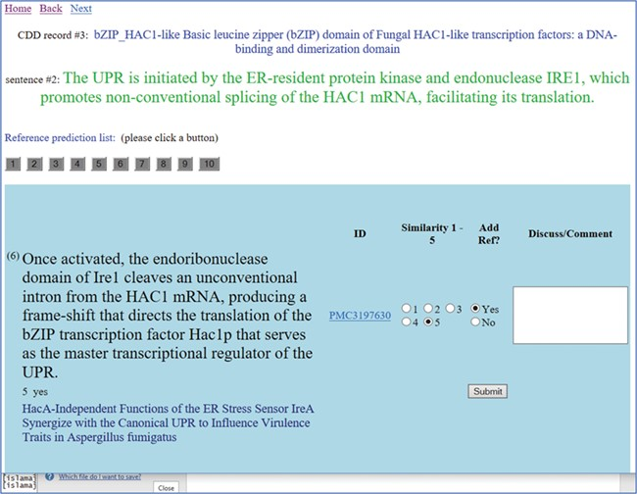
Figure 1 A screenshot of the text similarity annotation tool. The curator is reviewing the CDD record titled `Basic ...
Notes:
Figure 1 A screenshot of the text similarity annotation tool. The curator is reviewing the CDD record titled `Basic leucine zipper (bZIP) domain of Fungal HAC1-like transcription factors: a DNA-binding and dimerization domain’. The curator is reviewing the second sentence from the original summary, which is shown in green letters. Clicking on the button numbered 1–10, the reviewer can see the candidate sentences extracted from the reference list of articles. Each of these sentences is judged on a similarity scale 1–5, with 5 meaning most similar and 1 meaning the least similar. A link to the article is provided (in this case, a link to the full text is provided). The title of the referenced article is given under the candidate sentence, for the curator’s convenience. The curator selects the `Add reference’ button as needed.
Unless provided in the caption above, the following copyright applies to the content of this slide: Published by Oxford University Press 2019.This work is written by US Government employees and is in the public domain in the US.

Slide 2
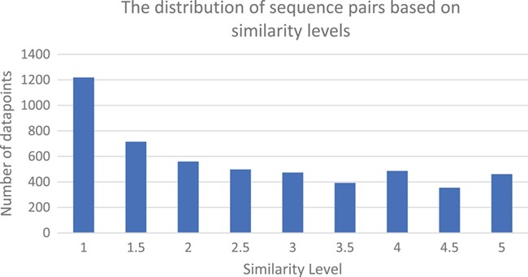
Figure 2 The similarity levels distribution of the judged pairs of sentences in the CDD sentence similarity dataset.
Notes:
Figure 2 The similarity levels distribution of the judged pairs of sentences in the CDD sentence similarity dataset.
Unless provided in the caption above, the following copyright applies to the content of this slide: Published by Oxford University Press 2019.This work is written by US Government employees and is in the public domain in the US.

Slide 3
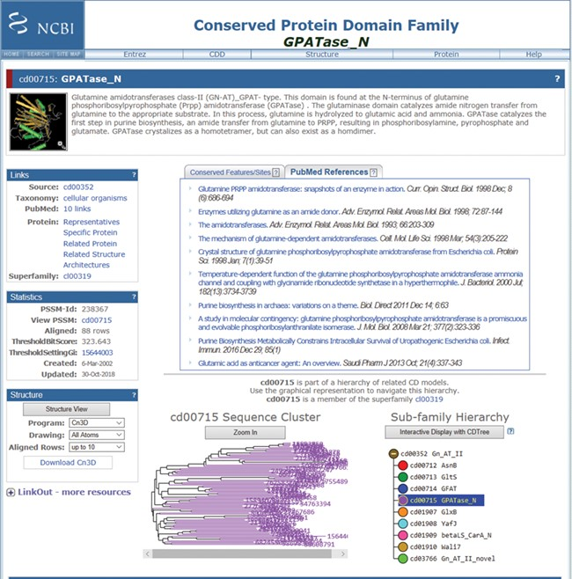
Figure 3 Screenshot of a random CDD record (the GPATase_N domain) page, after being updated with the new information ...
Notes:
Figure 3 Screenshot of a random CDD record (the GPATase_N domain) page, after being updated with the new information in the CDD. This record now has 10 PubMed articles linked as relevant references. The six new references are added below the original references (https://www.ncbi.nlm.nih.gov/Structure/cdd/cddsrv.cgi?uid=cd00715).
Unless provided in the caption above, the following copyright applies to the content of this slide: Published by Oxford University Press 2019.This work is written by US Government employees and is in the public domain in the US.

