Slide 1
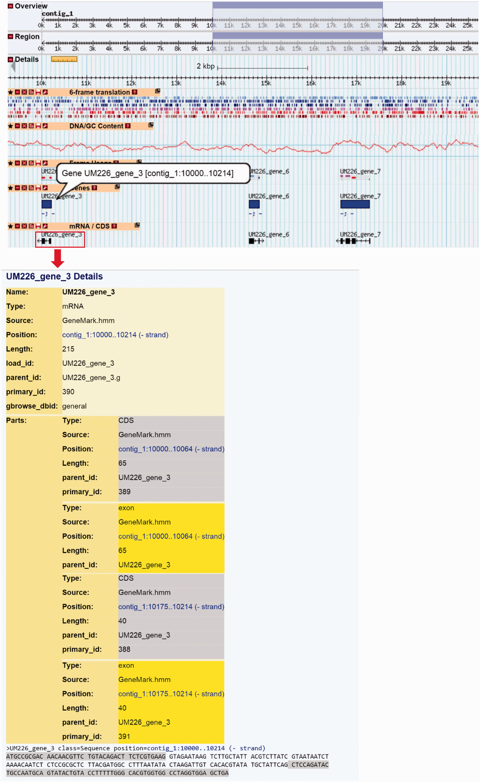
Figure 5. The layout of Genome Browser for B. papendorfii UM 226 genome. Horizontal tracks show genomic features of ...
Notes:
Figure 5. The layout of Genome Browser for B. papendorfii UM 226 genome. Horizontal tracks show genomic features of Contig 1. A highlighted blue rectangle indicates the genome region, that is, displayed in the details panel. A 6-frame translation track for DNA sequence is displayed in six different colour. The DNA/GC Content track represents the GC content in a given contig. In the genes track, blue bars indicate B. papendorfii UM 226 predicted genes. In the mRNA/CDs track, black arrows indicate B. papendorfii UM 226 mRNAs and their orientation. The information of a particular gene, including intron–exon organization, sequence and length is linked to each mRNA (black arrow).
Unless provided in the caption above, the following copyright applies to the content of this slide: © The Author(s) 2016. Published by Oxford University Press. This is an Open Access article distributed under the terms of the Creative Commons Attribution License ( http://creativecommons.org/licenses/by/4.0/ ), which permits unrestricted reuse, distribution, and reproduction in any medium, provided the original work is properly cited.

