Slide 1
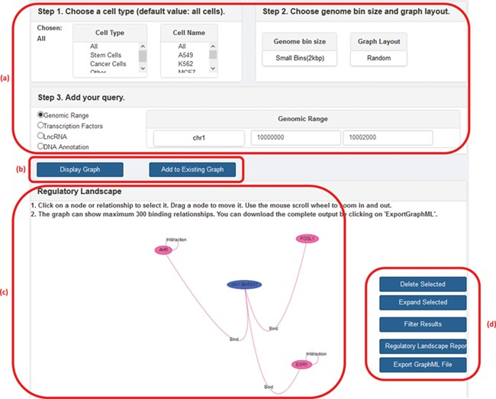
Figure 2 A screenshot of GREG’s web platform (basic mode). (a) Input data: cell type, DNA bin size and query (genomic ...
Notes:
Figure 2 A screenshot of GREG’s web platform (basic mode). (a) Input data: cell type, DNA bin size and query (genomic range, transcription factor, lncRNA or DNA annotation). (b) Options to run query: either display new graph or add query to existing graph. (c) Results window: data associated with each node or relationship (see Table 1) can be visualized by hovering over the graph. (d) Options to manage results: delete or expand selected nodes or relationships, filter results by a given type of relationship, print a summary report or export a graph to a graph format.
Unless provided in the caption above, the following copyright applies to the content of this slide: © The Author(s) 2020. Published by Oxford University Press.This is an Open Access article distributed under the terms of the Creative Commons Attribution License (http://creativecommons.org/licenses/by/4.0/), which permits unrestricted reuse, distribution, and reproduction in any medium, provided the original work is properly cited.

Slide 2
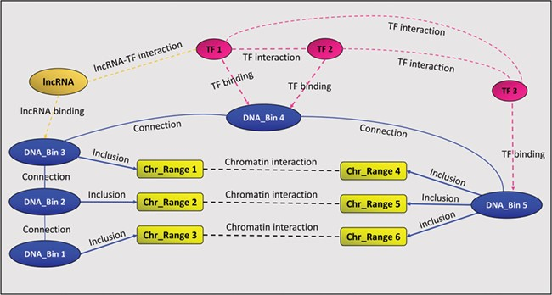
Figure 1 A GREG regulatory landscape. A regulatory landscape contains DNA bins (blue), which are ‘connected’ between ...
Notes:
Figure 1 A GREG regulatory landscape. A regulatory landscape contains DNA bins (blue), which are ‘connected’ between them. DNA-binding proteins or TF (red) ‘bind’ the DNA bins and ‘interact’ with other proteins (red). DNA bins (blue) also ‘include’ some DNA ranges (yellow), which, in time, ‘interact’ with other ranges through chromatin–chromatin interactions (black). lncRNAs (orange) can interact with both bins and proteins.
Unless provided in the caption above, the following copyright applies to the content of this slide: © The Author(s) 2020. Published by Oxford University Press.This is an Open Access article distributed under the terms of the Creative Commons Attribution License (http://creativecommons.org/licenses/by/4.0/), which permits unrestricted reuse, distribution, and reproduction in any medium, provided the original work is properly cited.

