Slide 1
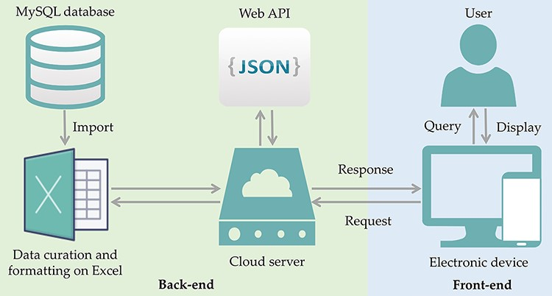
Figure 1. ProbResist database and interface. Information extracted from articles retrieved from PubMed database was ...
Notes:
Figure 1. ProbResist database and interface. Information extracted from articles retrieved from PubMed database was manually curated and formatted offline on Excel before importing into MySQL database in the following format: antibiotic, species, gene location, country, PMID and DOI. The database website structure was designed and developed using the front-end (blue box) and back-end (green box) separation where the website front-end will query the database when user invoked either the search function by species, antibiotic or country name, in the search bar. At the back-end, data are provided by restful web API in JSON format. For website development, an online web template provided by HTML design (https://html.design) was adopted and modulated. Front-end only requires the setting up of the user query input as a parameter to specify API URL and then displayed in appropriate table HTML format. Users have the option to export their retrieved results into Excel format.
Unless provided in the caption above, the following copyright applies to the content of this slide: © The Author(s) 2022. Published by Oxford University Press.This is an Open Access article distributed under the terms of the Creative Commons Attribution-NonCommercial License (https://creativecommons.org/licenses/by-nc/4.0/), which permits non-commercial re-use, distribution, and reproduction in any medium, provided the original work is properly cited. For commercial re-use, please contact journals.permissions@oup.com

