Slide 1
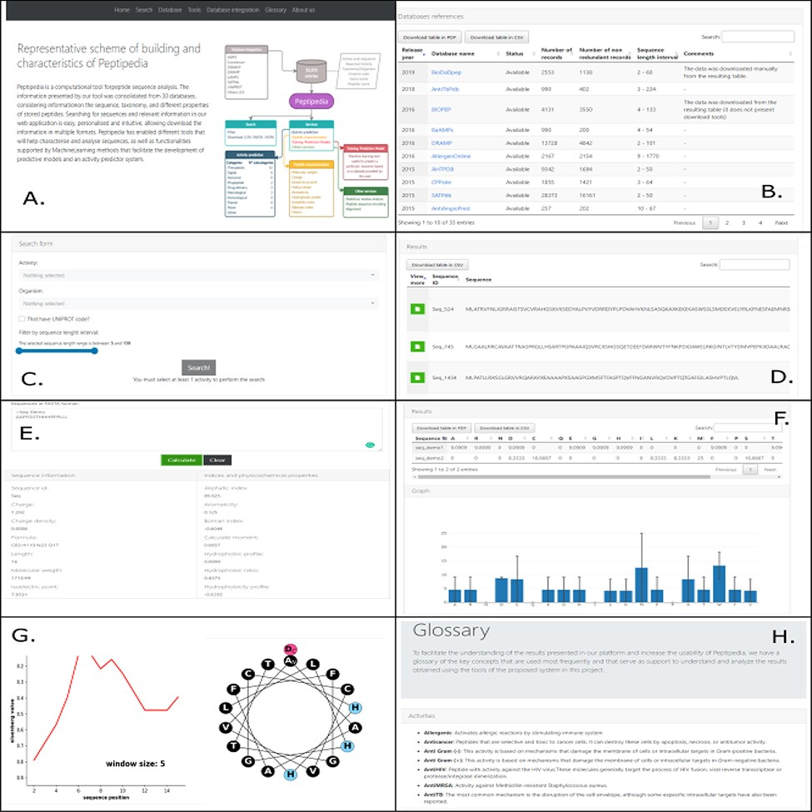
Figure 3. Different visualizations of the Peptipedia web interface. Home Page of Peptipedia (A). Different web tools ...
Notes:
Figure 3. Different visualizations of the Peptipedia web interface. Home Page of Peptipedia (A). Different web tools and previously reported database used to generate the integrated collection of peptides in the proposed tool on this work (B). The search in Peptipedia is easy, you can filter by activity and add more specific filters to personalize the search. The results are disposed in a summary table (C and D). Peptipedia has different services or tools to increase the usability of the web platform; to use any tool, you need to insert a sequence in FASTA format and execute the tool. The results will be displayed depending on the selected service, which could be a summary table, graphic summary and specialized graphic (E, F and G). Finally a glossary with different terms is available on Peptipedia to help the understanding of results generated by the application tool (H).
Unless provided in the caption above, the following copyright applies to the content of this slide: © The Author(s) 2021. Published by Oxford University Press.This is an Open Access article distributed under the terms of the Creative Commons Attribution License (https://creativecommons.org/licenses/by/4.0/), which permits unrestricted reuse, distribution, and reproduction in any medium, provided the original work is properly cited.

