Slide 1
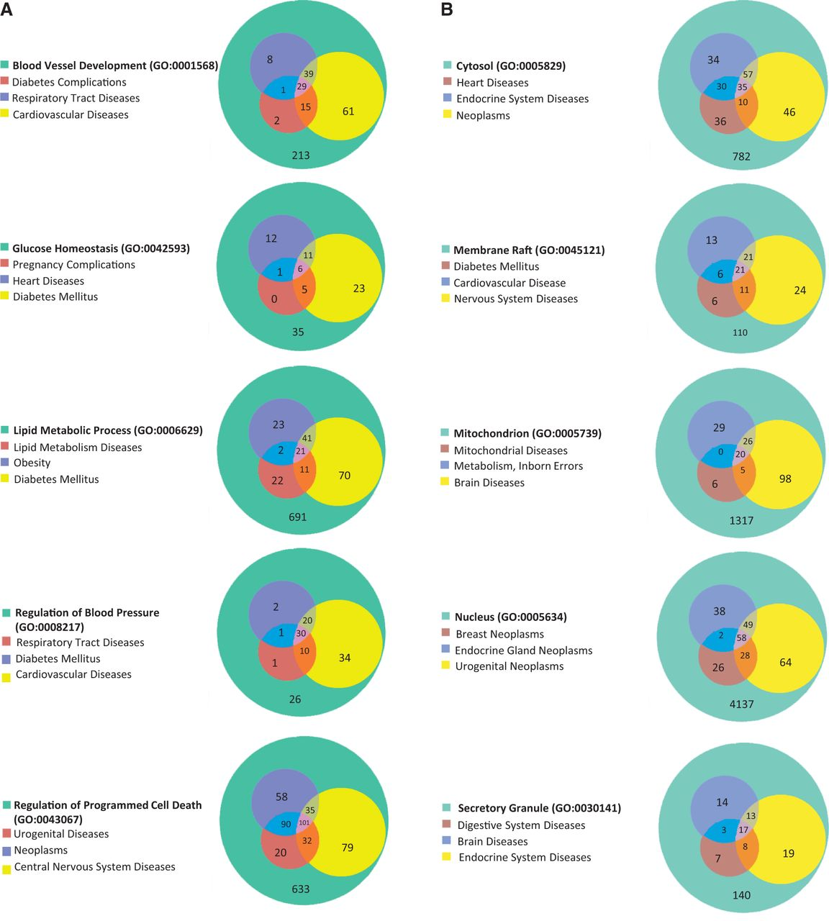
Figure 5. (A) The disease enrichment analysis of five BP-annotated gene lists. The three most enriched diseases from ...
Notes:
Figure 5. (A) The disease enrichment analysis of five BP-annotated gene lists. The three most enriched diseases from each gene list are presented in Venn diagrams. The numbers in each area represent the gene count of the section. (B) The disease enrichment analysis of five CC-annotated gene lists. The three most enriched diseases from each gene list are presented in Venn diagrams. The numbers in each area represent the gene count of that section. (C) The disease enrichment analysis of five MF annotated gene lists. The three most enriched diseases from each gene list are presented in Venn diagrams. The numbers in each area represent the gene count of that section.
Unless provided in the caption above, the following copyright applies to the content of this slide: © The Author(s) 2013. Published by Oxford University Press.This is an Open Access article distributed under the terms of the Creative Commons Attribution License (http://creativecommons.org/licenses/by/3.0/), which permits unrestricted reuse, distribution, and reproduction in any medium, provided the original work is properly cited.

