Slide 1
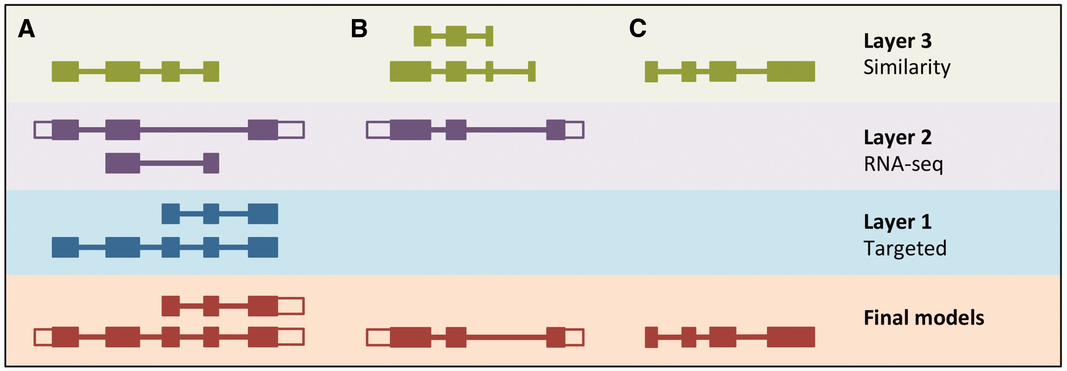
Figure 5. LayerAnnotation method. Candidate transcript models produced by each of the model-building pipelines are ...
Notes:
Figure 5. LayerAnnotation method. Candidate transcript models produced by each of the model-building pipelines are assigned varying levels of priority. In this example, models produced by the Targeted pipeline (which uses same-species protein data) are placed in Layer 1 and are therefore given preference over models with overlapping exons from the other model-building pipelines. Models produced using RNA-seq data are placed in Layer 2 and are given priority over those produced by the Similarity pipeline (which uses protein data from other species) in Layer 3. Final models indicate those selected for the final Ensembl gene set. ( A ) Candidate transcript models were produced by three model-building pipelines. The final protein-coding models were selected from Layer 1. Untranslated regions (unfilled boxes) were added from an RNA-seq model in Layer 2. The two transcript models will later be collapsed into a single gene model. ( B ) Layer 1 contains no model that overlaps with the model in Layer 2, and so the model in Layer 2 is the final model. ( C ) Layer 1 and Layer 2 contain no models that overlap with that in Layer 3, so the model in Layer 3 is selected as the final one.
Unless provided in the caption above, the following copyright applies to the content of this slide: © The Author(s) 2016. Published by Oxford University Press. This is an Open Access article distributed under the terms of the Creative Commons Attribution License ( http://creativecommons.org/licenses/by/4.0/ ), which permits unrestricted reuse, distribution, and reproduction in any medium, provided the original work is properly cited.

