Slide 1
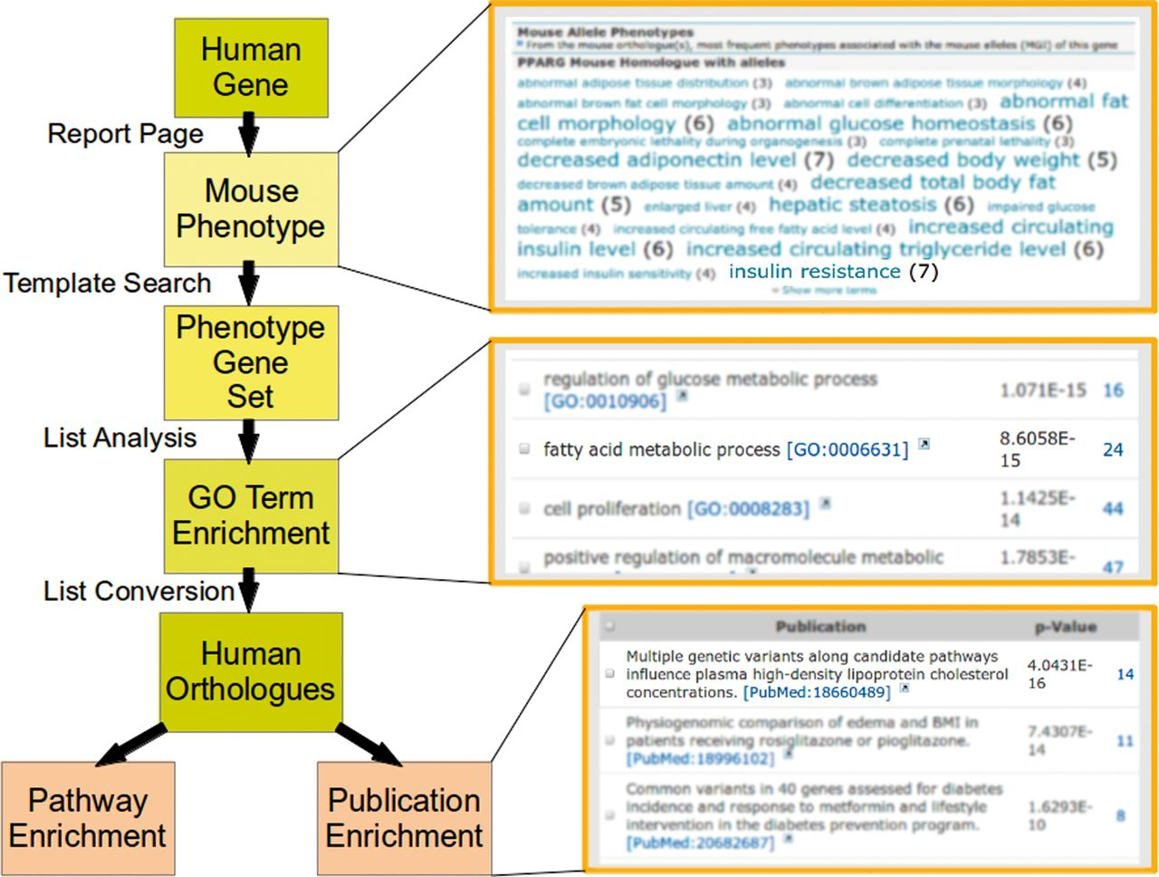
Figure 5. Using metabolicMine to uncover additional candidate genes. A researcher viewing the human PPARG gene report ...
Notes:
Figure 5. Using metabolicMine to uncover additional candidate genes. A researcher viewing the human PPARG gene report page finds mouse alleles with an insulin resistance phenotype. Conducting a template search (Phenotype → Alleles) using this phenotype term identifies 133 mouse genes sharing this phenotype, which can be saved as a list. The list is presented on a list analysis page that automatically runs a number of enrichment algorithms on the data. The GO enrichment widget identifies a subset of 26 genes involved in fatty acid metabolic process [GO:0006631] (P < 1.3E-15) that can be saved as a new list. Converting this list to their human orthologues shows enrichment for the adipocytokine signalling pathway. In addition, the top hit from the publications enrichment widget describes human genes associated with high-density lipoprotein cholesterol (HDL-C). Together, these provide the researcher with additional candidate targets for exploring interventions for insulin resistance and dyslipidaemia.
Unless provided in the caption above, the following copyright applies to the content of this slide: © Crown copyright 2013.

