Slide 1
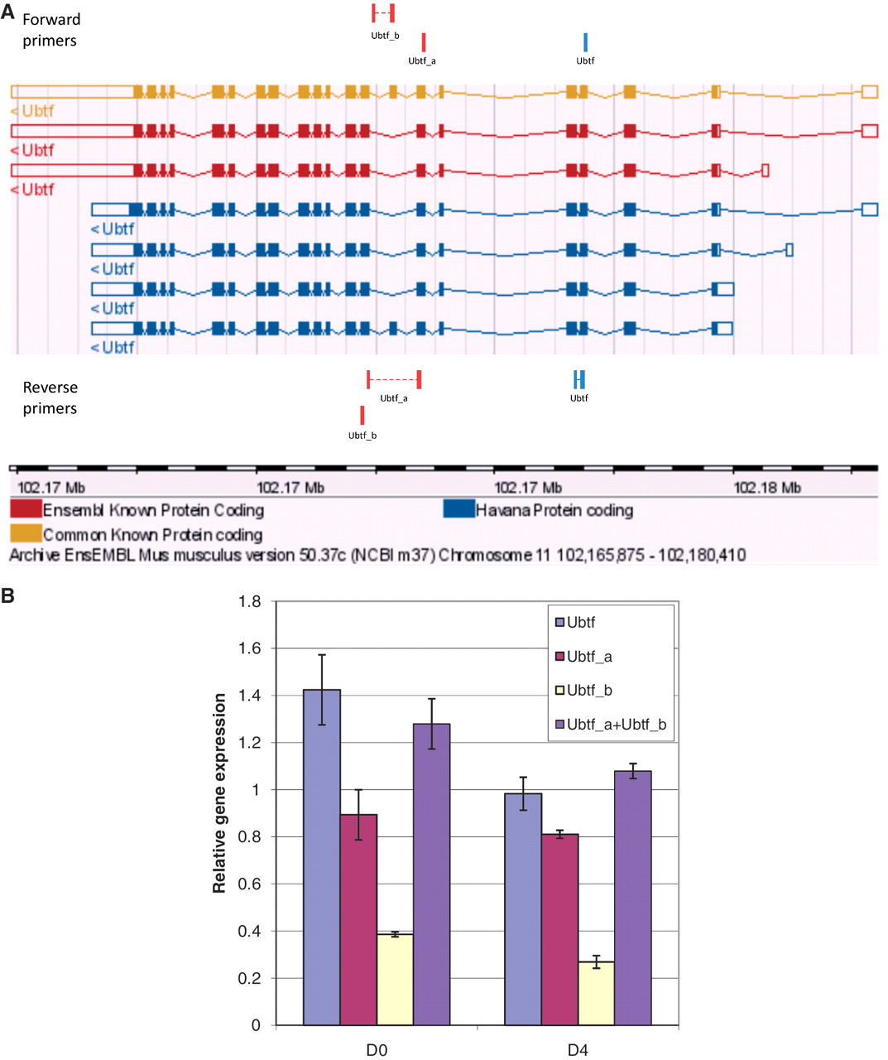
Figure 6. Graphical view and qPCR results to validate Ubtf-targeting primers covering either all or a subset of Ubtf ...
Notes:
Figure 6. Graphical view and qPCR results to validate Ubtf-targeting primers covering either all or a subset of Ubtf transcripts. (A) The ‘Ubtf’ primer pair in blue covers all seven transcripts (gene-specific primers) and the red ‘Ubtf_a’ and ‘Ubtf_b’ primer pairs cover five and two transcripts, respectively (transcript-specific primers). In this example, GETPrime could not find primers differentiating each transcript. (B) The relative gene expression levels before differentiation (D0) and four days after (D4) were normalized to Hprt1 and Tubb2c expression levels. ‘Ubtf’ represents the primer pair covering all seven transcripts, whereas, ‘Ubtf_a’ and ‘Ubtf_b’ are primer pairs specific to a subset of five and two transcripts, respectively. ‘Ubtf_a+Ubtf_b’ represents the sum of relative gene expression of ‘Ubtf_a’ and ‘Ubtf_b’. The data indicate that GETPrime can effectively differentiate distinct transcripts, as the sum of the individual transcript amounts matched the overall gene expression amount.
Unless provided in the caption above, the following copyright applies to the content of this slide: © The Author(s) 2011. Published by Oxford University Press.This is Open Access article distributed under the terms of the Creative Commons Attribution Non-Commercial License (http://creativecommons.org/licenses/by-nc/2.5), which permits unrestricted non-commercial use, distribution, and reproduction in any medium, provided the original work is properly cited.

