Slide 1
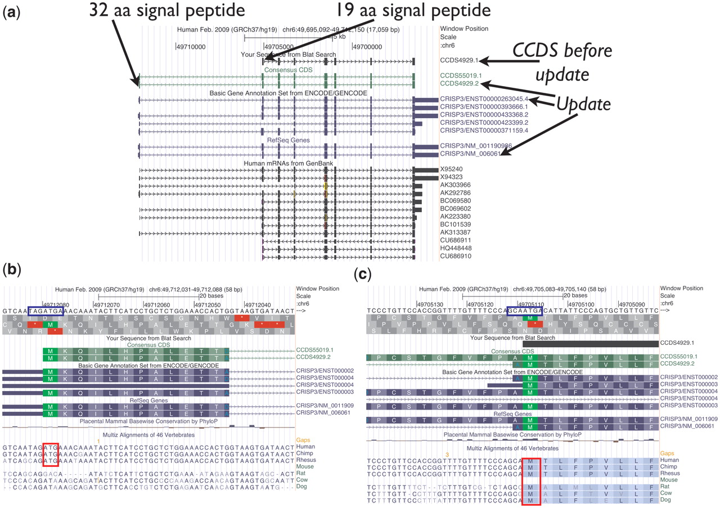
Figure 3. UCSC Genome Browser view of CCDS4929.1, which was updated to version 2, representing a variant of the human ...
Notes:
Figure 3. UCSC Genome Browser view of CCDS4929.1, which was updated to version 2, representing a variant of the human CRISP3 (cysteine-rich secretory protein 3) gene. The CDS was extended at the 5′-end. (a) Both the longer protein (258 amino acids) encoded by the update and the shorter protein (245 amino acids) have predicted signal peptides (SignalPv4.0) of 32 amino acids and 19 amino acids, respectively. (b and c) Base-level view. The upstream AUG start codon (b) has the weaker Kozak context (blue box) and is only conserved among primates (red box), whereas the downstream AUG (c) is conserved among more mammals (46-way alignment and conservation track).
Unless provided in the caption above, the following copyright applies to the content of this slide: Published by Oxford University Press on behalf of US Government 2012.This is an Open Access article distributed under the terms of the Creative Commons Attribution Non-Commercial License (http://creativecommons.org/licenses/by-nc/3.0), which permits unrestricted non-commercial use, distribution, and reproduction in any medium, provided the original work is properly cited.

