Slide 1
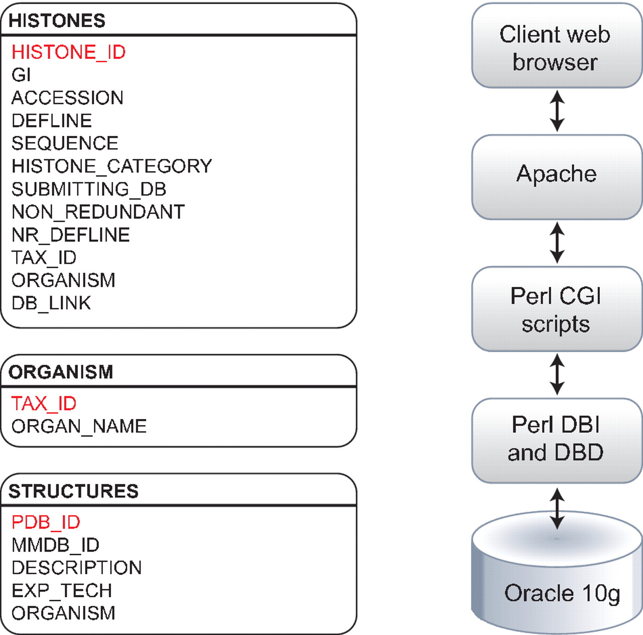
Figure 1. Histone Database data model. The Histone Database stores selected manually curated information from GenBank ...
Notes:
Figure 1. Histone Database data model. The Histone Database stores selected manually curated information from GenBank records. The information stored as part of each record includes the GenBank unique identifier (GI), accession number, definition line, sequence string, histone class, database source, NCBI taxonomic identifier and organism name. The database front-end is written in Perl, the data is stored in an Oracle 10 g relational database, and data is retrieved using Perl DBI and DBD libraries.
Unless provided in the caption above, the following copyright applies to the content of this slide: © The Author(s) 2011. Published by Oxford University Press on behalf of the National Institutes of Health.This is an Open Access article distributed under the terms of the Creative Commons Attribution Non-Commercial License (http://creativecommons.org/licenses/by-nc/3.0), which permits unrestricted non-commercial use, distribution, and reproduction in any medium, provided the original work is properly cited.

Slide 2
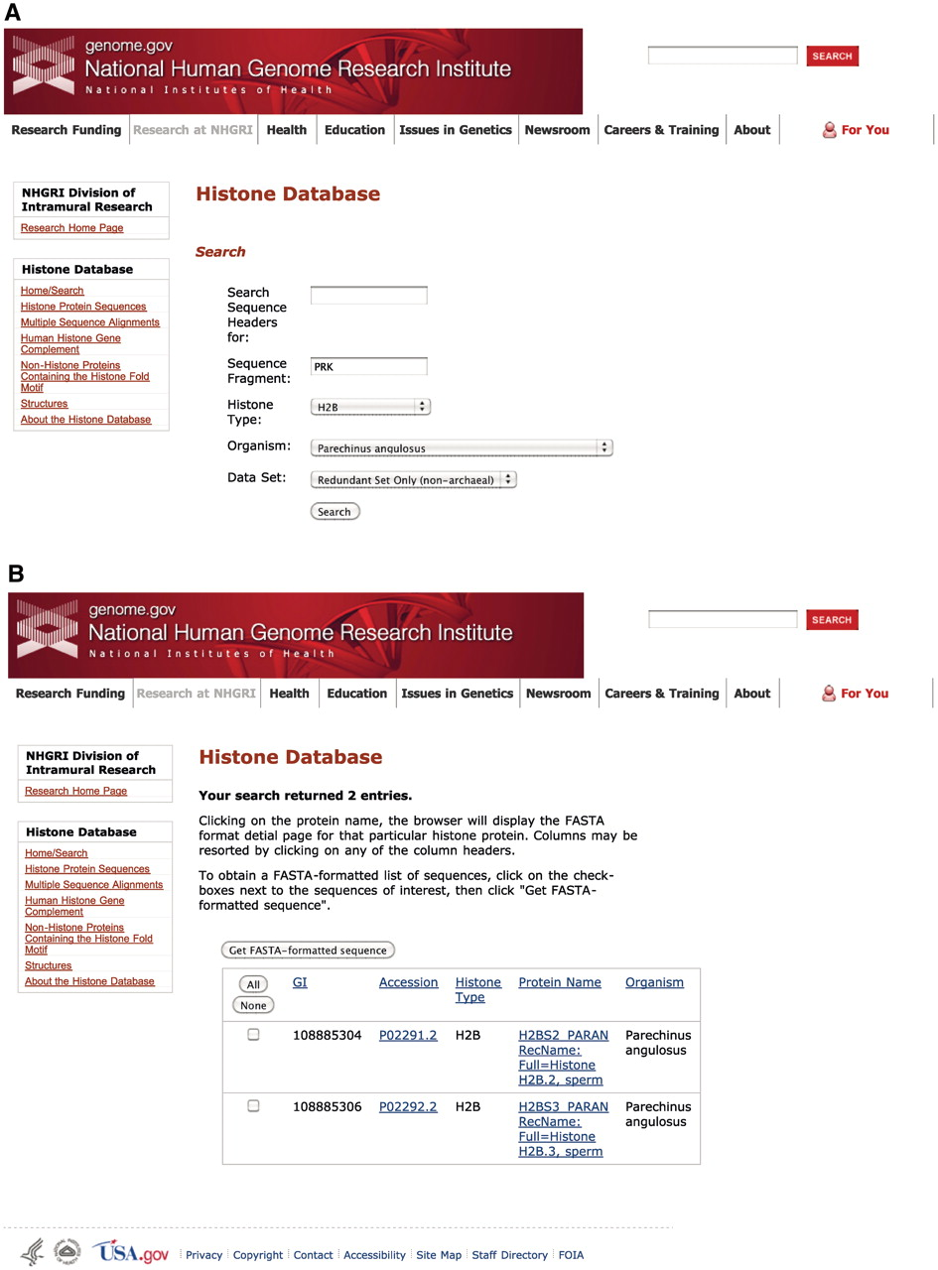
Figure 2. Histone Database query and results. The Histone Database main page displays a search engine that allows users ...
Notes:
Figure 2. Histone Database query and results. The Histone Database main page displays a search engine that allows users to find histone sequences from a large variety of organisms. Additionally, users have the possibility of exploring other features to access complete collections of Histone Protein Sequences, Multiple Sequence Alignments, The Human Histone Gene Complement, Non-Histone Proteins Containing the Histone fold Motif and Histone Structures. The upper panel shown (A) presents the criteria used for the query, which requires the sequence to contain a fragment with amino acids PRK from the angulate sea urchin (Parechinus angulosus) histone H2B. The search results presented in the lower panel (B) include two protein sequences that meet the criteria specified by the query.
Unless provided in the caption above, the following copyright applies to the content of this slide: © The Author(s) 2011. Published by Oxford University Press on behalf of the National Institutes of Health.This is an Open Access article distributed under the terms of the Creative Commons Attribution Non-Commercial License (http://creativecommons.org/licenses/by-nc/3.0), which permits unrestricted non-commercial use, distribution, and reproduction in any medium, provided the original work is properly cited.

Slide 3
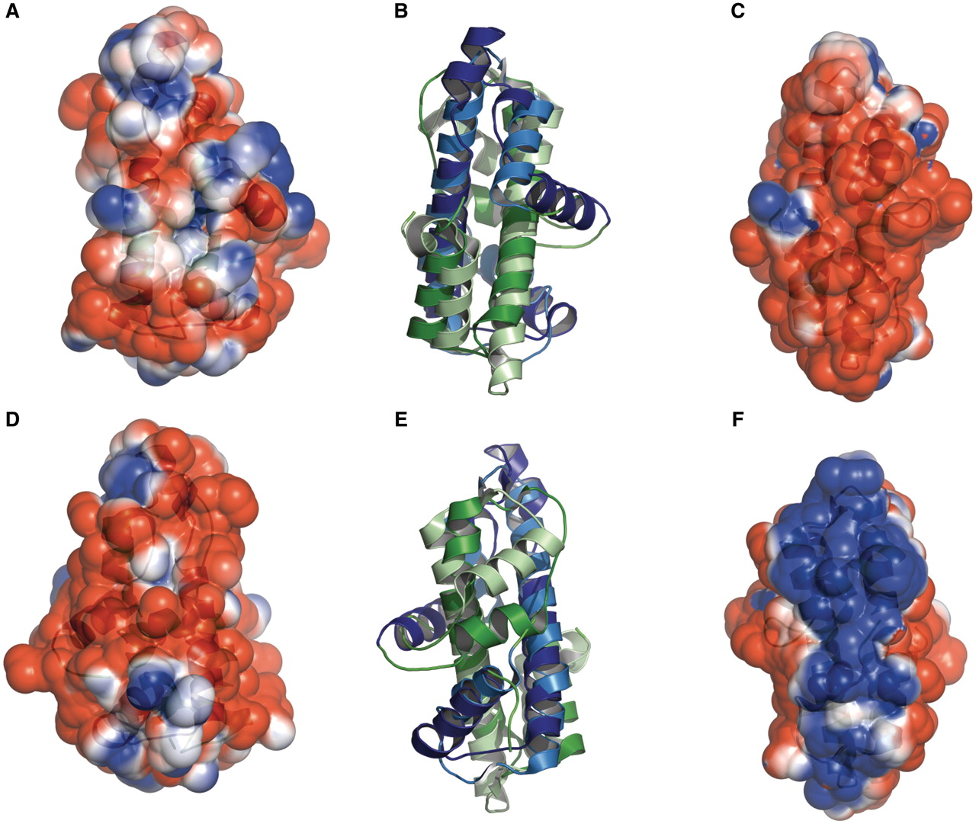
Figure 3. Histone-like folds in A. aeolicus and M. kandleri. Protein Aq_328 from the hyperthermophilic bacterium A. ...
Notes:
Figure 3. Histone-like folds in A. aeolicus and M. kandleri. Protein Aq_328 from the hyperthermophilic bacterium A. aeolicus (PDB:1R4V) and archaeal histone from M. kandleri (PDB:1F1E) have two histone like folds. These are colored as dark blue and dark green (for 1R4V) and light blue and light green (for 1F1E). The electrostatic surface potential ranges from +2 kTe−1 (blue) to −2 kTe−1(red). (A) and (D) the front and back views, respectively, of the electrostatic surface potential of Protein Aq_328. (B) and (E) superimposed structures of protein Aq_328 and the archaeal histone from M. kandleri. (C) and (F) the front and back views, respectively, of the electrostatic surface potential of the archaeal histone from M. kandleri. The figures were generated with PyMOL (49) and the APBS plug-in for PyMOL (50).
Unless provided in the caption above, the following copyright applies to the content of this slide: © The Author(s) 2011. Published by Oxford University Press on behalf of the National Institutes of Health.This is an Open Access article distributed under the terms of the Creative Commons Attribution Non-Commercial License (http://creativecommons.org/licenses/by-nc/3.0), which permits unrestricted non-commercial use, distribution, and reproduction in any medium, provided the original work is properly cited.

