Slide 1
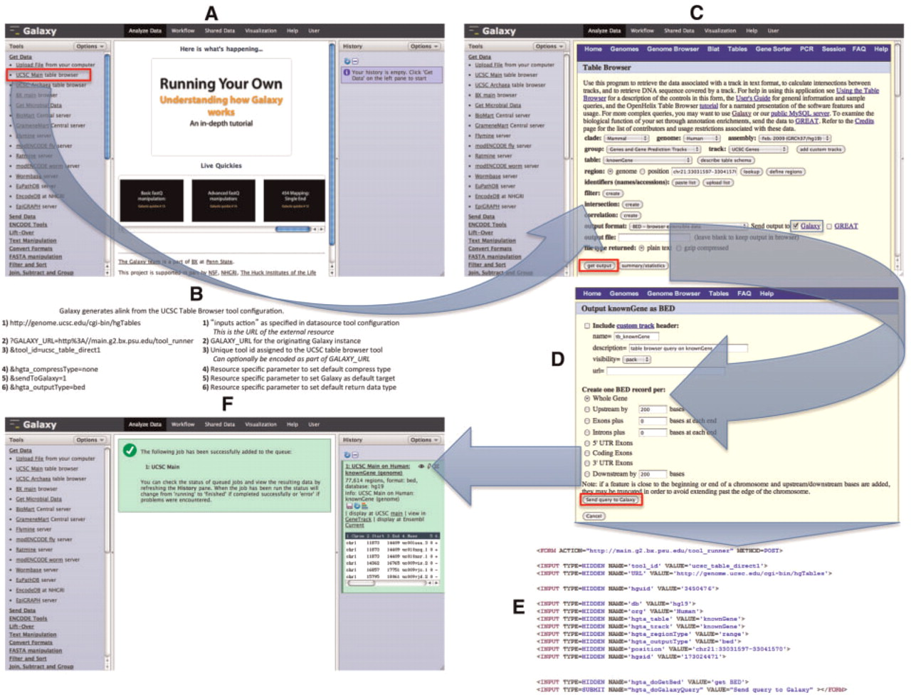
Figure 2. UCSC Table Browser as a synchronous data resource example. An overview of a typical synchronous data resource ...
Notes:
Figure 2. UCSC Table Browser as a synchronous data resource example. An overview of a typical synchronous data resource tool, with the UCSC Table Browser as an example, is shown here. Based upon the XML configuration file for the UCSC Table Browser tool (Figure 1), Galaxy creates a new tool as a link (outlined in red) that references the data resource under the Get Data tool section (A). An example of the link (B) that is generated is described along with the parameters of which it is composed; several of the parameters provided in the tool XML configuration customize the initial interface of the external resource. By accessing the link, the user is forwarded within their web-browser to the native UCSC Table Browser interface (C). Once the user is satisfied with their query configuration and has selected the desired formatting options (D), the UCSC Table Browser generates a form (E; for brevity, some parameters have been removed from the original HTML) with an action that points to the Galaxy server. When Galaxy receives the post (F), a new data set is created in the user's history. Galaxy collects the parameters provided within the request and executes a process in the background that resubmits these parameters back to the Table Browser at the location specified by the provided URL parameter; the response from the Table Browser is the content that Galaxy will use to populate the new data set.
Unless provided in the caption above, the following copyright applies to the content of this slide: © The Author(s) 2011. Published by Oxford University Press.This is Open Access article distributed under the terms of the Creative Commons Attribution Non-Commercial License (http://creativecommons.org/licenses/by-nc/2.5), which permits unrestricted non-commercial use, distribution, and reproduction in any medium, provided the original work is properly cited.

