Slide 1
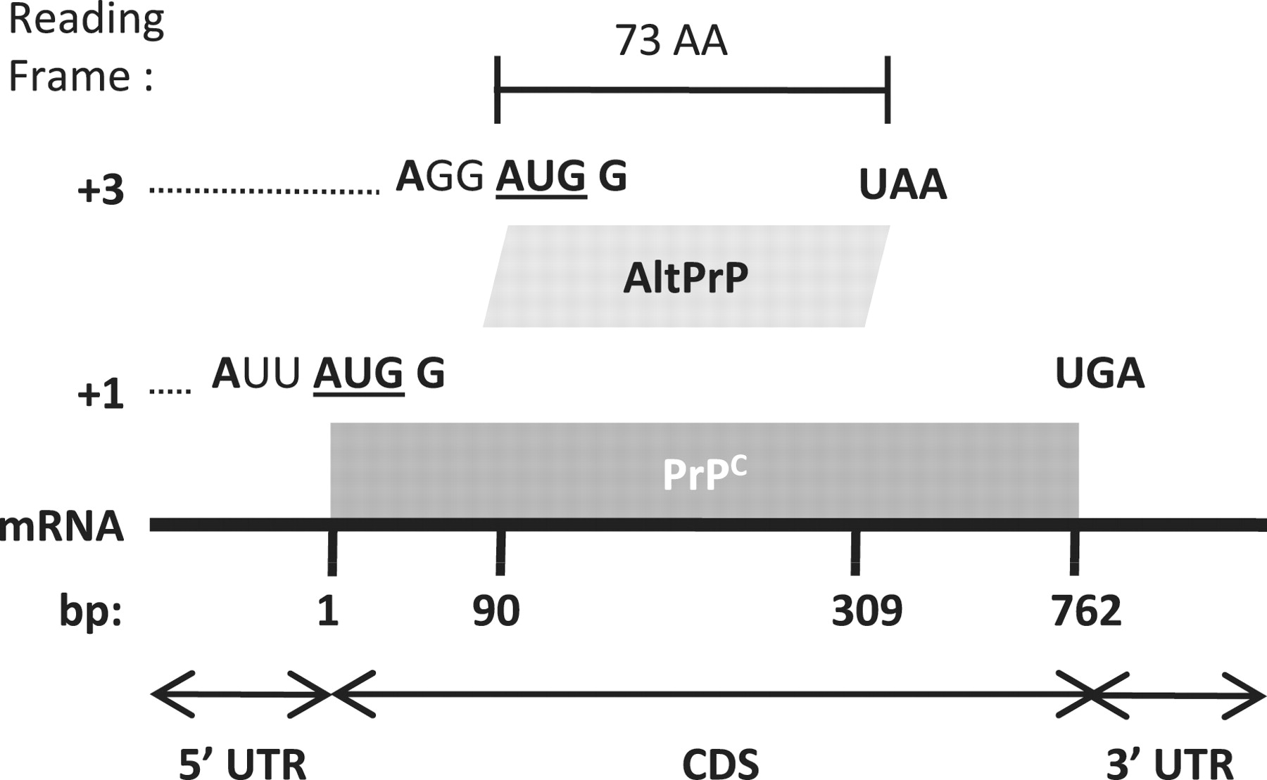
Figure 1 AltPrP, a typical example of AltORFs in the HAltORF database. All mRNAs produced from the PRNP gene have the ...
Notes:
Figure 1 AltPrP, a typical example of AltORFs in the HAltORF database. All mRNAs produced from the PRNP gene have the same reference ORF (nt 1–762, gray box) which encodes the prion protein (PrPC) in the +1 reading frame. An AltORF (white box) is present in the +3 reading frame (nt 90–309). Similar to all AltORFs present in the database, the alternative prion protein (AltPrP) encoding AltORF is entirely included in the CDS of the reference protein, and encodes a protein longer than 24 amino acids (minimum size threshold). Additionally, its AUG codon is in a different reading frame than the reference protein, and is located in an optimal Kozak context (shown in bold; consensus: A/GNNAUGG).
Unless provided in the caption above, the following copyright applies to the content of this slide: © The Author(s) 2012. Published by Oxford University Press.This is an Open Access article distributed under the terms of the Creative Commons Attribution Non-Commercial License (http://creativecommons.org/licenses/by-nc/3.0), which permits unrestricted non-commercial use, distribution, and reproduction in any medium, provided the original work is properly cited.

