Slide 1
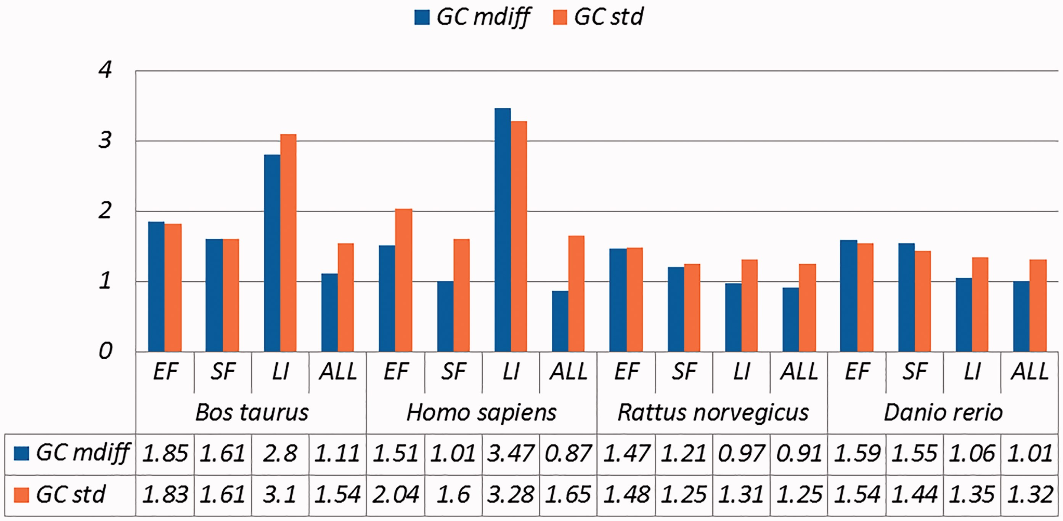
Figure 1. A selection of results for organisms in terms of GC content (Exemplar vs. Original merged groups) Categories ...
Notes:
Figure 1. A selection of results for organisms in terms of GC content (Exemplar vs. Original merged groups) Categories are the same as Table 1; mdiff and std: the mean and standard deviation of absolute value of the difference between each exemplar and the mean of the original group, respectively.
Unless provided in the caption above, the following copyright applies to the content of this slide: © The Author(s) 2017. Published by Oxford University Press.This is an Open Access article distributed under the terms of the Creative Commons Attribution License (http://creativecommons.org/licenses/by/4.0/), which permits unrestricted reuse, distribution, and reproduction in any medium, provided the original work is properly cited.

Slide 2
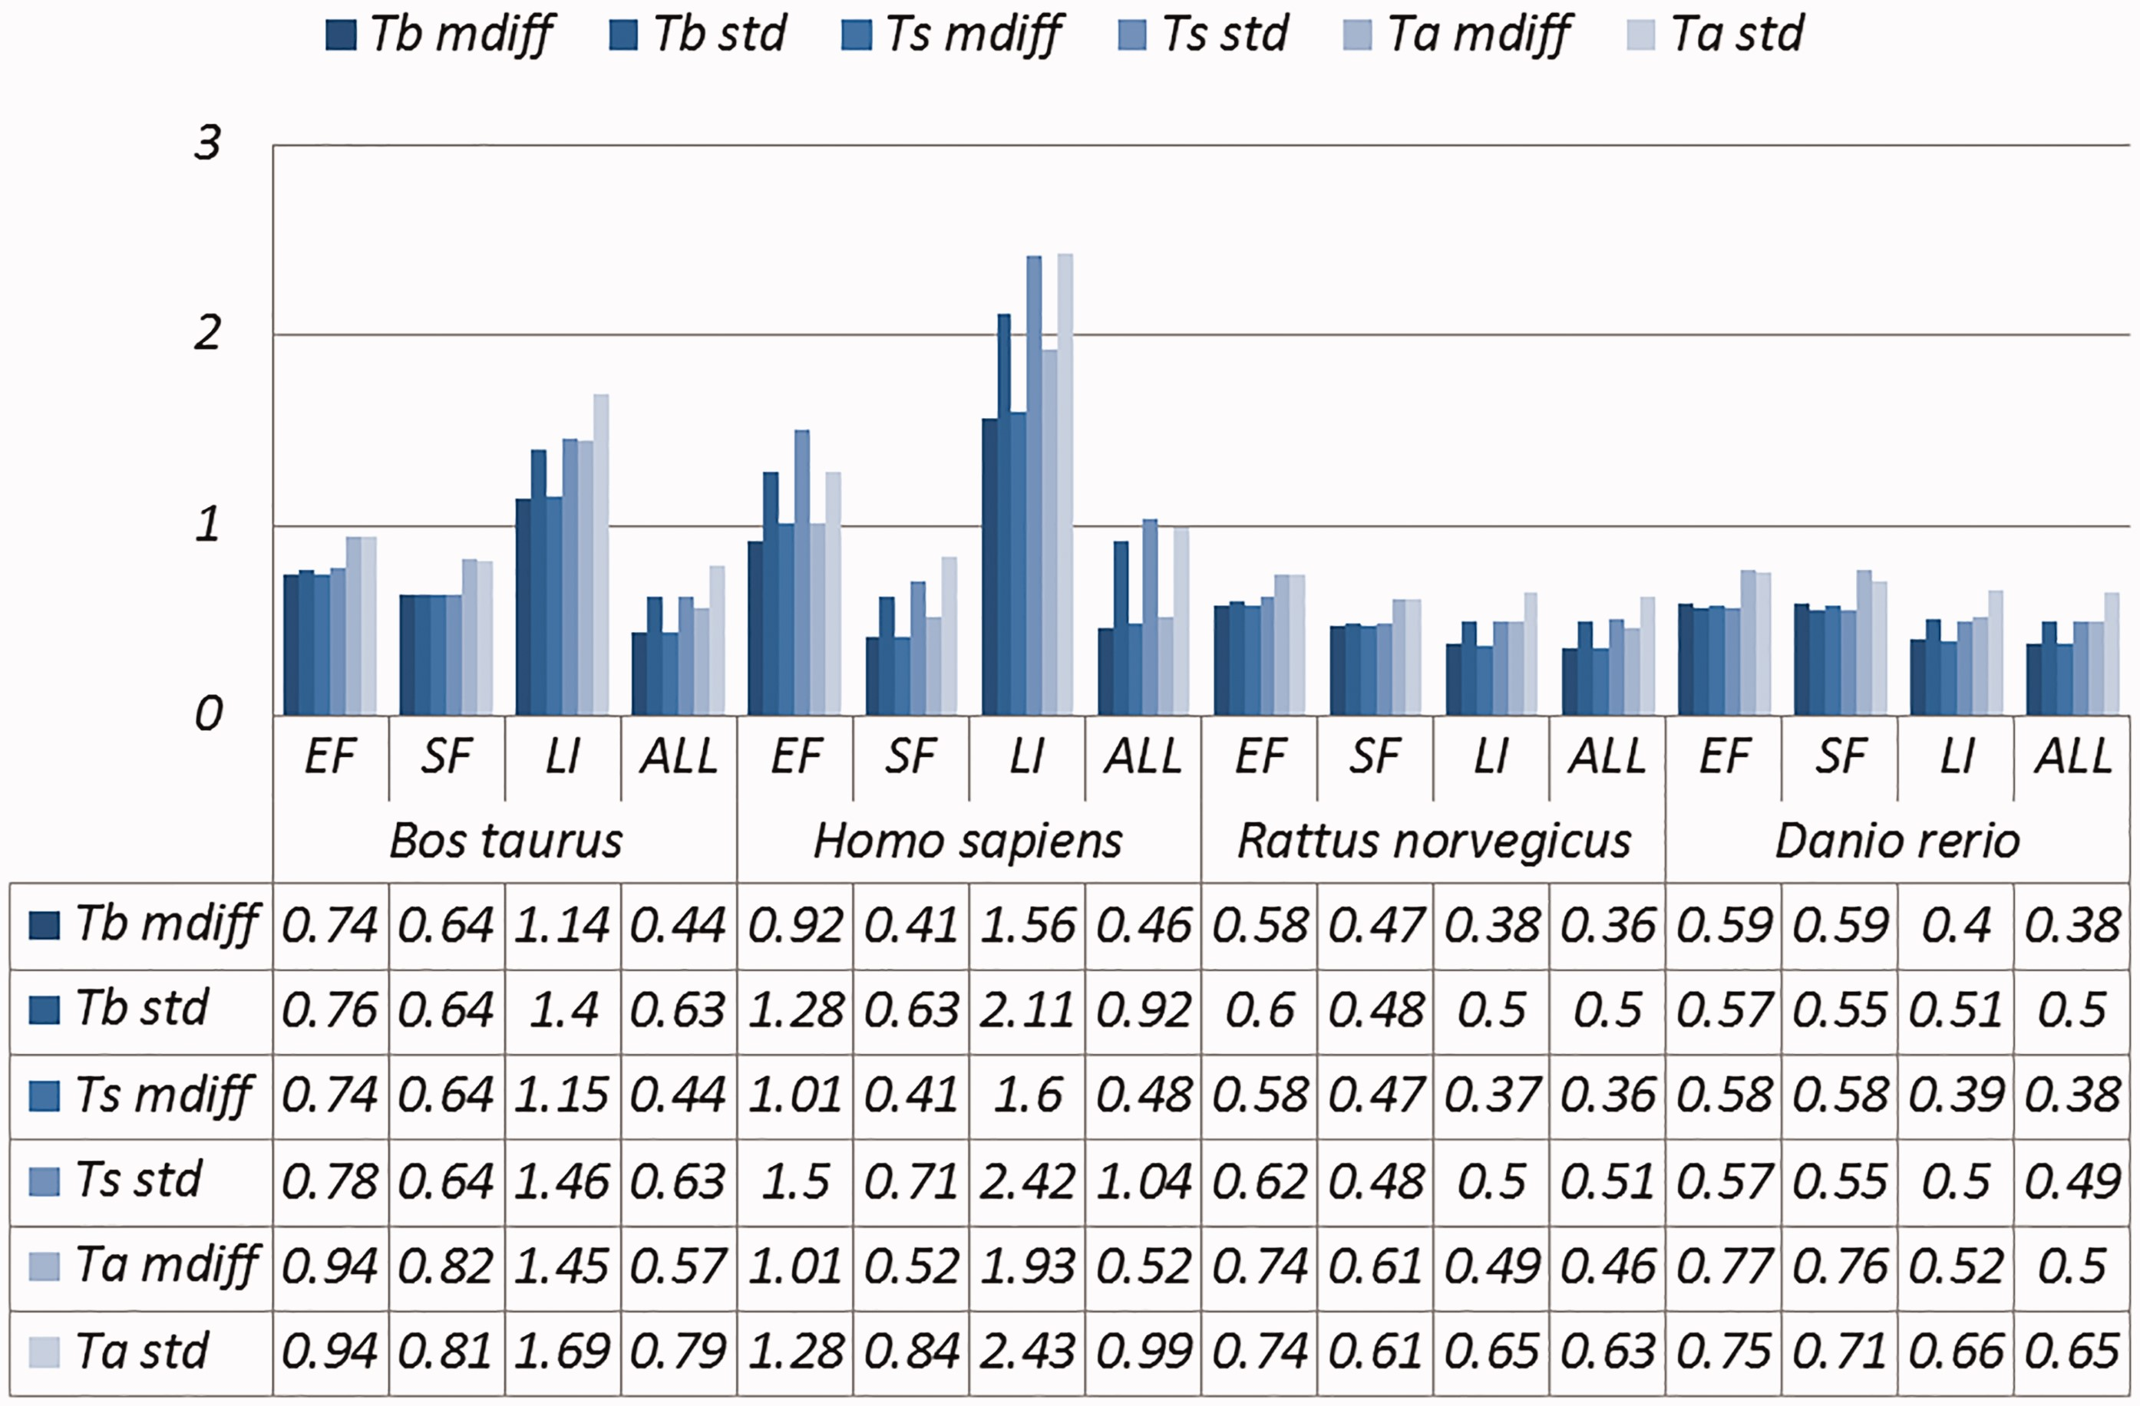
Figure 2. A selection of results for organisms in terms of melting temperatures (Exemplar vs. Original merged groups) ...
Notes:
Figure 2. A selection of results for organisms in terms of melting temperatures (Exemplar vs. Original merged groups) mdiff and std: the mean and standard deviation of absolute value of the difference between each exemplar and the mean of the original group respectively; Tb, Ts, Ta: melting temperature calculated using basic, salted and advanced formula in supplement, respectively.
Unless provided in the caption above, the following copyright applies to the content of this slide: © The Author(s) 2017. Published by Oxford University Press.This is an Open Access article distributed under the terms of the Creative Commons Attribution License (http://creativecommons.org/licenses/by/4.0/), which permits unrestricted reuse, distribution, and reproduction in any medium, provided the original work is properly cited.

Slide 3
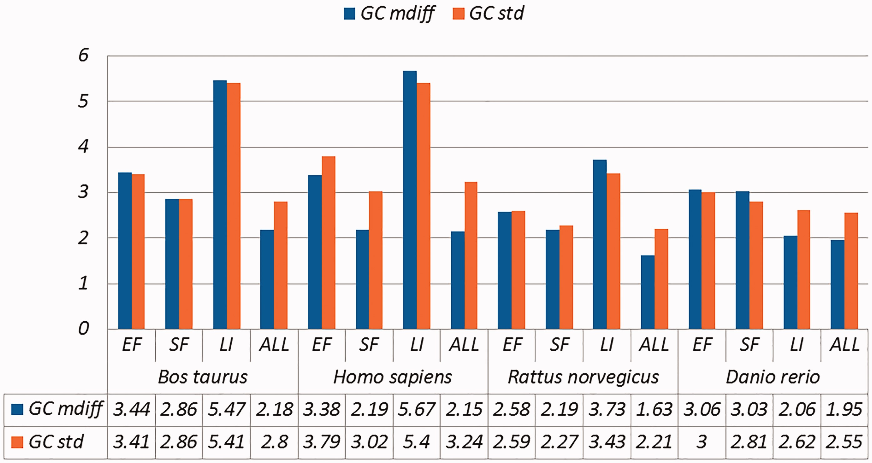
Figure 3. A selection of results for organisms in terms of GC content (Exemplar vs. Duplicate pairs) Categories are the ...
Notes:
Figure 3. A selection of results for organisms in terms of GC content (Exemplar vs. Duplicate pairs) Categories are the same as Table 1; mdiff and std: the mean and standard deviation of absolute value of the difference between each exemplar and the mean of the duplicates group, respectively.
Unless provided in the caption above, the following copyright applies to the content of this slide: © The Author(s) 2017. Published by Oxford University Press.This is an Open Access article distributed under the terms of the Creative Commons Attribution License (http://creativecommons.org/licenses/by/4.0/), which permits unrestricted reuse, distribution, and reproduction in any medium, provided the original work is properly cited.

Slide 4
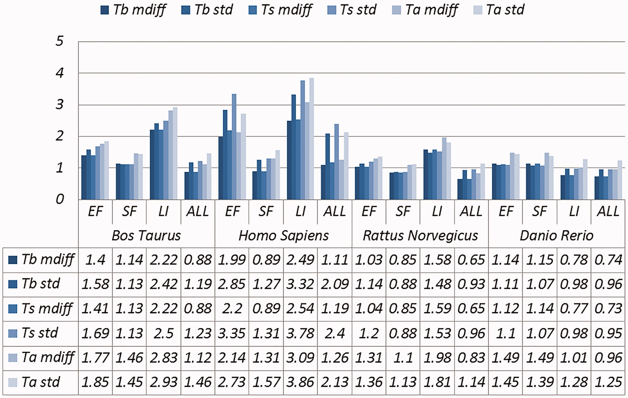
Figure 4. A selection of results for organisms in terms of melting temperatures (Exemplar vs. Duplicate pairs) mdiff ...
Notes:
Figure 4. A selection of results for organisms in terms of melting temperatures (Exemplar vs. Duplicate pairs) mdiff and std: the mean and standard deviation of absolute value of the difference between each exemplar and the mean of the original group, respectively; Tb, Ts, Ta: melting temperature calculated using basic, salted and advanced formula in supplement, respectively.
Unless provided in the caption above, the following copyright applies to the content of this slide: © The Author(s) 2017. Published by Oxford University Press.This is an Open Access article distributed under the terms of the Creative Commons Attribution License (http://creativecommons.org/licenses/by/4.0/), which permits unrestricted reuse, distribution, and reproduction in any medium, provided the original work is properly cited.

