Slide 1
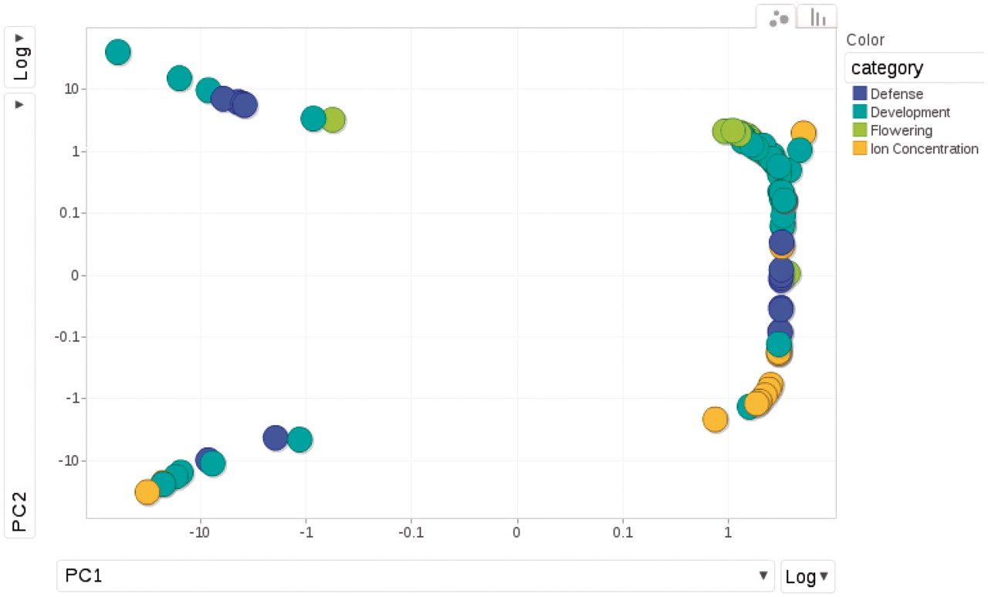
Figure 6. Relationships among phenotypes is plotted by the first and second princi pal components from PCA (Principal ...
Notes:
Figure 6. Relationships among phenotypes is plotted by the first and second princi pal components from PCA (Principal Component Analysis). Each dot represents one phenotype, colored according to the category to which it belongs.
Unless provided in the caption above, the following copyright applies to the content of this slide: © The Author(s) 2011. Published by Oxford University Press.This is Open Access article distributed under the terms of the Creative Commons Attribution Non-Commercial License (http://creativecommons.org/licenses/by-nc/2.5), which permits unrestricted non-commercial use, distribution, and reproduction in any medium, provided the original work is properly cited.

