Slide 1
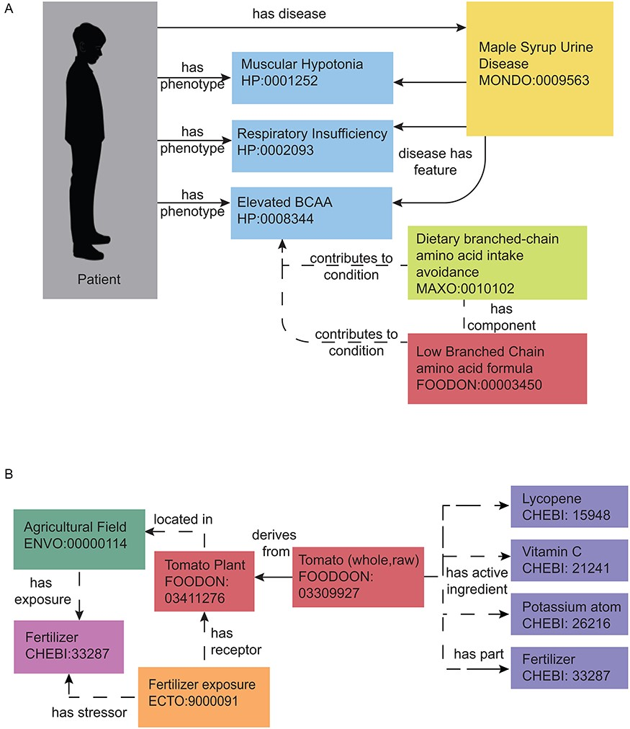
Figure 3. Representing nutrition using ontologies. Nutrition representation in current ontologies and databases is not ...
Notes:
Figure 3. Representing nutrition using ontologies. Nutrition representation in current ontologies and databases is not yet sufficient to meet the needs of the nutri-informatics research community, yet some meaningful relationships can still be identified within the current landscape. Currently defined relationships can be seen with solid arrows and proposed modeling relationships can be seen in dashed arrows. (A) MSUD. This rare metabolic disease can be annotated with related phenotypes, nutritional recommendations and medical foods using interoperable biomedical ontology terms. These present and proposed relationships can be used to facilitate disease and therapeutic intervention identification with a set of patient phenotypes. (B) Farm to Fork with a Tomato. The process of growing a tomato can also be annotated by its exposures and nutrient content. Present and proposed relationships can connect fertilizer application at the field, to the food produced, to its nutrient and potential chemical content.
Unless provided in the caption above, the following copyright applies to the content of this slide: © The Author(s) 2021. Published by Oxford University Press.This is an Open Access article distributed under the terms of the Creative Commons Attribution License (http://creativecommons.org/licenses/by/4.0/), which permits unrestricted reuse, distribution, and reproduction in any medium, provided the original work is properly cited.

