Slide 1
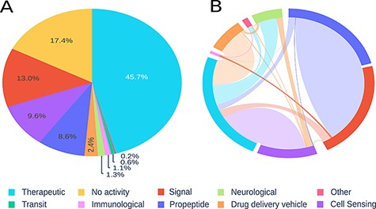
Figure 2. Visualization of registered peptides on Peptipedia. Representation of the information contained in ...
Notes:
Figure 2. Visualization of registered peptides on Peptipedia. Representation of the information contained in Peptipedia. A: distribution of peptides according to the categories proposed in this work. B: analysis of the relationship of simultaneous activities for the same type of peptide; the most significant trends are seen between therapeutics and cell sensing peptides, and between propeptides and signal.
Unless provided in the caption above, the following copyright applies to the content of this slide: © The Author(s) 2021. Published by Oxford University Press.This is an Open Access article distributed under the terms of the Creative Commons Attribution License (https://creativecommons.org/licenses/by/4.0/), which permits unrestricted reuse, distribution, and reproduction in any medium, provided the original work is properly cited.

