Slide 1
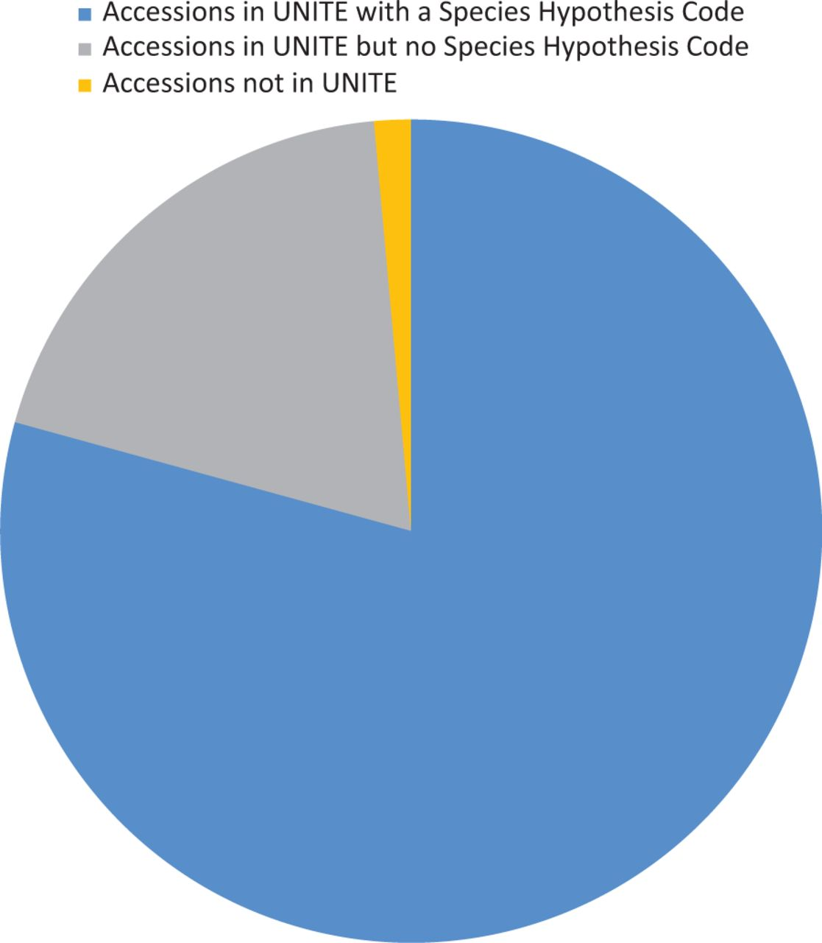
Figure 3. Diagram showing the proportion of accessions associated with UNITE (version 6) data.
Notes:
Figure 3. Diagram showing the proportion of accessions associated with UNITE (version 6) data.
Unless provided in the caption above, the following copyright applies to the content of this slide: Published by Oxford University Press 2013. This work is written by US Government employees and is in the public domain in the US.

