Slide 1
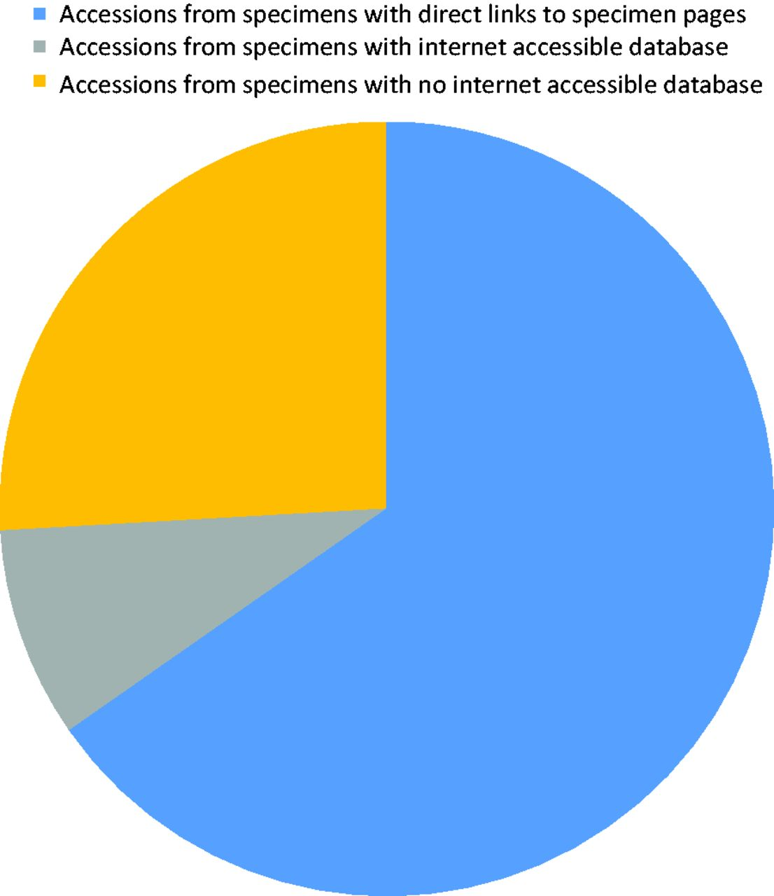
Figure 5. Diagram showing the proportion of accessions that originated from specimens associated with a collection that ...
Notes:
Figure 5. Diagram showing the proportion of accessions that originated from specimens associated with a collection that has an online database.
Unless provided in the caption above, the following copyright applies to the content of this slide: Published by Oxford University Press 2013. This work is written by US Government employees and is in the public domain in the US.

