Slide 1
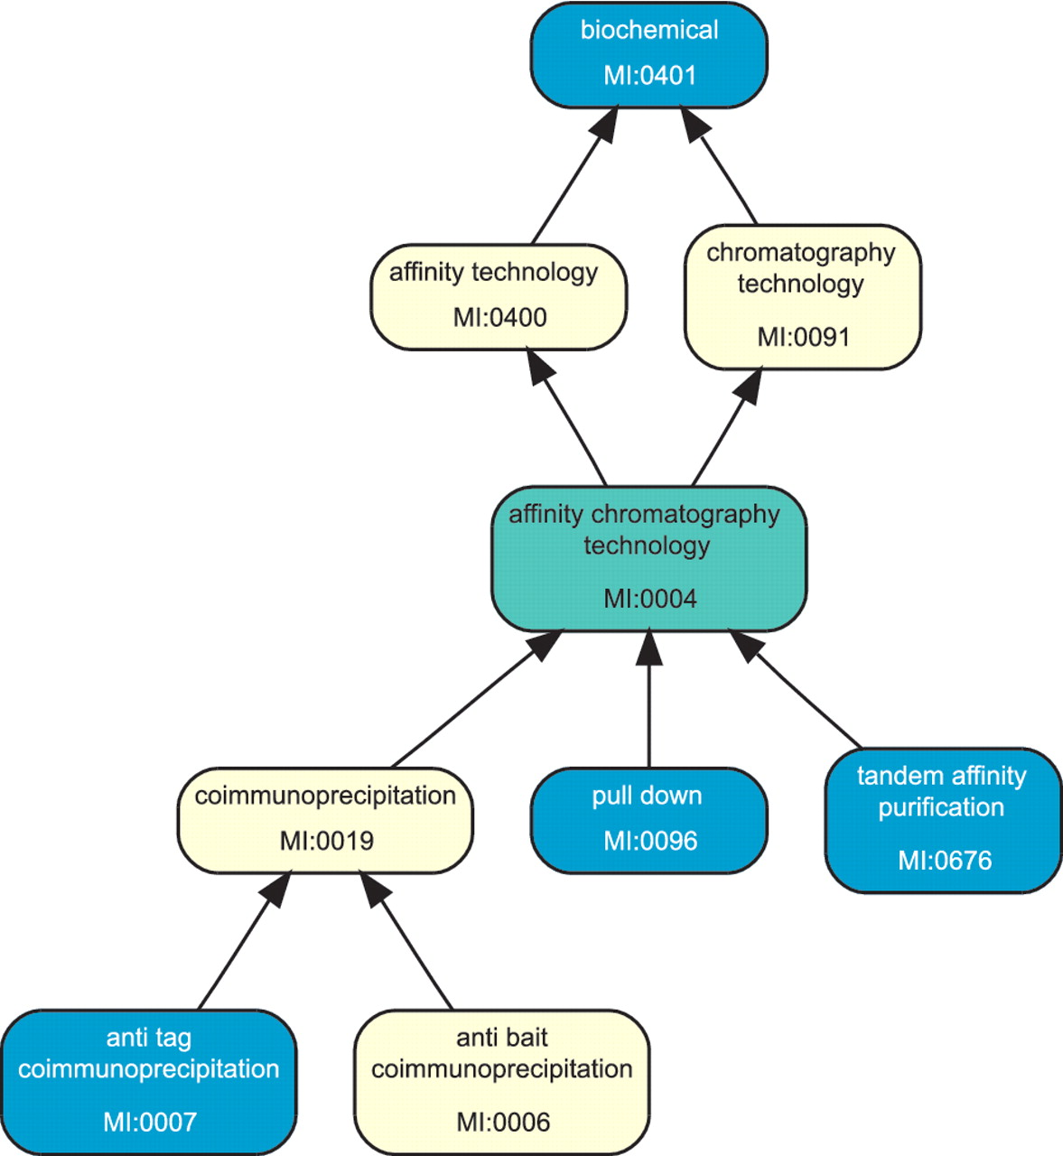
Figure 2. The picture shows a part of the PSI-MI ontology graph for interaction-detection method associated with a ...
Notes:
Figure 2. The picture shows a part of the PSI-MI ontology graph for interaction-detection method associated with a hypothetical cluster of source interactions involving the same interactants from the same publication. The terms colored blue are associated with the source interactions within the cluster, while those marked yellow and green are present in the ontology but do not label any source interaction from the cluster. The entire cluster as shown is consistent, with the term MI:0401 as the maximal element. Its finest consistent term is MI:0004 (colored green) since the cluster members smaller than it are not comparable between themselves. Removing the source interactions labeled by MI:0401 from the cluster would result in three distinct subclusters. If two subclusters contain no interaction from the same source database, they would be reported as conflicts.
Unless provided in the caption above, the following copyright applies to the content of this slide: Published by Oxford University Press 2011.This is Open Access article distributed under the terms of the Creative Commons Attribution Non-Commercial License (http://creativecommons.org/licenses/by-nc/2.5), which permits unrestricted non-commercial use, distribution, and reproduction in any medium, provided the original work is properly cited.

