Slide 1
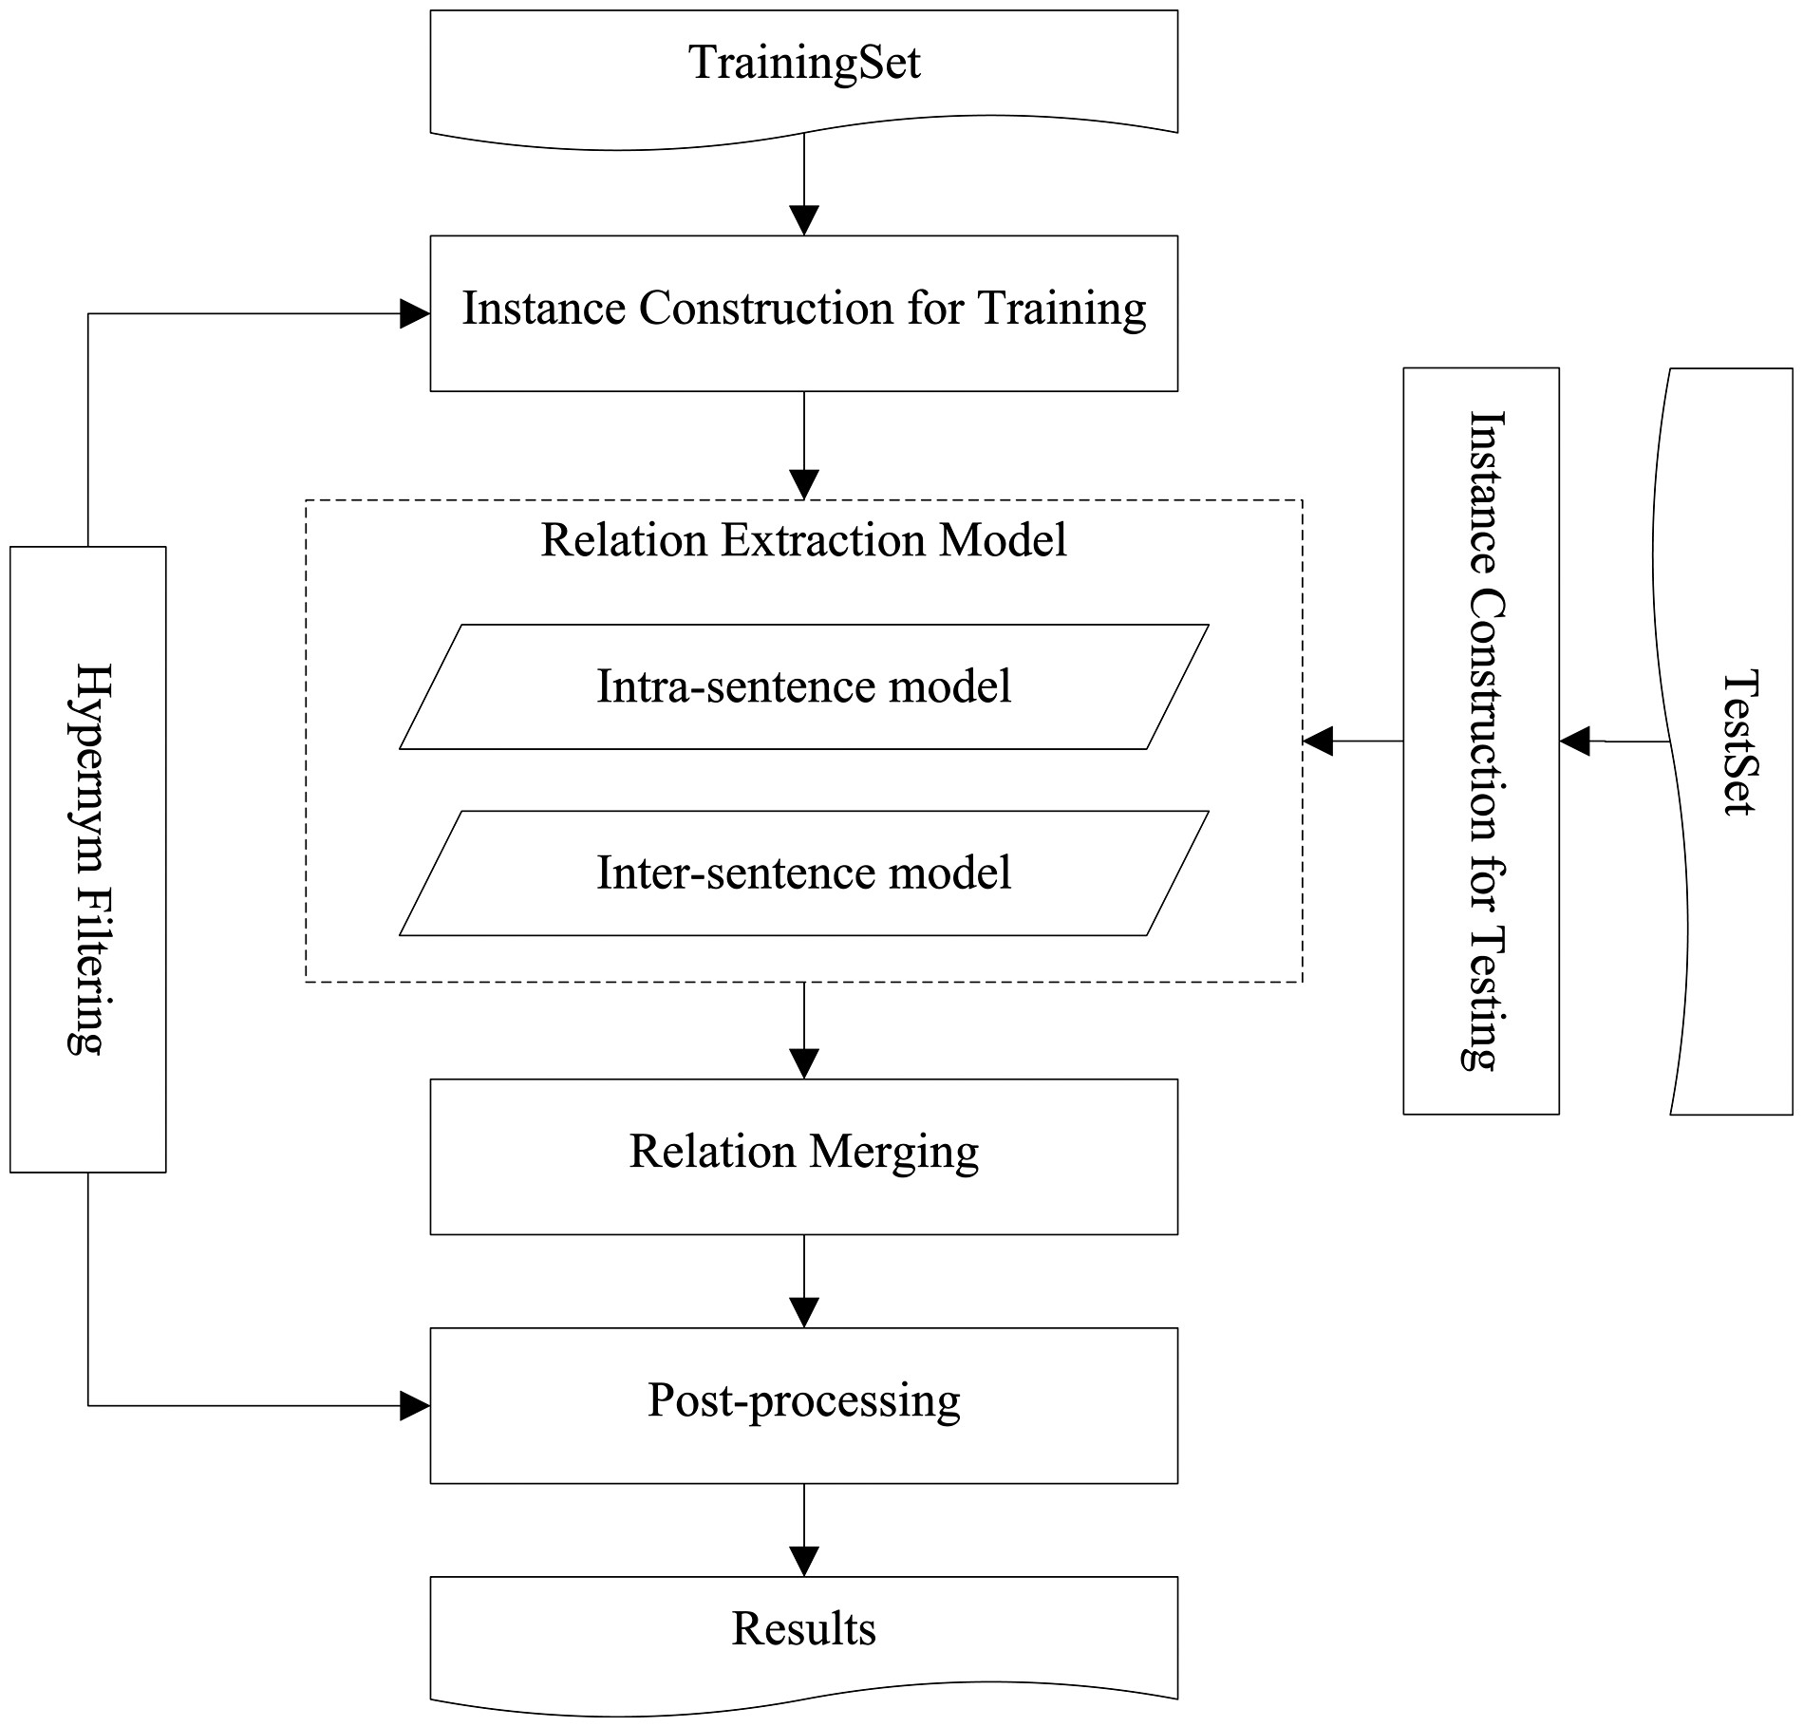
Figure 1. The system workflow diagram.
Notes:
Figure 1. The system workflow diagram.
Unless provided in the caption above, the following copyright applies to the content of this slide: © The Author(s) 2017. Published by Oxford University Press.This is an Open Access article distributed under the terms of the Creative Commons Attribution License (http://creativecommons.org/licenses/by/4.0/), which permits unrestricted reuse, distribution, and reproduction in any medium, provided the original work is properly cited.

Slide 2
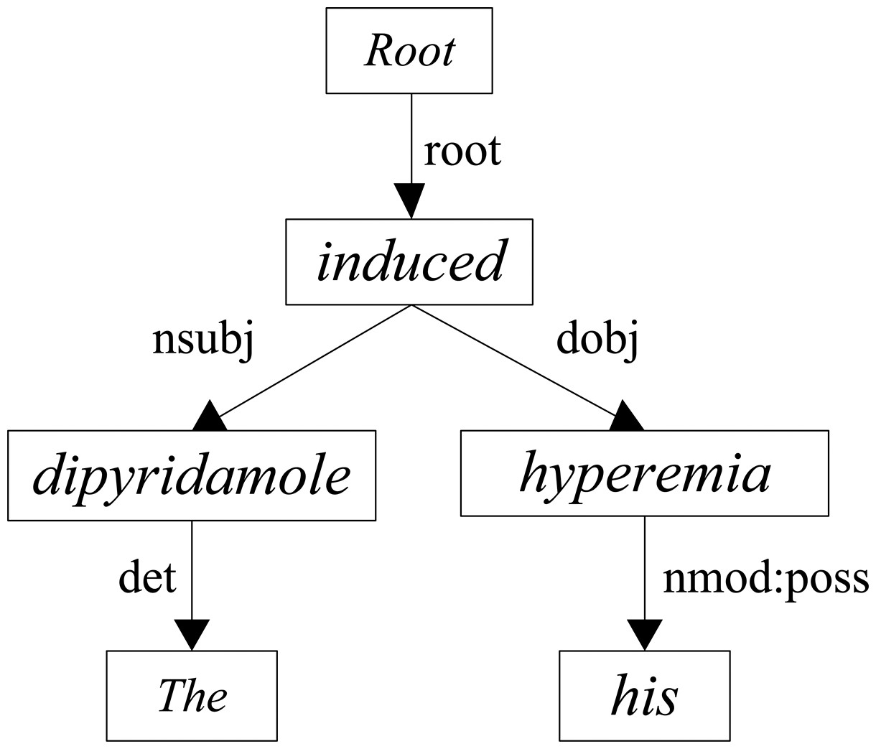
Figure 3. The dependency parsing tree of the example sentence.
Notes:
Figure 3. The dependency parsing tree of the example sentence.
Unless provided in the caption above, the following copyright applies to the content of this slide: © The Author(s) 2017. Published by Oxford University Press.This is an Open Access article distributed under the terms of the Creative Commons Attribution License (http://creativecommons.org/licenses/by/4.0/), which permits unrestricted reuse, distribution, and reproduction in any medium, provided the original work is properly cited.

Slide 3
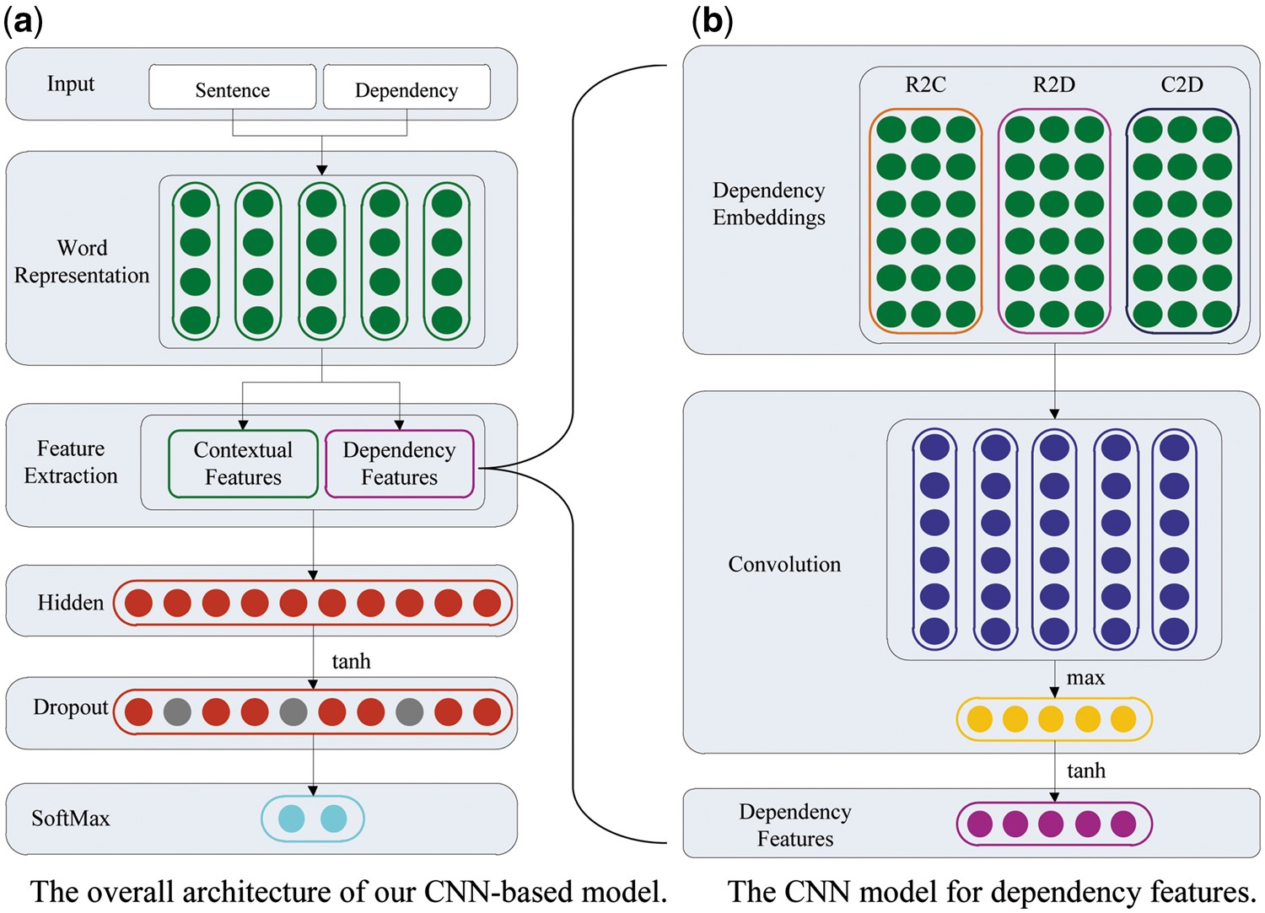
Figure 2. The architecture of our CNN-based model for the intra-sentence level relation extraction. (a) The overall ...
Notes:
Figure 2. The architecture of our CNN-based model for the intra-sentence level relation extraction. (a) The overall architecture of our CNN-based model; (b) the CNN model for dependency features.
Unless provided in the caption above, the following copyright applies to the content of this slide: © The Author(s) 2017. Published by Oxford University Press.This is an Open Access article distributed under the terms of the Creative Commons Attribution License (http://creativecommons.org/licenses/by/4.0/), which permits unrestricted reuse, distribution, and reproduction in any medium, provided the original work is properly cited.

Slide 4
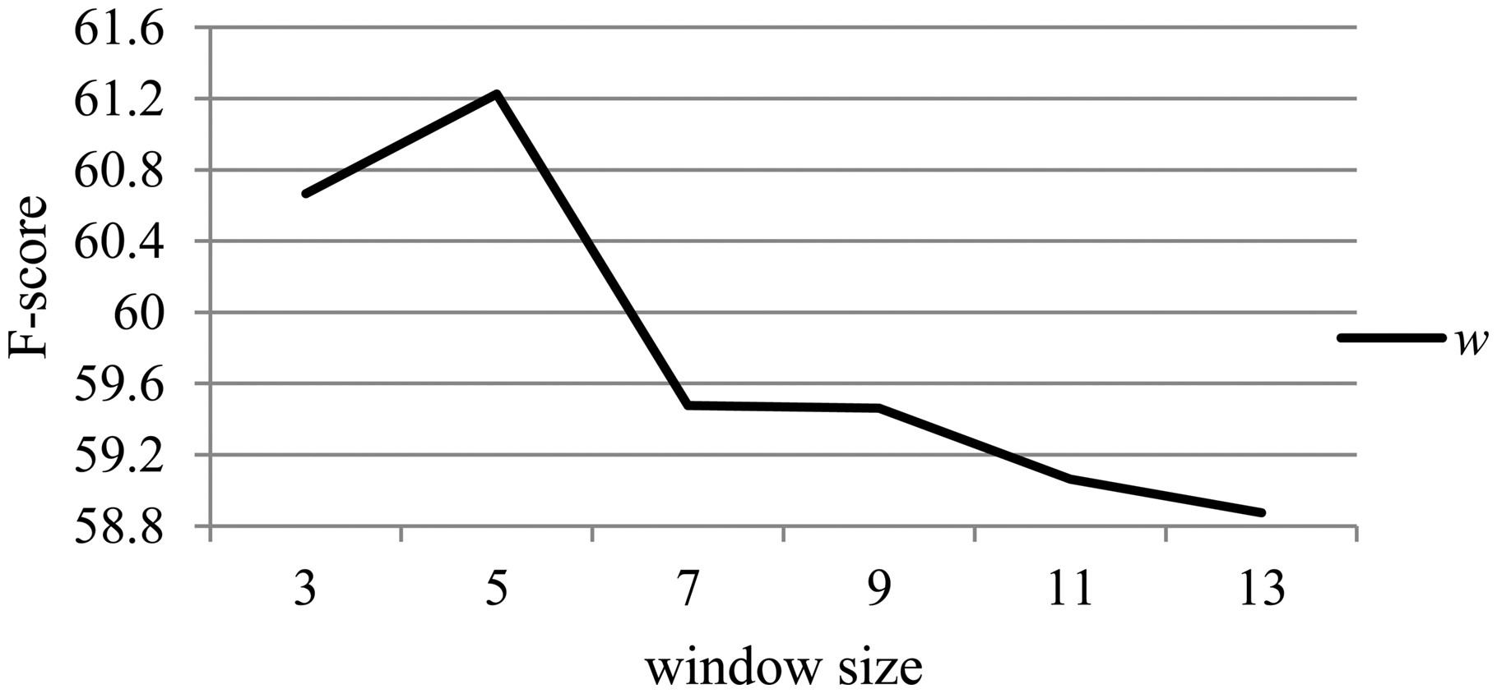
Figure 4. The effect of the hyper-parameter w on the development dataset.
Notes:
Figure 4. The effect of the hyper-parameter w on the development dataset.
Unless provided in the caption above, the following copyright applies to the content of this slide: © The Author(s) 2017. Published by Oxford University Press.This is an Open Access article distributed under the terms of the Creative Commons Attribution License (http://creativecommons.org/licenses/by/4.0/), which permits unrestricted reuse, distribution, and reproduction in any medium, provided the original work is properly cited.

Slide 5
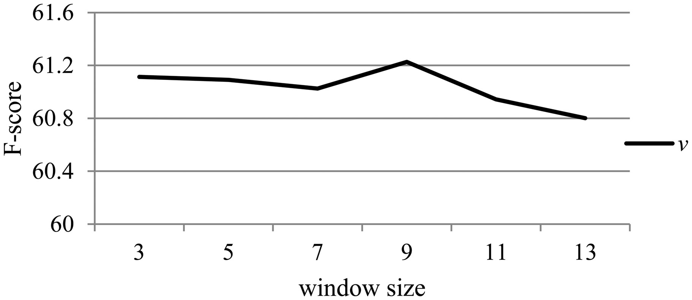
Figure 5. The effect of the hyper-parameter v on the development dataset.
Notes:
Figure 5. The effect of the hyper-parameter v on the development dataset.
Unless provided in the caption above, the following copyright applies to the content of this slide: © The Author(s) 2017. Published by Oxford University Press.This is an Open Access article distributed under the terms of the Creative Commons Attribution License (http://creativecommons.org/licenses/by/4.0/), which permits unrestricted reuse, distribution, and reproduction in any medium, provided the original work is properly cited.

