Slide 1
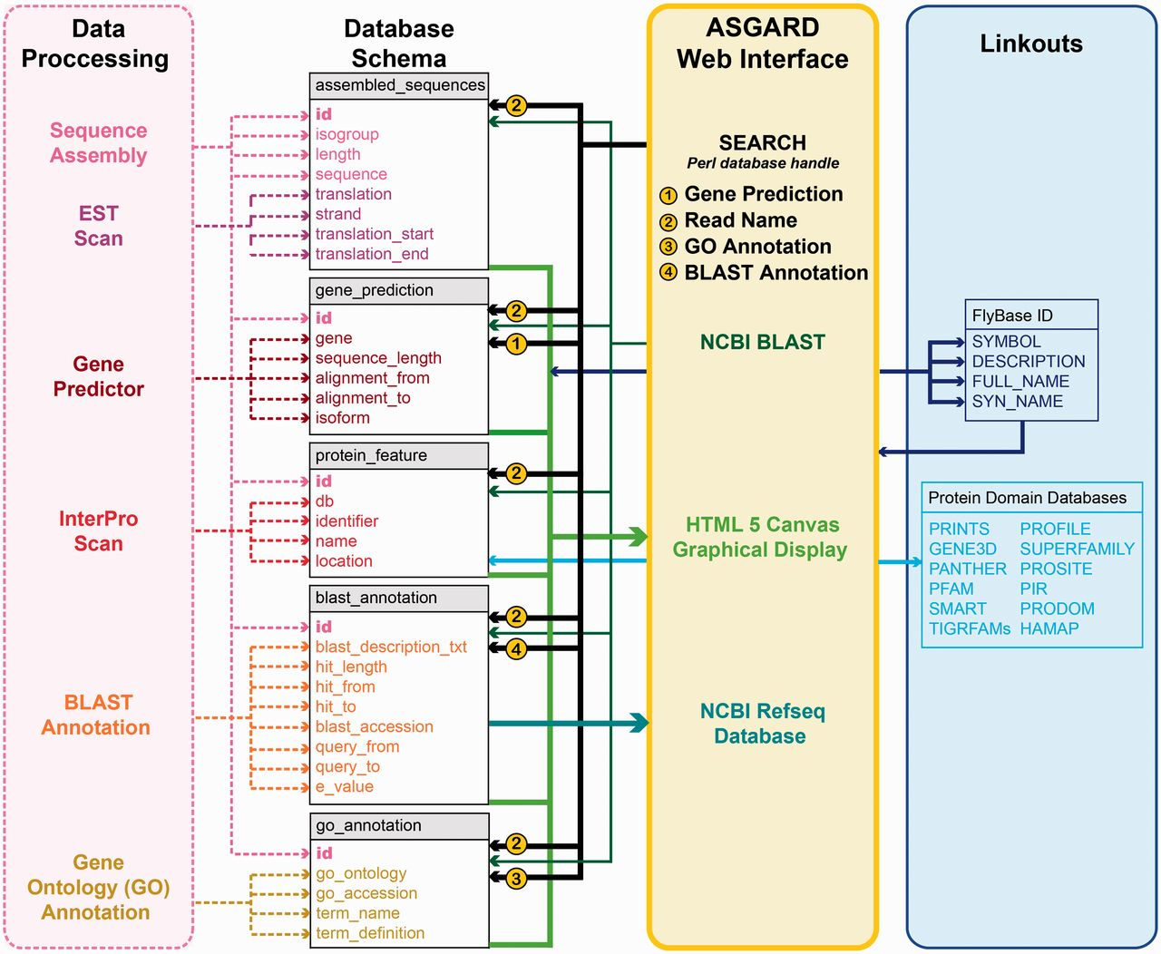
Figure 2 ASGARD database schema. Schematic of database implementation showing destination tables (gray/white) for each ...
Notes:
Figure 2 ASGARD database schema. Schematic of database implementation showing destination tables (gray/white) for each data type created by the data processing pipeline (pink), how users may access those data via the ASGARD web interface (yellow) and sources of linkout data provided by the ASGARD search results displays (blue). See main text for details.
Unless provided in the caption above, the following copyright applies to the content of this slide: © The Author(s) 2012. Published by Oxford University Press.This is an Open Access article distributed under the terms of the Creative Commons Attribution License (http://creativecommons.org/licenses/by-nc/3.0/), which permits non-commercial reuse, distribution, and reproduction in any medium, provided the original work is properly cited. For commercial re-use, please contact journals.permissions@oup.com.

