Slide 1
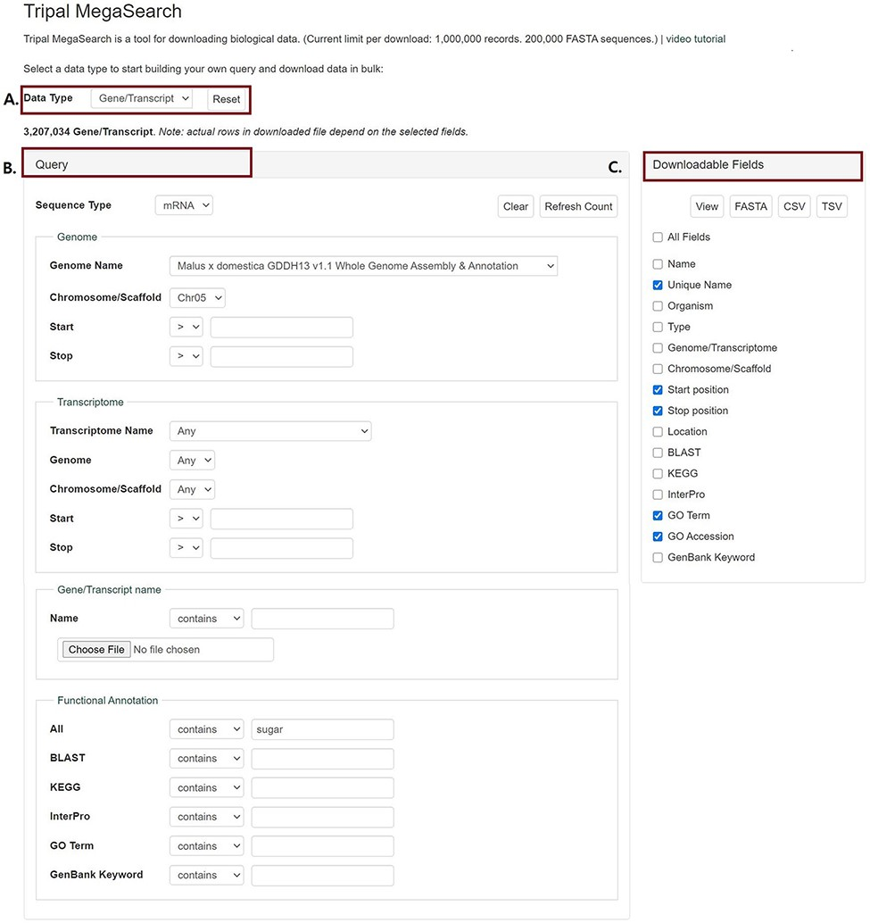
Figure 1. An example interface of complex static forms of Tripal MegaSearch (A). Data Type section where users can ...
Notes:
Figure 1. An example interface of complex static forms of Tripal MegaSearch (A). Data Type section where users can choose data type (B). Query section that provides a query form that allows users to perform complex queries using various metadata as filters (C). Downloadable Fields section where users can choose data fields to view and download.
Unless provided in the caption above, the following copyright applies to the content of this slide: © The Author(s) 2021. Published by Oxford University Press.This is an Open Access article distributed under the terms of the Creative Commons Attribution License (http://creativecommons.org/licenses/by/4.0/), which permits unrestricted reuse, distribution, and reproduction in any medium, provided the original work is properly cited.

