Slide 1
Figure 1. Fungi of Pakistan logo design represents the online database.
Notes:
Figure 1. Fungi of Pakistan logo design represents the online database.
Unless provided in the caption above, the following copyright applies to the content of this slide: © The Author(s) 2021. Published by Oxford University Press.This is an Open Access article distributed under the terms of the Creative Commons Attribution License (https://creativecommons.org/licenses/by/4.0/), which permits unrestricted reuse, distribution, and reproduction in any medium, provided the original work is properly cited.

Slide 2
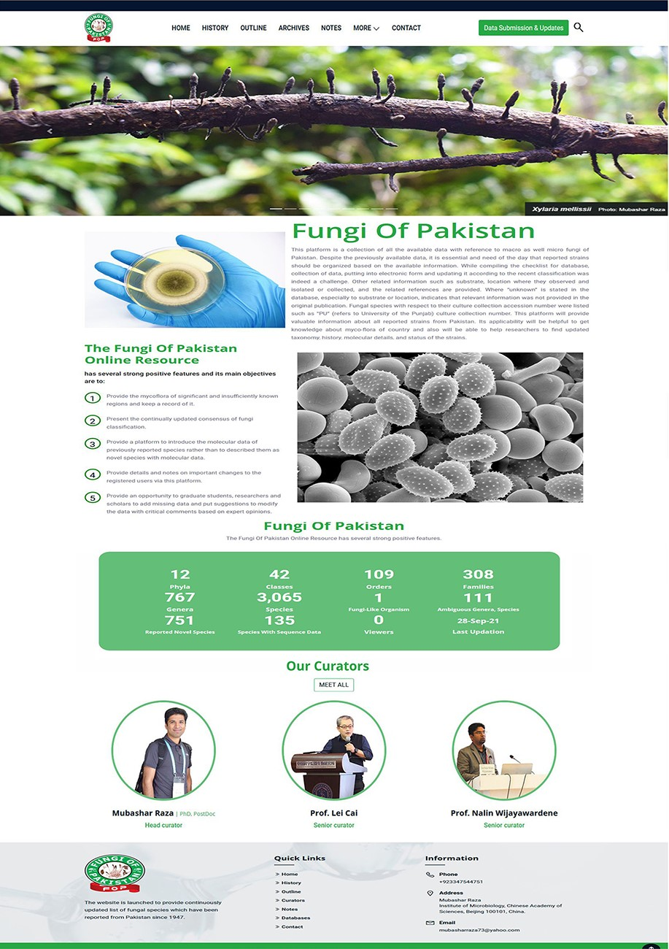
Figure 2. The homepage view of fungiofpakistan.com.
Notes:
Figure 2. The homepage view of fungiofpakistan.com.
Unless provided in the caption above, the following copyright applies to the content of this slide: © The Author(s) 2021. Published by Oxford University Press.This is an Open Access article distributed under the terms of the Creative Commons Attribution License (https://creativecommons.org/licenses/by/4.0/), which permits unrestricted reuse, distribution, and reproduction in any medium, provided the original work is properly cited.

Slide 3
Figure 3. Experts team in database management.
Notes:
Figure 3. Experts team in database management.
Unless provided in the caption above, the following copyright applies to the content of this slide: © The Author(s) 2021. Published by Oxford University Press.This is an Open Access article distributed under the terms of the Creative Commons Attribution License (https://creativecommons.org/licenses/by/4.0/), which permits unrestricted reuse, distribution, and reproduction in any medium, provided the original work is properly cited.

Slide 4
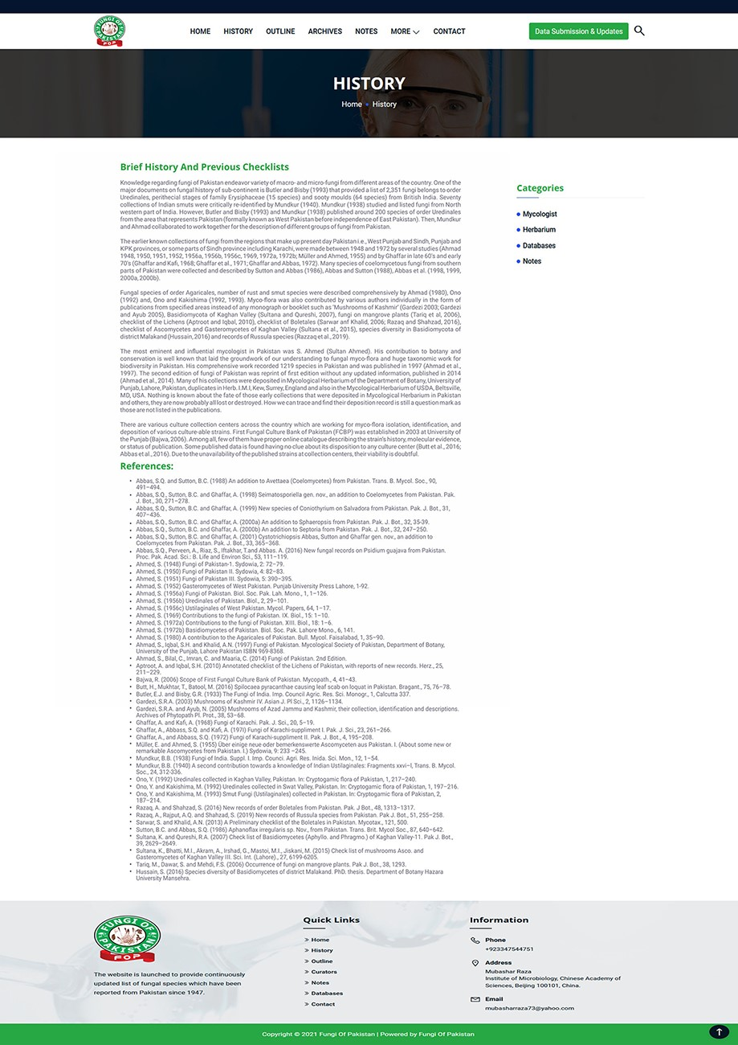
Figure 4. Brief history of fungi collected in Pakistan.
Notes:
Figure 4. Brief history of fungi collected in Pakistan.
Unless provided in the caption above, the following copyright applies to the content of this slide: © The Author(s) 2021. Published by Oxford University Press.This is an Open Access article distributed under the terms of the Creative Commons Attribution License (https://creativecommons.org/licenses/by/4.0/), which permits unrestricted reuse, distribution, and reproduction in any medium, provided the original work is properly cited.

Slide 5
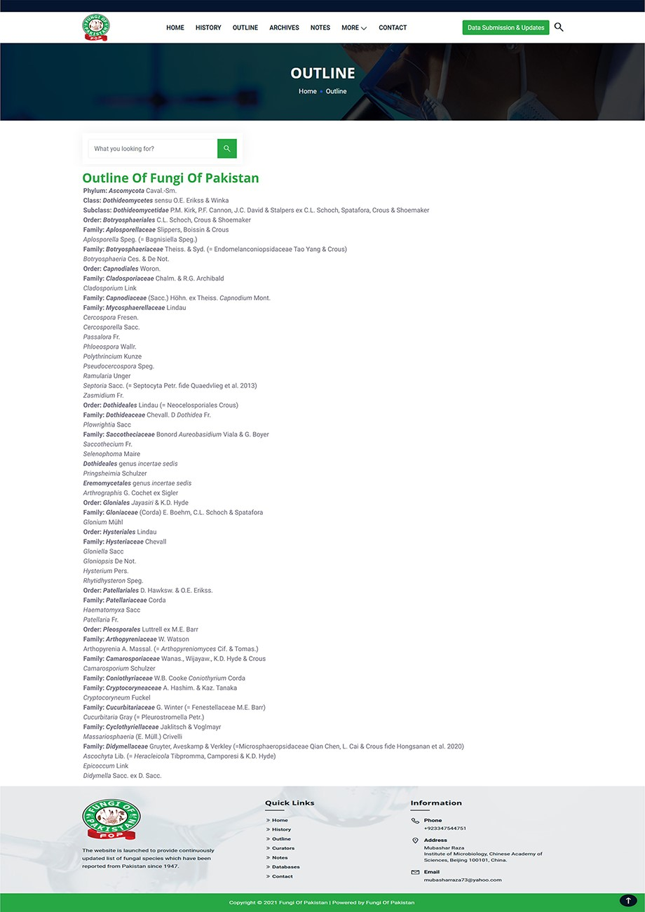
Figure 5. Fungi of Pakistan outline.
Notes:
Figure 5. Fungi of Pakistan outline.
Unless provided in the caption above, the following copyright applies to the content of this slide: © The Author(s) 2021. Published by Oxford University Press.This is an Open Access article distributed under the terms of the Creative Commons Attribution License (https://creativecommons.org/licenses/by/4.0/), which permits unrestricted reuse, distribution, and reproduction in any medium, provided the original work is properly cited.

Slide 6
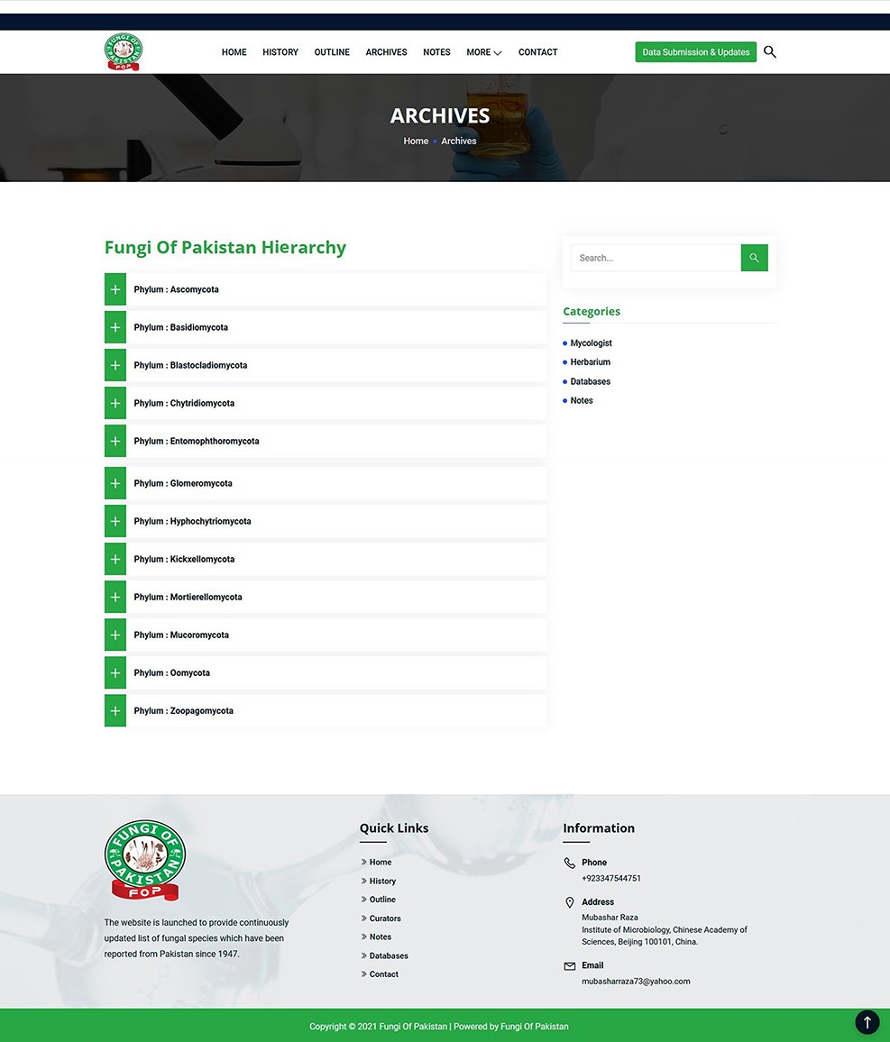
Figure 6. Use of Archives tool.
Notes:
Figure 6. Use of Archives tool.
Unless provided in the caption above, the following copyright applies to the content of this slide: © The Author(s) 2021. Published by Oxford University Press.This is an Open Access article distributed under the terms of the Creative Commons Attribution License (https://creativecommons.org/licenses/by/4.0/), which permits unrestricted reuse, distribution, and reproduction in any medium, provided the original work is properly cited.

Slide 7
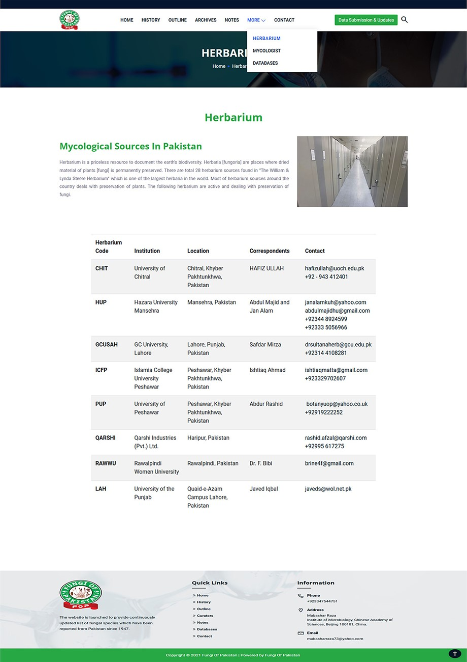
Figure 7. Information on herbarium centers within Pakistan.
Notes:
Figure 7. Information on herbarium centers within Pakistan.
Unless provided in the caption above, the following copyright applies to the content of this slide: © The Author(s) 2021. Published by Oxford University Press.This is an Open Access article distributed under the terms of the Creative Commons Attribution License (https://creativecommons.org/licenses/by/4.0/), which permits unrestricted reuse, distribution, and reproduction in any medium, provided the original work is properly cited.

Slide 8
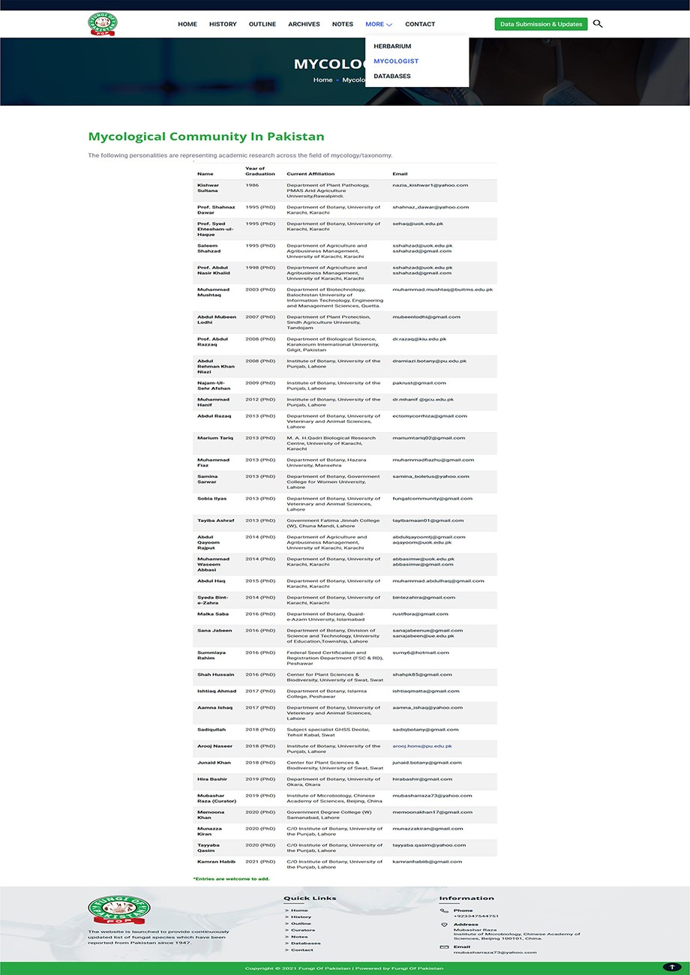
Figure 8. Information of mycological community for international collaboration.
Notes:
Figure 8. Information of mycological community for international collaboration.
Unless provided in the caption above, the following copyright applies to the content of this slide: © The Author(s) 2021. Published by Oxford University Press.This is an Open Access article distributed under the terms of the Creative Commons Attribution License (https://creativecommons.org/licenses/by/4.0/), which permits unrestricted reuse, distribution, and reproduction in any medium, provided the original work is properly cited.

Slide 9
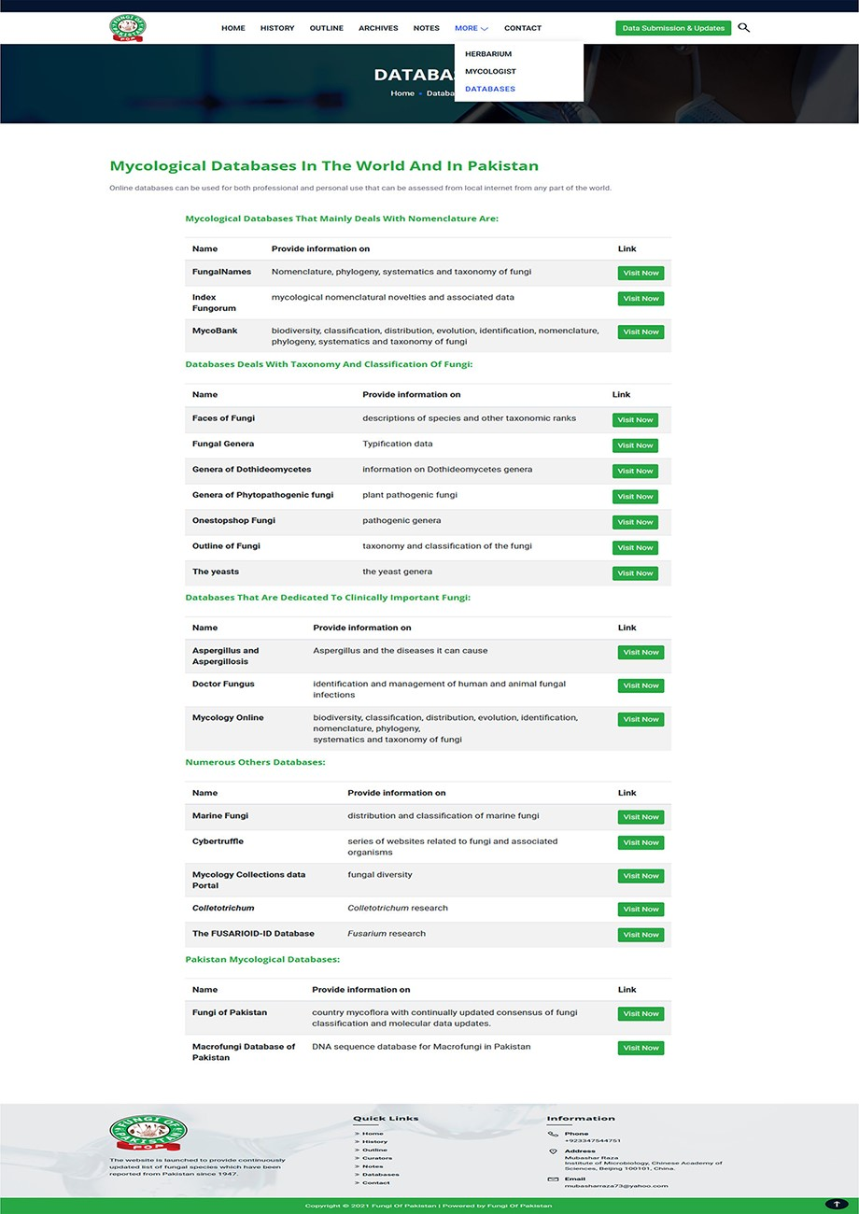
Figure 9. Some fungi related databases.
Notes:
Figure 9. Some fungi related databases.
Unless provided in the caption above, the following copyright applies to the content of this slide: © The Author(s) 2021. Published by Oxford University Press.This is an Open Access article distributed under the terms of the Creative Commons Attribution License (https://creativecommons.org/licenses/by/4.0/), which permits unrestricted reuse, distribution, and reproduction in any medium, provided the original work is properly cited.

Slide 10
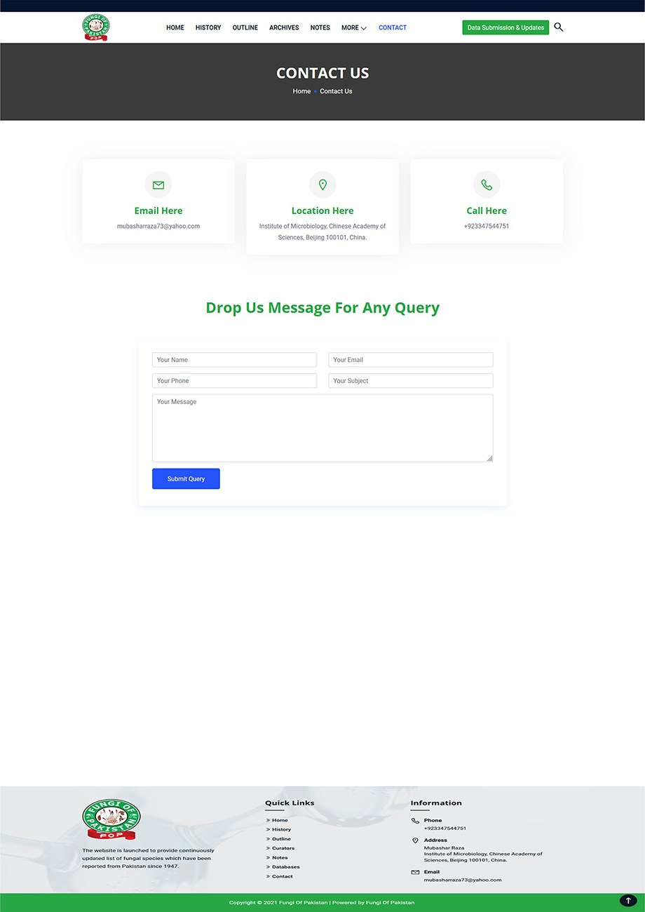
Figure 10. Tool for user comments and suggestions.
Notes:
Figure 10. Tool for user comments and suggestions.
Unless provided in the caption above, the following copyright applies to the content of this slide: © The Author(s) 2021. Published by Oxford University Press.This is an Open Access article distributed under the terms of the Creative Commons Attribution License (https://creativecommons.org/licenses/by/4.0/), which permits unrestricted reuse, distribution, and reproduction in any medium, provided the original work is properly cited.

