Slide 1
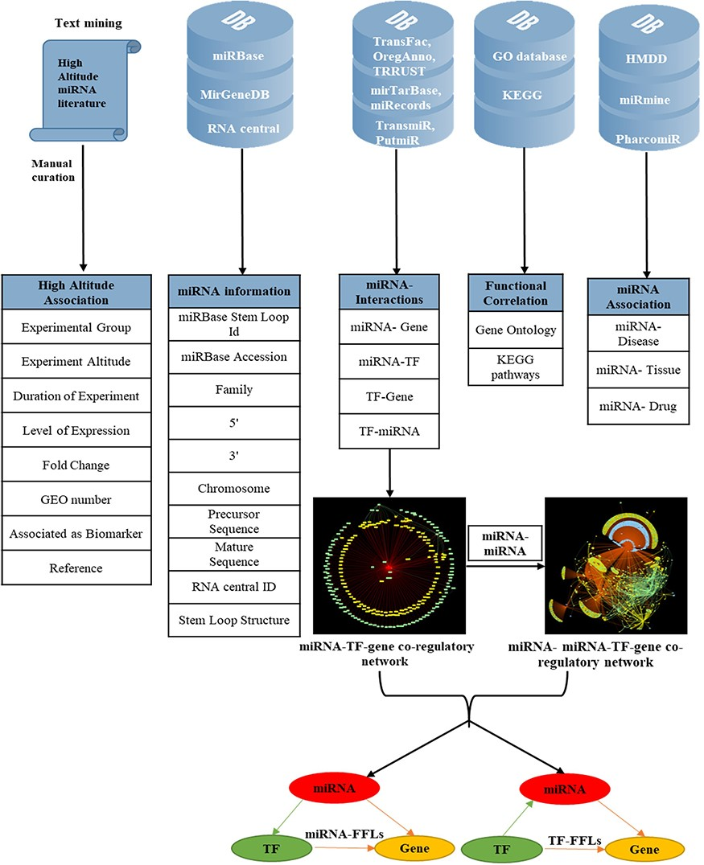
Figure 1. Overview of data collection and annotation in HAHmiR.DB. A comprehensive list of differentially expressed ...
Notes:
Figure 1. Overview of data collection and annotation in HAHmiR.DB. A comprehensive list of differentially expressed HA-associated human miRNAs was mined from the published literature with its HA-associated information, i.e experimental group, experiment altitude, duration of experiment, level of expression, fold change, GEO accession and association as biomarker. These miRNAs were further enriched with a variety of other information from generic biological databases that includes miRNA sequence–related information, miRNA stem-loop structure, miRNA–network interactions (miRNA–gene, miRNA–TF, TF–miRNA, TF–gene), functional enrichments (Gene Ontology, pathways), miRNA–disease association, miRNA–drug association and miRNA–tissue expression.
Unless provided in the caption above, the following copyright applies to the content of this slide: © The Author(s) 2020. Published by Oxford University Press.This is an Open Access article distributed under the terms of the Creative Commons Attribution License (http://creativecommons.org/licenses/by/4.0/), which permits unrestricted reuse, distribution, and reproduction in any medium, provided the original work is properly cited.

