Slide 1
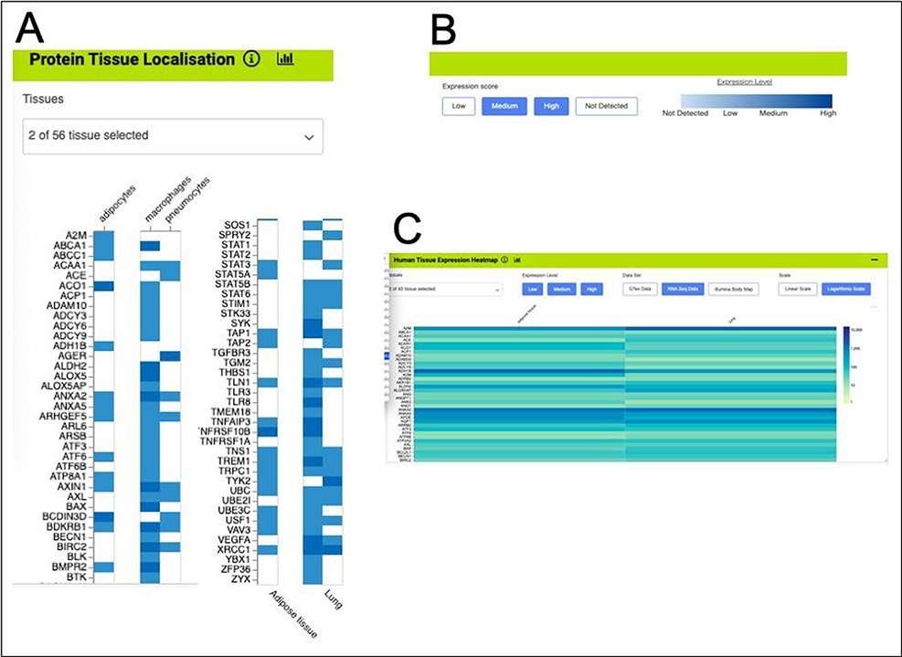
Figure 11. Gene expression heat maps for a selection of the genes from the shared set. (A). Protein tissue localization ...
Notes:
Figure 11. Gene expression heat maps for a selection of the genes from the shared set. (A). Protein tissue localization (original data from The Protein Atlas project, https://www.proteinatlas.org/humanproteome/tissue). The viewer has been filtered to show data for adipose tissue (adipocytes) and lung (macrophages and pneumocytes) only. (B). It is possible to toggle the expression score ‘bins’ on or off and a colour scale representing expression level is shown. (C). Heat map filtered to show RNA-seq data for adipose and lung (original data from The Protein Atlas project, https://www.proteinatlas.org/humanproteome/tissue). The viewer allows toggling between other expression data sets, showing different binned levels of expression and provides a scale for expression level.
Unless provided in the caption above, the following copyright applies to the content of this slide: © The Author(s) 2022. Published by Oxford University Press.This is an Open Access article distributed under the terms of the Creative Commons Attribution-NonCommercial License (https://creativecommons.org/licenses/by-nc/4.0/), which permits non-commercial re-use, distribution, and reproduction in any medium, provided the original work is properly cited. For commercial re-use, please contact journals.permissions@oup.com

