Slide 1
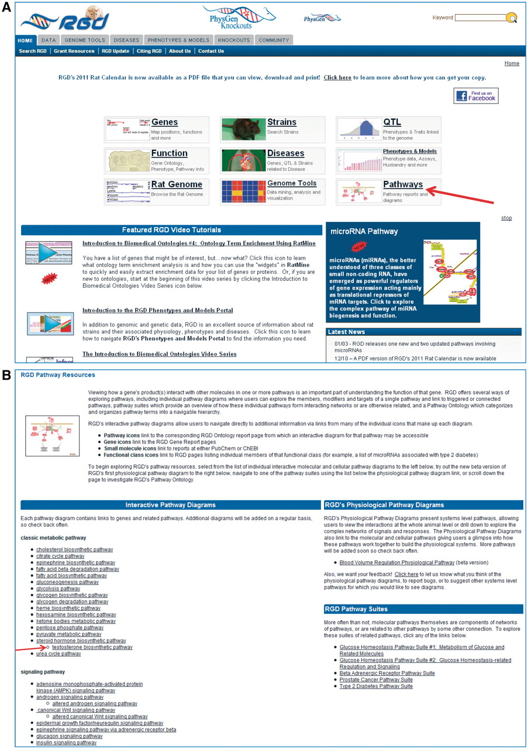
Figure 1. Shows a partial view of RGD's home page with the main entry points, video tutorials, rotating banner and the ...
Notes:
Figure 1. Shows a partial view of RGD's home page with the main entry points, video tutorials, rotating banner and the Latest News sections, with an arrow pointing to the Pathways entry (A) and the top portion of RGD's Pathway Resource page the Pathway entry brings, housing the interactive pathway diagram pages and pathway suites and physiological pathway diagrams with an arrow pointing to the ‘testosterone biosynthetic pathway’ (B).
Unless provided in the caption above, the following copyright applies to the content of this slide: © The Author(s) 2011. Published by Oxford University Press.This is Open Access article distributed under the terms of the Creative Commons Attribution Non-Commercial License (http://creativecommons.org/licenses/by-nc/2.5), which permits unrestricted non-commercial use, distribution, and reproduction in any medium, provided the original work is properly cited.

