Slide 1
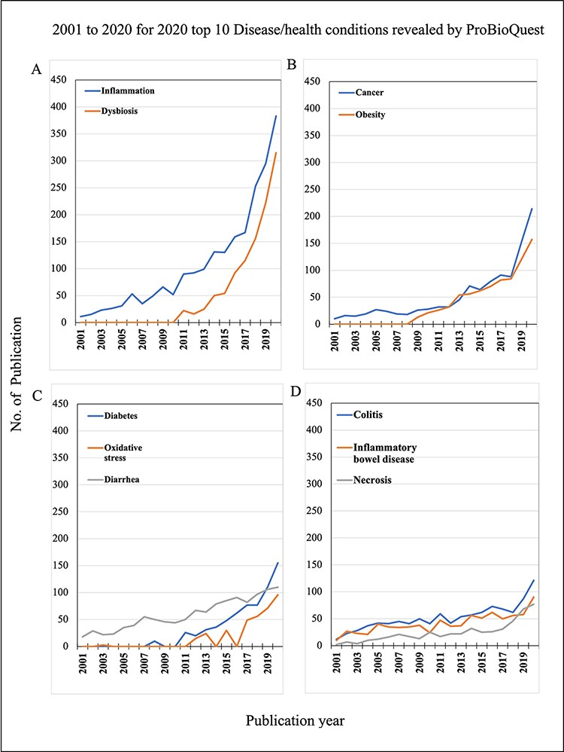
Figure 5. 2001 to 2020 for 2020 top 10 Disease/Health conditions revealed by ProBioQuest. The top 10 most popular ...
Notes:
Figure 5. 2001 to 2020 for 2020 top 10 Disease/Health conditions revealed by ProBioQuest. The top 10 most popular Disease/Health keywords in 2020 were selected for further analysis of their trends during the two decades from 2001 to 2020. (A) Inflammation and dysbiosis have clear trends of marked growth in numbers. (C–D) Specific diseases of awareness on metabolic disorders like obesity, diabetes and oxidative stress and diseases of abnormal cell growth like cancer and necrosis also increased in the past 10 years, although to a lesser extent.
Unless provided in the caption above, the following copyright applies to the content of this slide: © The Author(s) 2022. Published by Oxford University Press.This is an Open Access article distributed under the terms of the Creative Commons Attribution-NonCommercial License (https://creativecommons.org/licenses/by-nc/4.0/), which permits non-commercial re-use, distribution, and reproduction in any medium, provided the original work is properly cited. For commercial re-use, please contact journals.permissions@oup.com

