Slide 1
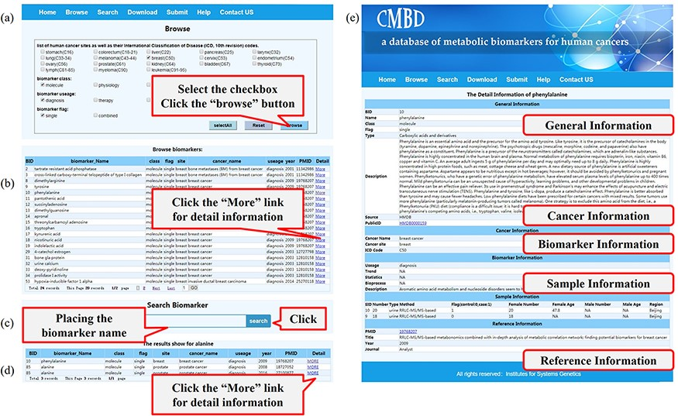
Figure 3. A screenshot of the utility of CMBD. (a) The browse page, biomarkers are classified by their site, class, ...
Notes:
Figure 3. A screenshot of the utility of CMBD. (a) The browse page, biomarkers are classified by their site, class, usage and flag reported in the literature; (b) the list of items matching the filter criteria; (c) search page; (d) the list of items matching fuzzy retrieval; (e) detail information about biomarkers.
Unless provided in the caption above, the following copyright applies to the content of this slide: © The Author(s) 2021. Published by Oxford University Press.This is an Open Access article distributed under the terms of the Creative Commons Attribution License (http://creativecommons.org/licenses/by/4.0/), which permits unrestricted reuse, distribution, and reproduction in any medium, provided the original work is properly cited.

