Slide 1
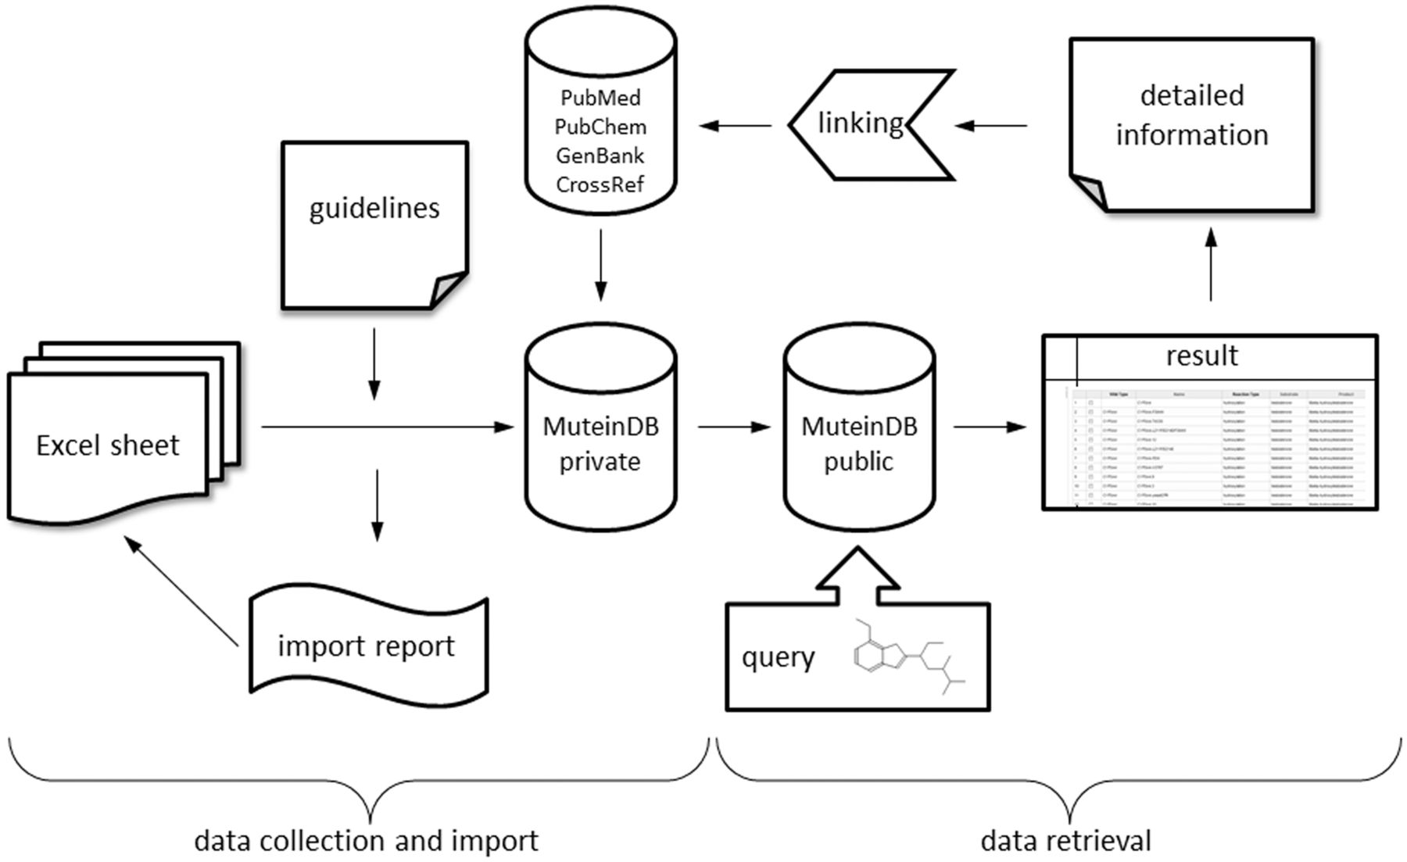
Figure 1 Schematic diagram of database structure. MuteinDB structure can be divided into two major parts. Firstly, the ...
Notes:
Figure 1 Schematic diagram of database structure. MuteinDB structure can be divided into two major parts. Firstly, the data collection and import structure within MuteinDB, illustrated on the left. Detailed guidelines structure and specify the correct and unified data collection as well as the data import. The standardized excel data import template guarantees data quality and consistency. During the automated data import from the data import excel sheet, metadata from third party databases such as PubMed, PubChem, GenBank and CrossRef are retrieved and added. The data import procedure ends either with a summary including imported muteins, molecules, reactions, activities or with a detailed error report. Secondly, stored public mutein data can be easily retrieved via various search mechanisms. For example, chemical structures can be used for identifying molecules of interest and their catalyzed reactions. Results are presented in tabular listings with links to third party databases or to detailed information contained in MuteinDB.
Unless provided in the caption above, the following copyright applies to the content of this slide: © The Author(s) 2012. Published by Oxford University Press.This is an Open Access article distributed under the terms of the Creative Commons Attribution Non-Commercial License (http://creativecommons.org/licenses/by-nc/3.0), which permits unrestricted non-commercial use, distribution, and reproduction in any medium, provided the original work is properly cited.

Slide 2
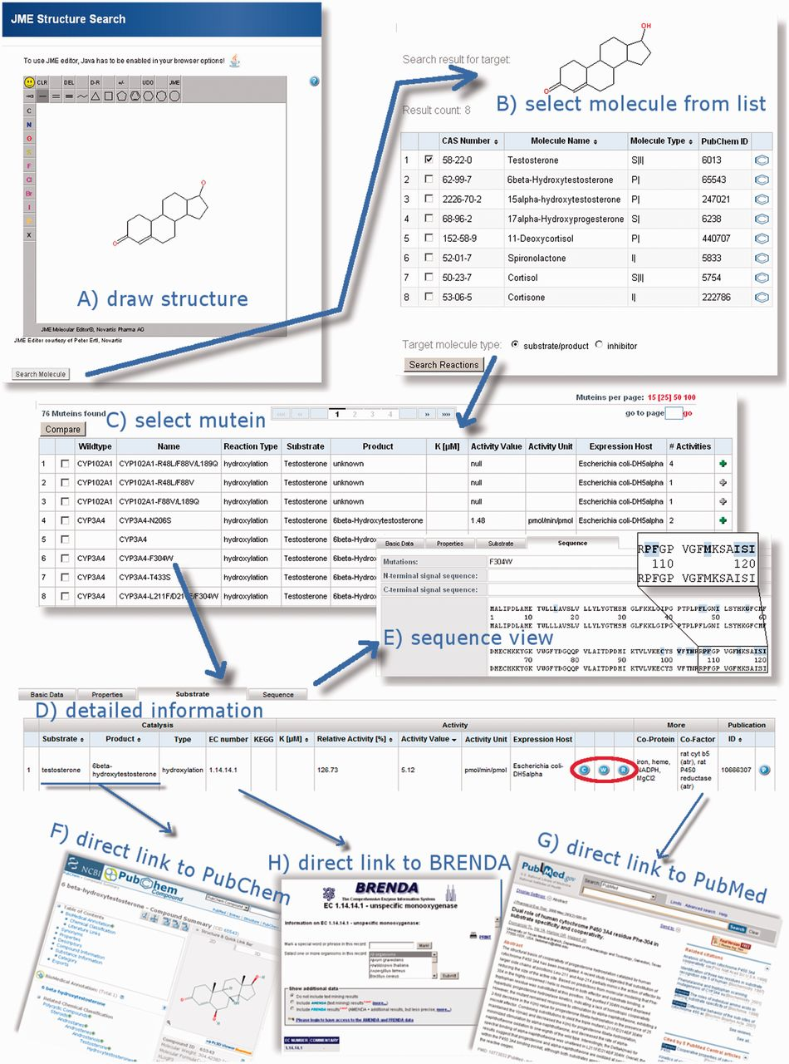
Figure 2 MuteinDB structure search, its results and the capabilities of the MuteinDB webinterface. (A) The MuteinDB ...
Notes:
Figure 2 MuteinDB structure search, its results and the capabilities of the MuteinDB webinterface. (A) The MuteinDB (sub) structure search uses the JME editor, which allows users to draw arbitrary molecular structures. (B) The user-drawn structure is used as seed for the following database search and shown on top of the structure search result table. In this table all molecules, substrates, products or inhibitors which contain the query structure are presented. A selection of these molecules can be used for a subsequent ‘Search by Reaction’. (C) All wild type enzymes and muteins which catalyze the selected molecules are shown. (D) For each row of the tabular result, further information can be obtained via the mutein or wild type name. The detailed information is organized in four main categories: (i) basic data; (ii) properties; (iii) substrate and (iv) sequence. (E) The ‘Sequence’ tab of the selected mutein allows to explore the sequence of the mutein as well as the wild type sequence. Known mutations are highlighted and linked to the corresponding entries of MuteinDB. (F) Information in the ‘Substrate’ tab is linked to third party databases. For example, (F) molecules are linked to PubChem, (H) EC-Numbers to Brenda and (G) literature to PubMed or to its DOI location. For muteins, experimental settings and wild type activity values are available from the ‘Substrate’ tab.
Unless provided in the caption above, the following copyright applies to the content of this slide: © The Author(s) 2012. Published by Oxford University Press.This is an Open Access article distributed under the terms of the Creative Commons Attribution Non-Commercial License (http://creativecommons.org/licenses/by-nc/3.0), which permits unrestricted non-commercial use, distribution, and reproduction in any medium, provided the original work is properly cited.

Slide 3
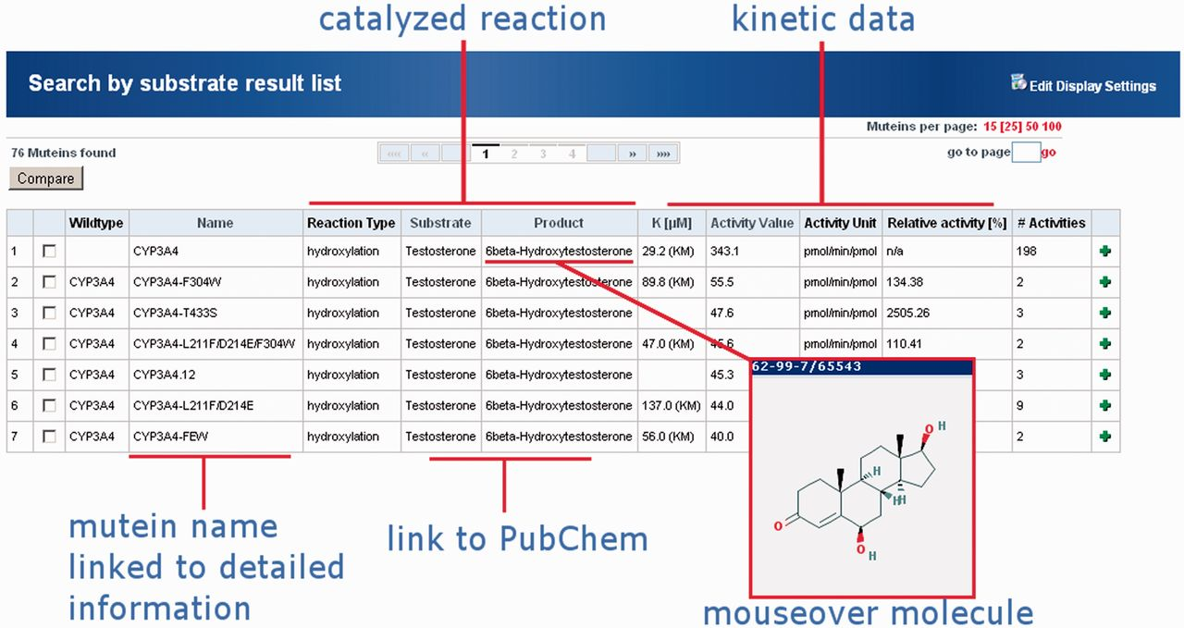
Figure 3 Result display of the MuteinDB web-interface for testosterone as a substrate. Information within the result ...
Notes:
Figure 3 Result display of the MuteinDB web-interface for testosterone as a substrate. Information within the result listing for each mutein is by default grouped into catalyzed reaction and kinetic data. Reaction information comprises the reaction type as well as the catalyzed substrate and product. Molecules are directly linked to their corresponding PubChem entry. Additionally, the molecule structure can be displayed by moving over the compound’s name. Important kinetic parameters such as K value, activity value including its unit as well as the relative activity in (%) are directly available in the result view. All presented information and further links for each mutein or wild type is directly linked by its name.
Unless provided in the caption above, the following copyright applies to the content of this slide: © The Author(s) 2012. Published by Oxford University Press.This is an Open Access article distributed under the terms of the Creative Commons Attribution Non-Commercial License (http://creativecommons.org/licenses/by-nc/3.0), which permits unrestricted non-commercial use, distribution, and reproduction in any medium, provided the original work is properly cited.

