Slide 1
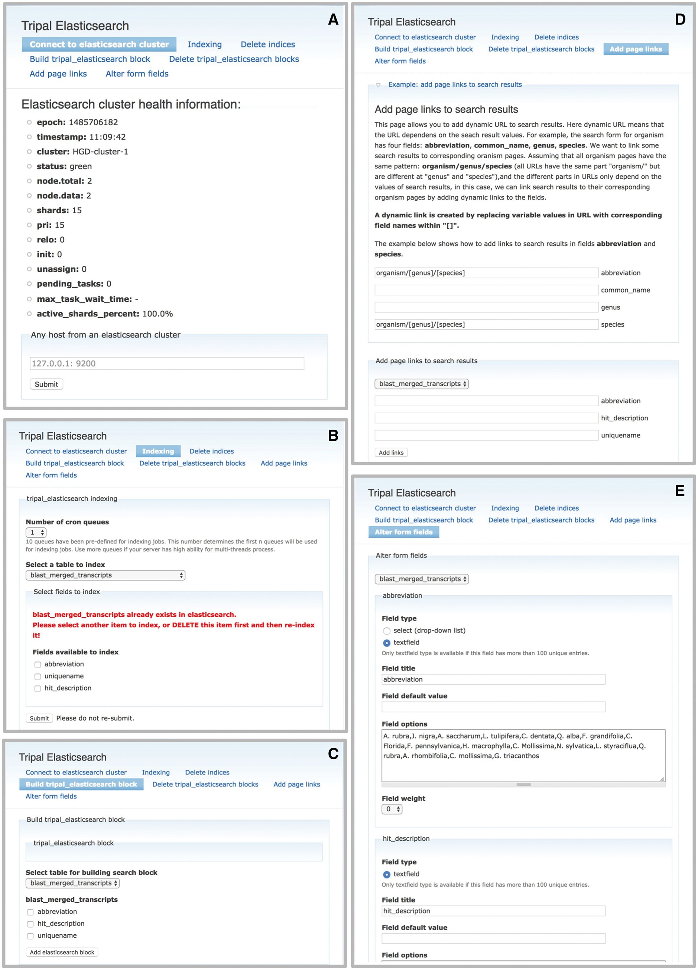
Figure 2. The Tripal Elasticsearch module administrative pages provide centralized control of data indexing and ...
Notes:
Figure 2. The Tripal Elasticsearch module administrative pages provide centralized control of data indexing and construction of search interfaces. (A) The module first needs to be connected to a running Elasticsearch cluster. (B) The user may opt to index the entire site by selecting ‘index_website’ or select individual tables and fields from the database. The index jobs are automatically launched via cron. (C) Based on available search indexes, a search form can be built and placed in a Drupal content block for display to users. (D) For each search block, the search results are linked to site content by constructing custom URLs (universal resource locator). The administrative page gives an example of how to use search results as tokens in the construction of URLs. (E) The search form can be customized for the best final user experience.
Unless provided in the caption above, the following copyright applies to the content of this slide: © The Author(s) 2017. Published by Oxford University Press.This is an Open Access article distributed under the terms of the Creative Commons Attribution License (http://creativecommons.org/licenses/by/4.0/), which permits unrestricted reuse, distribution, and reproduction in any medium, provided the original work is properly cited.

