Slide 1
Figure 1. Summary of the new features added to the structural annotation file from the Q. suber genome publication for ...
Notes:
Figure 1. Summary of the new features added to the structural annotation file from the Q. suber genome publication for the CorkOakDB, which are identified with ‘+’.
Unless provided in the caption above, the following copyright applies to the content of this slide: © The Author(s) 2020. Published by Oxford University Press.This is an Open Access article distributed under the terms of the Creative Commons Attribution License (http://creativecommons.org/licenses/by/4.0/), which permits unrestricted reuse, distribution, and reproduction in any medium, provided the original work is properly cited.

Slide 2
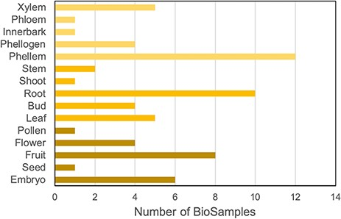
Figure 2. Distribution of cork oak publicly available NCBI BioSamples related to RNA-Seq data sets, according to cork ...
Notes:
Figure 2. Distribution of cork oak publicly available NCBI BioSamples related to RNA-Seq data sets, according to cork oak tissue or organ.
Unless provided in the caption above, the following copyright applies to the content of this slide: © The Author(s) 2020. Published by Oxford University Press.This is an Open Access article distributed under the terms of the Creative Commons Attribution License (http://creativecommons.org/licenses/by/4.0/), which permits unrestricted reuse, distribution, and reproduction in any medium, provided the original work is properly cited.

Slide 3
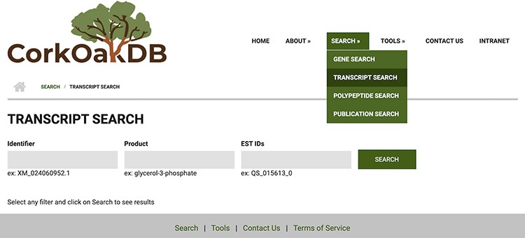
Figure 3. View of Transcript Search page in CorkOakDB.
Notes:
Figure 3. View of Transcript Search page in CorkOakDB.
Unless provided in the caption above, the following copyright applies to the content of this slide: © The Author(s) 2020. Published by Oxford University Press.This is an Open Access article distributed under the terms of the Creative Commons Attribution License (http://creativecommons.org/licenses/by/4.0/), which permits unrestricted reuse, distribution, and reproduction in any medium, provided the original work is properly cited.

Slide 4
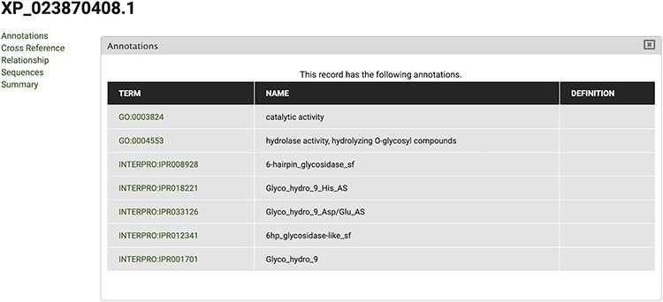
Figure 4. View of InterPro and Gene Ontology annotations for polypeptide sequence XP_023870408.1, obtained by selecting ...
Notes:
Figure 4. View of InterPro and Gene Ontology annotations for polypeptide sequence XP_023870408.1, obtained by selecting the ‘Annotations’ tab in the CorkOakDB.
Unless provided in the caption above, the following copyright applies to the content of this slide: © The Author(s) 2020. Published by Oxford University Press.This is an Open Access article distributed under the terms of the Creative Commons Attribution License (http://creativecommons.org/licenses/by/4.0/), which permits unrestricted reuse, distribution, and reproduction in any medium, provided the original work is properly cited.

Slide 5
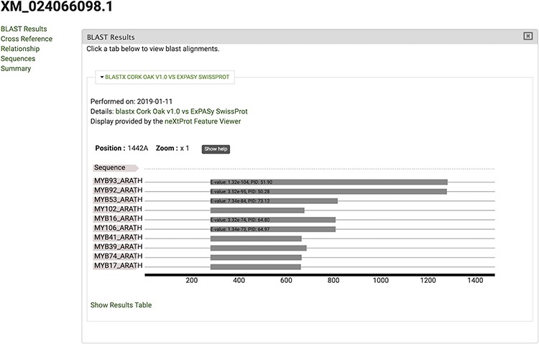
Figure 5. View of significant blastx hits for mRNA sequence XM_024066098.1, obtained by selecting the ‘BLAST results’ ...
Notes:
Figure 5. View of significant blastx hits for mRNA sequence XM_024066098.1, obtained by selecting the ‘BLAST results’ tab.
Unless provided in the caption above, the following copyright applies to the content of this slide: © The Author(s) 2020. Published by Oxford University Press.This is an Open Access article distributed under the terms of the Creative Commons Attribution License (http://creativecommons.org/licenses/by/4.0/), which permits unrestricted reuse, distribution, and reproduction in any medium, provided the original work is properly cited.

Slide 6
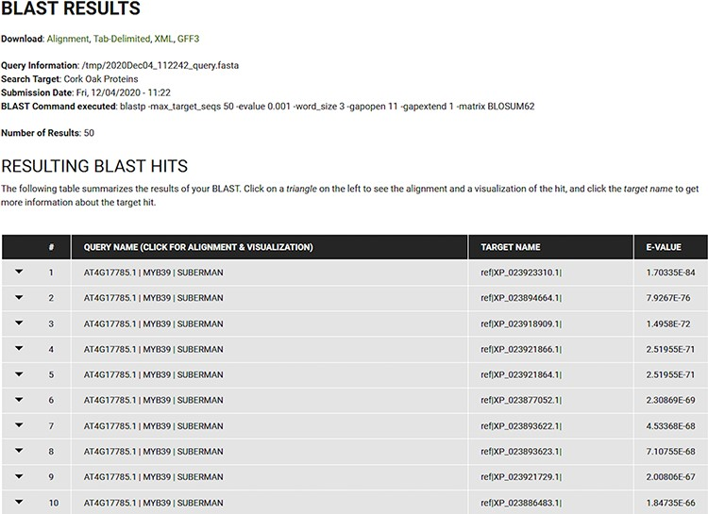
Figure 6. BLAST results for blastp search of the Arabidopsis MYB39 transcription factor on the cork oak protein ...
Notes:
Figure 6. BLAST results for blastp search of the Arabidopsis MYB39 transcription factor on the cork oak protein database displayed in CorkOakDB.
Unless provided in the caption above, the following copyright applies to the content of this slide: © The Author(s) 2020. Published by Oxford University Press.This is an Open Access article distributed under the terms of the Creative Commons Attribution License (http://creativecommons.org/licenses/by/4.0/), which permits unrestricted reuse, distribution, and reproduction in any medium, provided the original work is properly cited.

Slide 7
Figure 7. Genome browser view of LOC112033310 structural annotation. RNA-seq data from three different tissues were ...
Notes:
Figure 7. Genome browser view of LOC112033310 structural annotation. RNA-seq data from three different tissues were selected to showcase exon coverage.
Unless provided in the caption above, the following copyright applies to the content of this slide: © The Author(s) 2020. Published by Oxford University Press.This is an Open Access article distributed under the terms of the Creative Commons Attribution License (http://creativecommons.org/licenses/by/4.0/), which permits unrestricted reuse, distribution, and reproduction in any medium, provided the original work is properly cited.

Slide 8
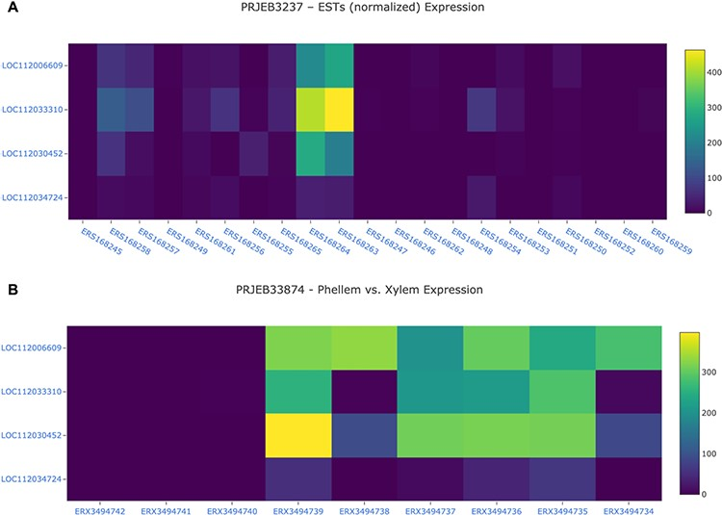
Figure 8. Gene expression analysis for the cork oak MYB39 (LOC112034724) and MYB92 (LOC112033310) orthologues, and two ...
Notes:
Figure 8. Gene expression analysis for the cork oak MYB39 (LOC112034724) and MYB92 (LOC112033310) orthologues, and two closely related MYB genes (LOC112030452 and LOC112006609) in different BioSamples included in BioProjects PRJEB3237 (A) and PRJEB33874 (B). These BioProjects were selected since they represent different cork oak tissues. BioSamples ERS168264, ERS168263 (upper panel), and ERX3494734 to ERX3494739 were obtained from developing phellem (or cork). BioSample names are hyperlinks to retrieve corresponding metadata.
Unless provided in the caption above, the following copyright applies to the content of this slide: © The Author(s) 2020. Published by Oxford University Press.This is an Open Access article distributed under the terms of the Creative Commons Attribution License (http://creativecommons.org/licenses/by/4.0/), which permits unrestricted reuse, distribution, and reproduction in any medium, provided the original work is properly cited.

Slide 9
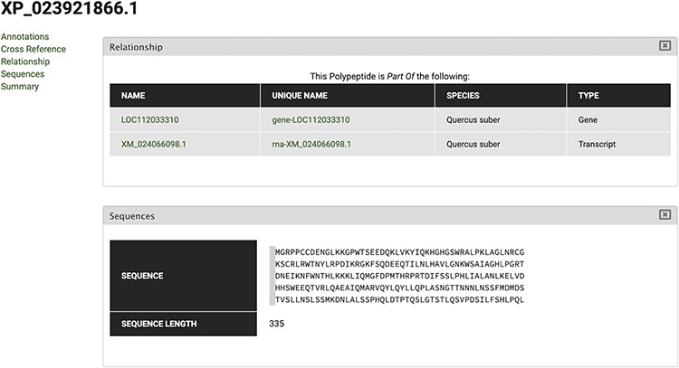
Figure 9. Polypeptide feature page for XP_023921866 polypeptide. Using the Relationship tab, the correspondent Gene and ...
Notes:
Figure 9. Polypeptide feature page for XP_023921866 polypeptide. Using the Relationship tab, the correspondent Gene and Transcript IDs can be retrieved.
Unless provided in the caption above, the following copyright applies to the content of this slide: © The Author(s) 2020. Published by Oxford University Press.This is an Open Access article distributed under the terms of the Creative Commons Attribution License (http://creativecommons.org/licenses/by/4.0/), which permits unrestricted reuse, distribution, and reproduction in any medium, provided the original work is properly cited.

Slide 10
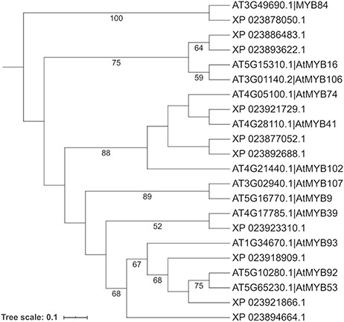
Figure 10. Phylogenetic analysis of selected cork oak and Arabidopsis MYBs TFs related to AtMYB39 and AtMYB92. Amino ...
Notes:
Figure 10. Phylogenetic analysis of selected cork oak and Arabidopsis MYBs TFs related to AtMYB39 and AtMYB92. Amino acid sequences were retrieved from CorkOakDB and TAIR, and multiple alignment of conserved MYB domains was performed using MAFFT v7. Phylogenetic inference was obtained using the Maximum Likelihood method with RAxML v8.2.12. Branch support was obtained by bootstrap analysis (1000 replications) and indicated for specific nodes (bootstrap value >50%).
Unless provided in the caption above, the following copyright applies to the content of this slide: © The Author(s) 2020. Published by Oxford University Press.This is an Open Access article distributed under the terms of the Creative Commons Attribution License (http://creativecommons.org/licenses/by/4.0/), which permits unrestricted reuse, distribution, and reproduction in any medium, provided the original work is properly cited.

