Slide 1
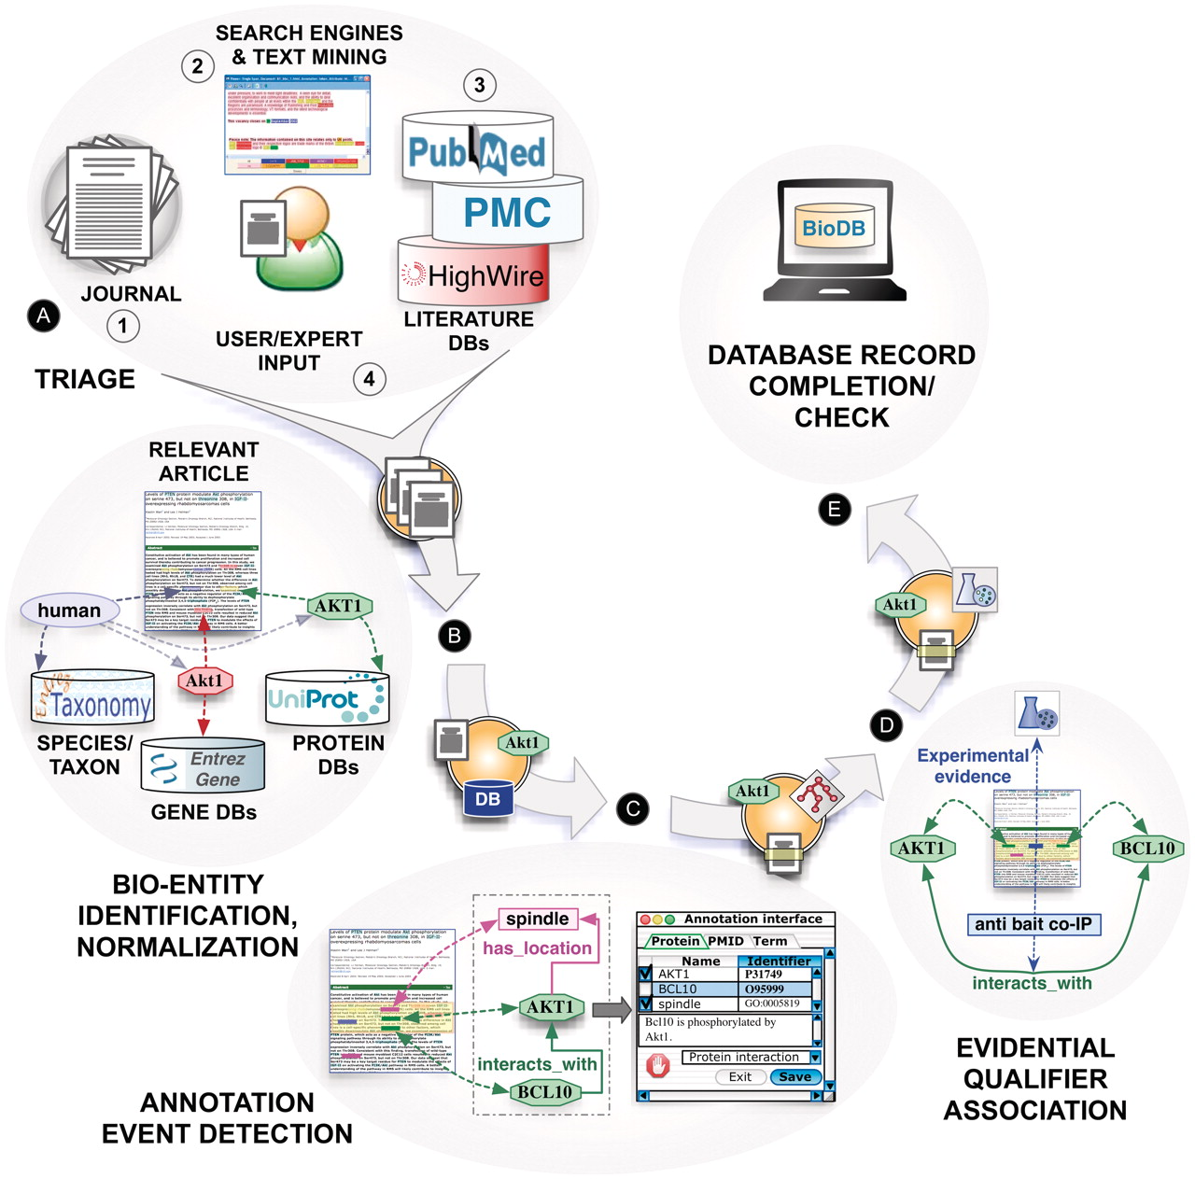
Figure 1. Text mining and the biocuration workflow: main tasks of a canonical annotation workflow, including (A) ...
Notes:
Figure 1. Text mining and the biocuration workflow: main tasks of a canonical annotation workflow, including (A) triage, (B) bio-entity identification and normalization, (C) annotation event detection, (D) evidential qualifier association and (E) database record completion.
Unless provided in the caption above, the following copyright applies to the content of this slide: © The Author(s) 2012. Published by Oxford University Press.This is an Open Access article distributed under the terms of the Creative Commons Attribution Non-Commercial License (http://creativecommons.org/licenses/by-nc/3.0), which permits unrestricted non-commercial use, distribution, and reproduction in any medium, provided the original work is properly cited.

