Slide 1
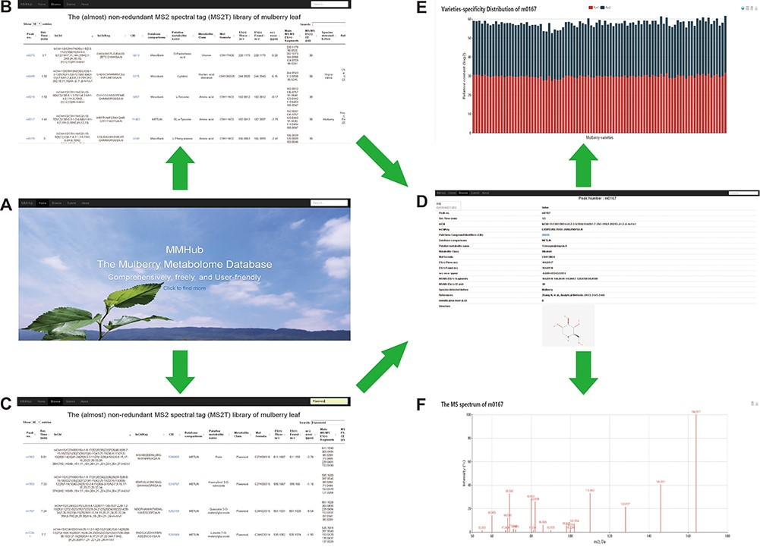
Figure 4 Snapshots of searches for metabolites and related information in MMHub. Researchers can retrieve general ...
Notes:
Figure 4 Snapshots of searches for metabolites and related information in MMHub. Researchers can retrieve general information about metabolites by basic browsing (A and B) or specific searches (C). Detailed information including available compound information (D), quantitative data (E) and mass spectrum (F) retrieved by clicking the ‘Peak no.’ link.
Unless provided in the caption above, the following copyright applies to the content of this slide: © The Author(s) 2020. Published by Oxford University Press.This is an Open Access article distributed under the terms of the Creative Commons Attribution License (http://creativecommons.org/licenses/by/4.0/), which permits unrestricted reuse, distribution, and reproduction in any medium, provided the original work is properly cited.

