Slide 1
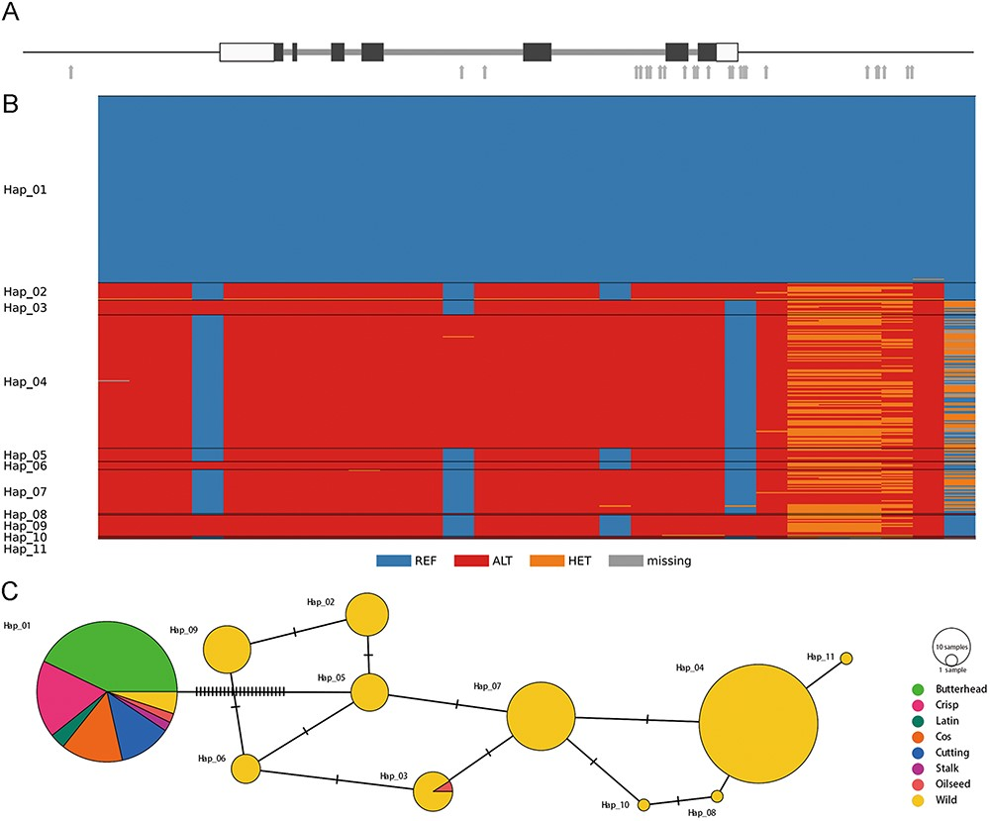
Figure 12. Genetic diversity in the lettuce KN1 gene. (A) Gene structure of Lsat_1_v5_gn_7_15020 that encodes the KN1 ...
Notes:
Figure 12. Genetic diversity in the lettuce KN1 gene. (A) Gene structure of Lsat_1_v5_gn_7_15020 that encodes the KN1 transcription factor. Black bars denote coding regions, and white bars represent 5ʹ- and 3ʹ-untranslated regions. Gray arrows indicate SNPs in their genic and flanking regions. (B) Genotypes of 28 SNPs in the genic and flanking regions in 332 cultivated and wild accessions (C) A median-joining haplotype network.
Unless provided in the caption above, the following copyright applies to the content of this slide: © The Author(s) 2024. Published by Oxford University Press.This is an Open Access article distributed under the terms of the Creative Commons Attribution License (https://creativecommons.org/licenses/by/4.0/), which permits unrestricted reuse, distribution, and reproduction in any medium, provided the original work is properly cited.

