Slide 1
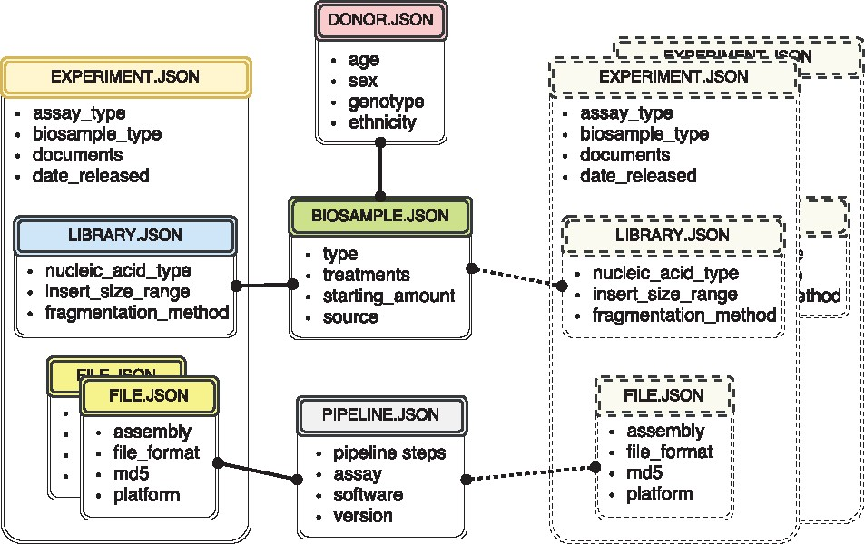
Figure 1. The metadata captured for ENCODE can be grouped into the following main object types: donors/strains, ...
Notes:
Figure 1. The metadata captured for ENCODE can be grouped into the following main object types: donors/strains, biosamples, genetic modifications, sequencing libraries, antibodies, data files and pipelines. Experiment objects (representing replicates of an assay) are constructed from these object types. Each object type represents a category of experimental entities and is used to store information about entities from that category. For example, the library object represents sequencing library and would include information such as nucleic acid type or the fragmentation method used to construct the library. In a similar fashion the file object (that is different from the actual data file) stores information about the data file submitted to the portal. Examples of the properties that would be stored in a file object would be: information about the sequencing platform used to produce this FASTQ file or information about the reference genome assembly that was used for alignment producing this BAM file. Some of the objects are unique per experiment (e.g. sequencing library, or raw data file) while others could be shared between different experiment objects (e.g. the donor or the biosample objects). The figure includes both types of objects, the library (blue color header) and the files (yellow color header) are unique and are associated with a single experiment (amber header), while the biosample (green color header) and the pipeline (pink color header) objects could be shared between multiple experiments. Potential experiments the biosample and the pipeline objects could be shared with are depicted by the rectangles with the dashed borderline. Only a subset of object types is listed in the figure to provide an overview of the breadth and depth of metadata collected. The full set of metadata can be viewed at https://github.com/ENCODE-DCC/encoded/tree/master/src/encoded/schemas.
Unless provided in the caption above, the following copyright applies to the content of this slide: © The Author(s) 2018. Published by Oxford University Press.This is an Open Access article distributed under the terms of the Creative Commons Attribution License (http://creativecommons.org/licenses/by/4.0/), which permits unrestricted reuse, distribution, and reproduction in any medium, provided the original work is properly cited.

