Slide 1
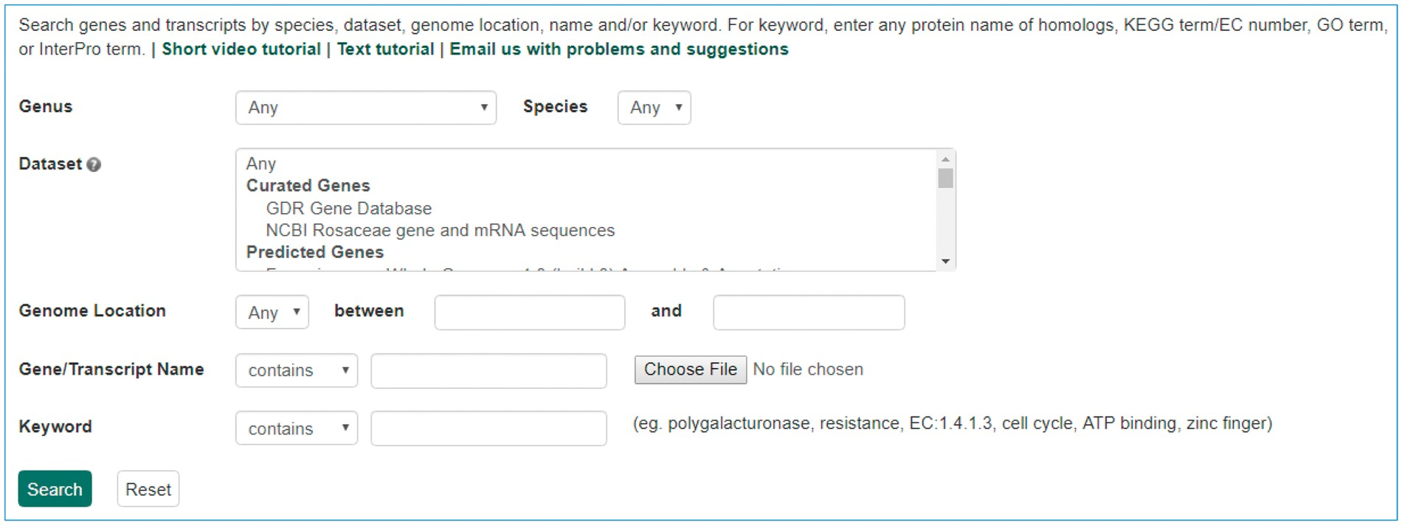
Figure 6. Search page for genes and transcripts in GDR. Users can search genes and transcripts using various filters ...
Notes:
Figure 6. Search page for genes and transcripts in GDR. Users can search genes and transcripts using various filters such as genus, species, dataset, aligned genome location, name and keyword.
Unless provided in the caption above, the following copyright applies to the content of this slide: © The Author(s) 2017. Published by Oxford University Press.This is an Open Access article distributed under the terms of the Creative Commons Attribution License (http://creativecommons.org/licenses/by/4.0/), which permits unrestricted reuse, distribution, and reproduction in any medium, provided the original work is properly cited.

