Slide 1
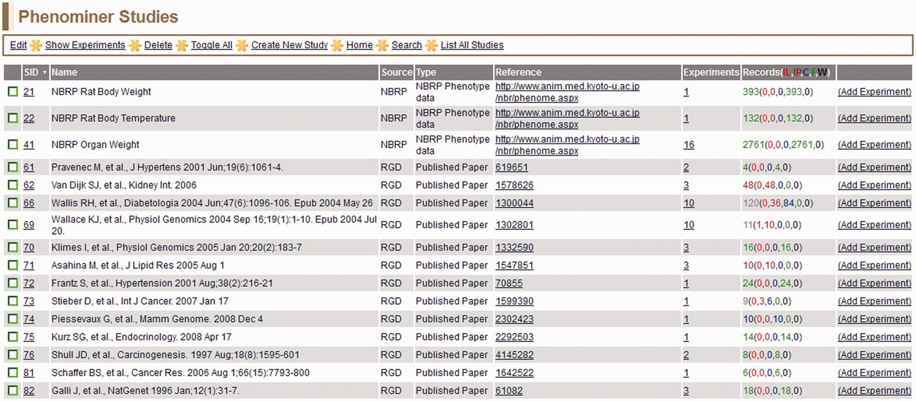
Figure 6 PhenoMiner Studies page—this is a one-page view of all studies in the PhenoMiner curation tool. The columns ...
Notes:
Figure 6 PhenoMiner Studies page—this is a one-page view of all studies in the PhenoMiner curation tool. The columns are all sortable by clicking on the headings. Important to note is the ‘Records’ column, which shows the number of records and status of those records. The status is color-coded—IL (red): initial load; IP (dark red): in progress; C (blue): curated; F (green): final; W (black): withdrawn.
Unless provided in the caption above, the following copyright applies to the content of this slide: © The Author(s) 2013. Published by Oxford University Press.This is an Open Access article distributed under the terms of the Creative Commons Attribution Non-Commercial License (http://creativecommons.org/licenses/by-nc/3.0/), which permits unrestricted non-commercial use, distribution, and reproduction in any medium, provided the original work is properly cited.

Slide 2
Figure 5 View Records page—a typical annotation viewed in the PhenoMiner curation tool with all data visible on one ...
Notes:
Figure 5 View Records page—a typical annotation viewed in the PhenoMiner curation tool with all data visible on one line.
Unless provided in the caption above, the following copyright applies to the content of this slide: © The Author(s) 2013. Published by Oxford University Press.This is an Open Access article distributed under the terms of the Creative Commons Attribution Non-Commercial License (http://creativecommons.org/licenses/by-nc/3.0/), which permits unrestricted non-commercial use, distribution, and reproduction in any medium, provided the original work is properly cited.

Slide 3
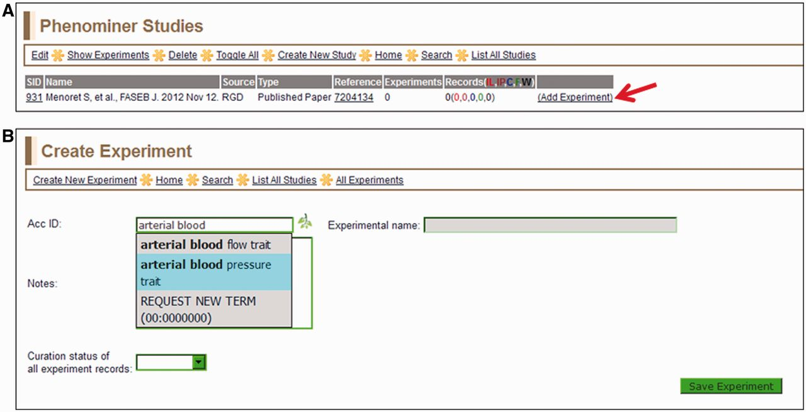
Figure 2 (A) Selected study page—this page displays the citation, a reference link and other information about the ...
Notes:
Figure 2 (A) Selected study page—this page displays the citation, a reference link and other information about the study. Clicking the ‘Add Experiment’ link (red arrow) returns the ‘Create Experiment’ page. (B) Create Experiment page—this page features an autocompleting text box for entering term IDs for either vertebrate trait terms (VT) or disease terms (RDO). The text box will accept a VT or RDO ID or any key word(s) found in VT or RDO terms. If a suggested term is selected, the ID is automatically entered in the selection text box and the term itself will be automatically entered in the accompanying ‘Experimental name’ box.
Unless provided in the caption above, the following copyright applies to the content of this slide: © The Author(s) 2013. Published by Oxford University Press.This is an Open Access article distributed under the terms of the Creative Commons Attribution Non-Commercial License (http://creativecommons.org/licenses/by-nc/3.0/), which permits unrestricted non-commercial use, distribution, and reproduction in any medium, provided the original work is properly cited.

Slide 4
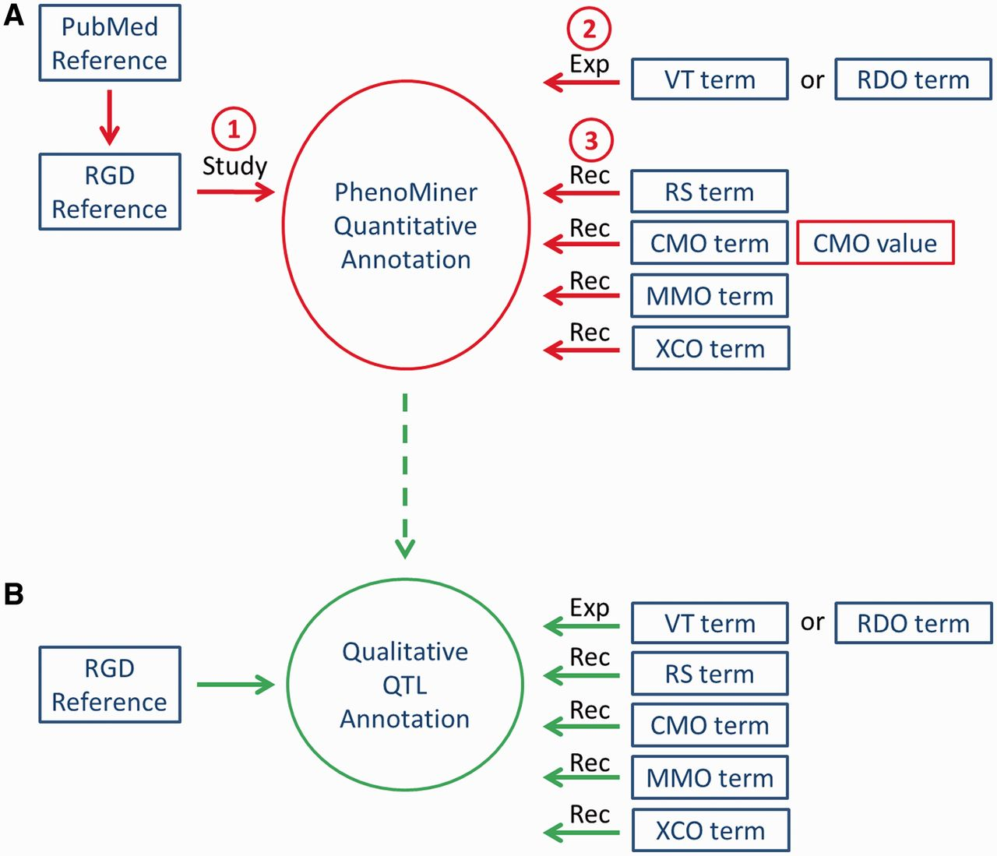
Figure 1 Workflow of PhenoMiner curation. (A) The quantitative PhenoMiner curation workflow showing the sequence that ...
Notes:
Figure 1 Workflow of PhenoMiner curation. (A) The quantitative PhenoMiner curation workflow showing the sequence that establishes first, the ‘Study’, second, the experiment name (Exp) and third, all the details of the annotation ‘Record’ (Rec). (B) Workflow for the new PhenoMiner-style qualitative annotation of QTLs. This workflow uses the same ontologies as the PhenoMiner curation, but uses the general curation tool because no numerical values are entered.
Unless provided in the caption above, the following copyright applies to the content of this slide: © The Author(s) 2013. Published by Oxford University Press.This is an Open Access article distributed under the terms of the Creative Commons Attribution Non-Commercial License (http://creativecommons.org/licenses/by-nc/3.0/), which permits unrestricted non-commercial use, distribution, and reproduction in any medium, provided the original work is properly cited.

Slide 5
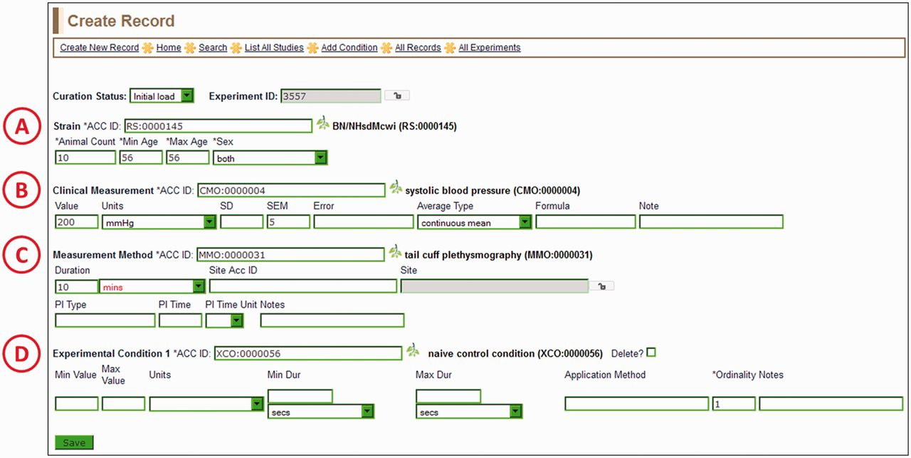
Figure 4 Create Record Page—most of the information for a manual PhenoMiner annotation is entered here. Four ...
Notes:
Figure 4 Create Record Page—most of the information for a manual PhenoMiner annotation is entered here. Four ontology/vocabulary terms are required and many more optional fields allow the addition of basic experimental information. In this example, the rat strain (A) is BN/NHsdMcwi, the CMO term (B) is ‘systolic blood pressure’, the MMO term (C) is ‘tail cuff plethysmography’ and the XCO term (D) is ‘naïve control condition’. The optional MA term goes in the ‘Site ACC ID’ text box in the measurement method section (C).
Unless provided in the caption above, the following copyright applies to the content of this slide: © The Author(s) 2013. Published by Oxford University Press.This is an Open Access article distributed under the terms of the Creative Commons Attribution Non-Commercial License (http://creativecommons.org/licenses/by-nc/3.0/), which permits unrestricted non-commercial use, distribution, and reproduction in any medium, provided the original work is properly cited.

Slide 6
Figure 3 View Experiments page—this page lists all experiments for the particular study being curated, in this case ...
Notes:
Figure 3 View Experiments page—this page lists all experiments for the particular study being curated, in this case ‘body mass’ (EID 3558) and ‘arterial blood pressure trait’ (EID 3557) for SID:851 (listed on left side of page).
Unless provided in the caption above, the following copyright applies to the content of this slide: © The Author(s) 2013. Published by Oxford University Press.This is an Open Access article distributed under the terms of the Creative Commons Attribution Non-Commercial License (http://creativecommons.org/licenses/by-nc/3.0/), which permits unrestricted non-commercial use, distribution, and reproduction in any medium, provided the original work is properly cited.

Slide 7
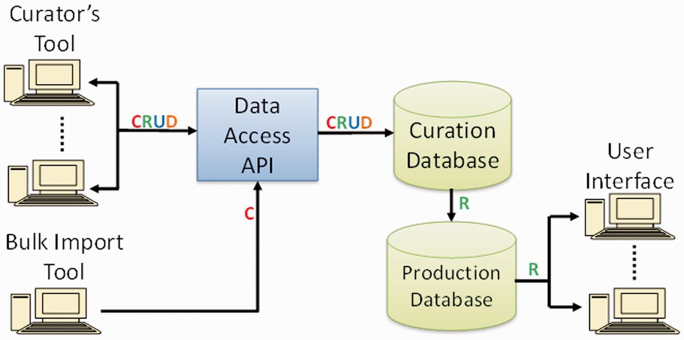
Figure 7 PhenoMiner software components and data flow. Operations in data flow: C = create, R = read, U = update, D = ...
Notes:
Figure 7 PhenoMiner software components and data flow. Operations in data flow: C = create, R = read, U = update, D = delete (API = application programming interface).
Unless provided in the caption above, the following copyright applies to the content of this slide: © The Author(s) 2013. Published by Oxford University Press.This is an Open Access article distributed under the terms of the Creative Commons Attribution Non-Commercial License (http://creativecommons.org/licenses/by-nc/3.0/), which permits unrestricted non-commercial use, distribution, and reproduction in any medium, provided the original work is properly cited.

