Slide 1
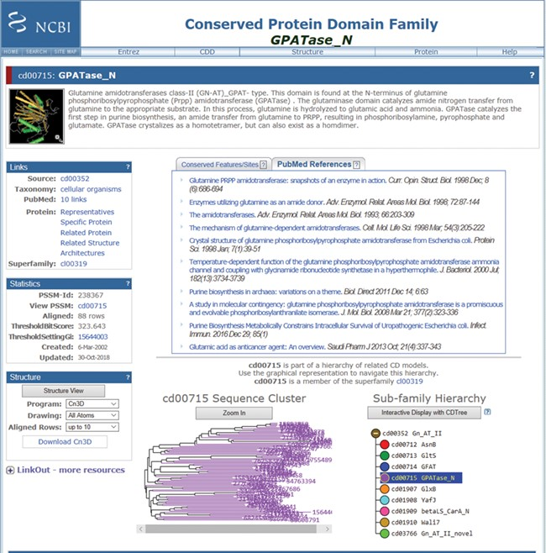
Figure 3 Screenshot of a random CDD record (the GPATase_N domain) page, after being updated with the new information ...
Notes:
Figure 3 Screenshot of a random CDD record (the GPATase_N domain) page, after being updated with the new information in the CDD. This record now has 10 PubMed articles linked as relevant references. The six new references are added below the original references (https://www.ncbi.nlm.nih.gov/Structure/cdd/cddsrv.cgi?uid=cd00715).
Unless provided in the caption above, the following copyright applies to the content of this slide: Published by Oxford University Press 2019.This work is written by US Government employees and is in the public domain in the US.

