Slide 1
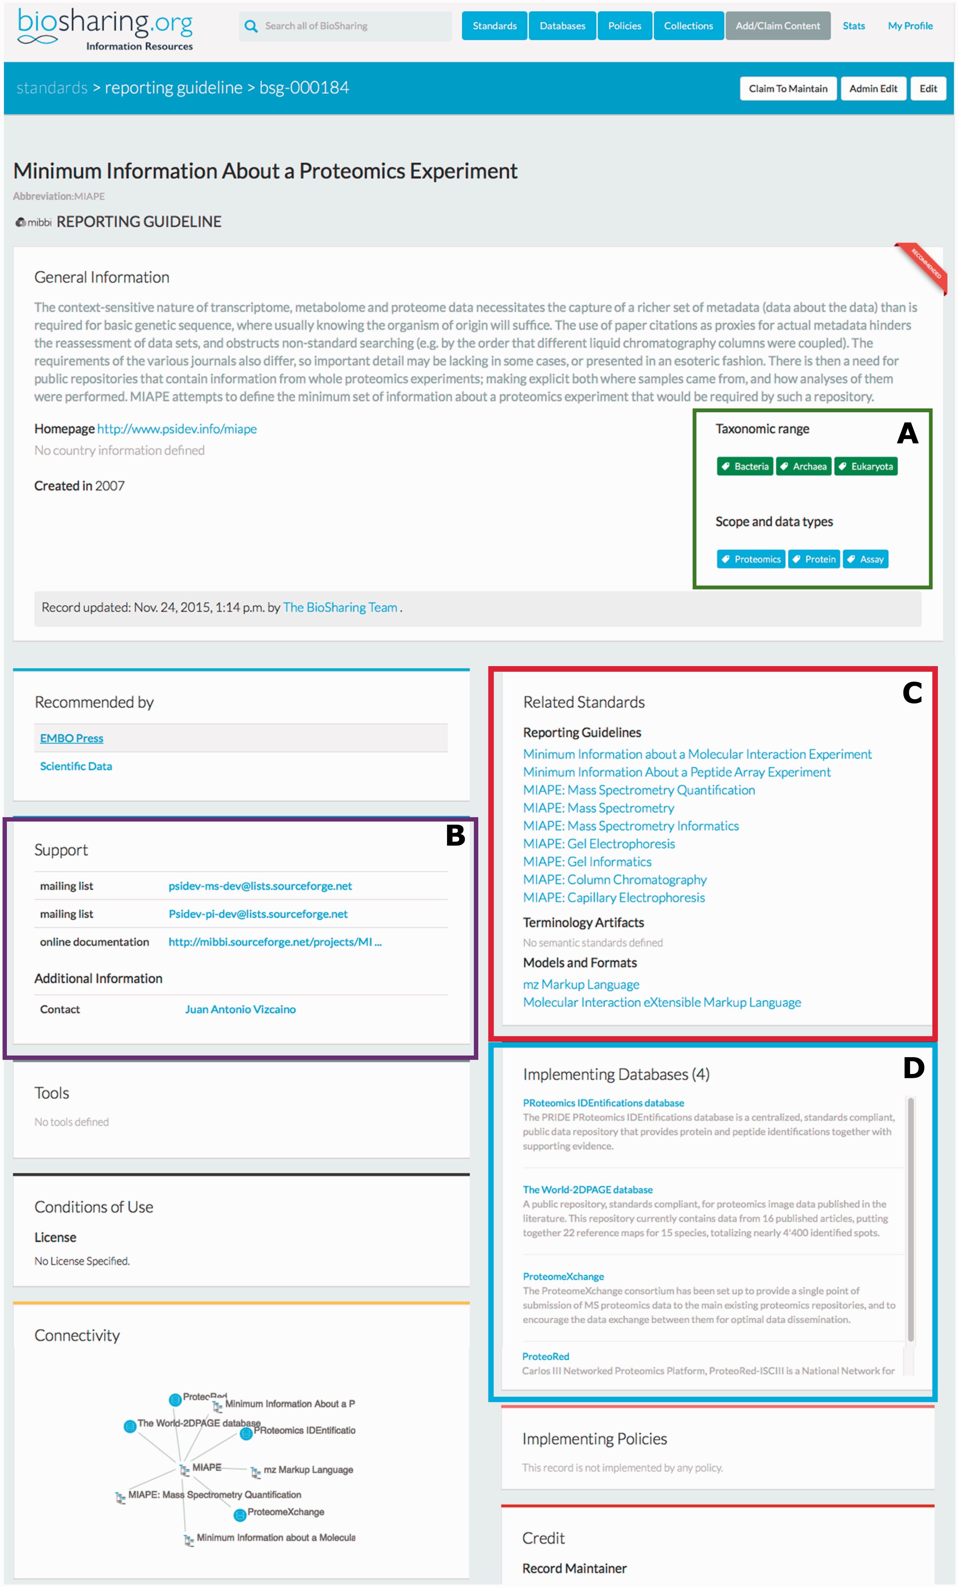
Figure 1 The BioSharing MIAPE Standard Record (top section). In the General Information section, the Taxonomic Range ...
Notes:
Figure 1 The BioSharing MIAPE Standard Record (top section). In the General Information section, the Taxonomic Range and Scope and data types tags are highlighted in a green box (A) . Clicking on a tag from within these two fields initiates a search for all the records annotated with that tag. The Support section (B —highlighted in purple) contains information on help documentation, mailing lists and contact details. The Related Standards section (C —highlighted in red) contains links to other metadata standards, such as the extensions to the initial MIAPE standard. Beneath this section, the implementing databases section (D —highlighted in blue) provides links to those resources that have implemented the MIAPE standard (e.g. The PRIDE database).
Unless provided in the caption above, the following copyright applies to the content of this slide: © The Author(s) 2016. Published by Oxford University Press. This is an Open Access article distributed under the terms of the Creative Commons Attribution License ( http://creativecommons.org/licenses/by/4.0/ ), which permits unrestricted reuse, distribution, and reproduction in any medium, provided the original work is properly cited.

