Slide 1
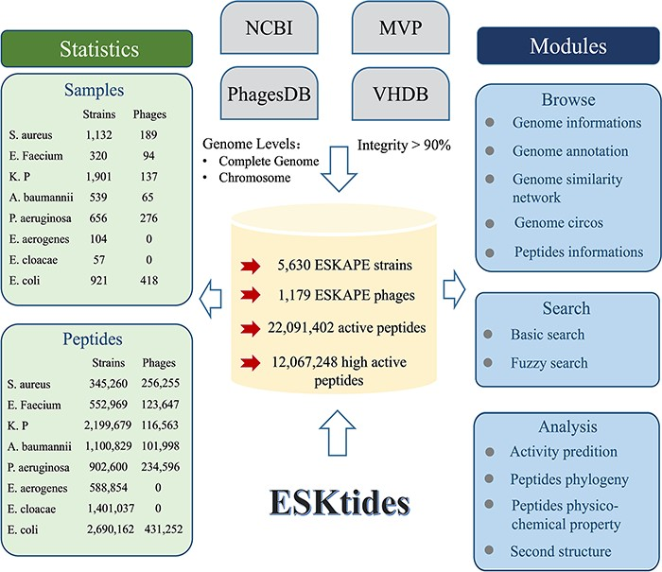
Figure 1. Workflow for ESKAPE-derived peptides mining. The main steps include annotation of phages and prophages, ...
Notes:
Figure 1. Workflow for ESKAPE-derived peptides mining. The main steps include annotation of phages and prophages, de-redundancy, search PGH structure and scoring of antibacterial activity.
Unless provided in the caption above, the following copyright applies to the content of this slide: © The Author(s) 2024. Published by Oxford University Press.This is an Open Access article distributed under the terms of the Creative Commons Attribution License (https://creativecommons.org/licenses/by/4.0/), which permits unrestricted reuse, distribution, and reproduction in any medium, provided the original work is properly cited.

Slide 2
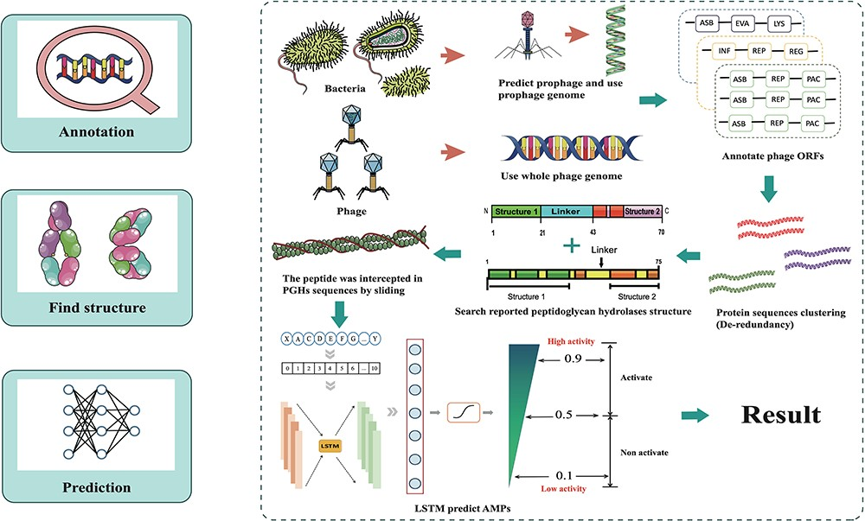
Figure 2. Overall design of ESKtides. ESKtides curated metadata information from NCBI, MVP, VHDB and PhagesDB, and the ...
Notes:
Figure 2. Overall design of ESKtides. ESKtides curated metadata information from NCBI, MVP, VHDB and PhagesDB, and the data in these four databases are subjected to the following procedures. First, for ESKAPE strains, we filter incomplete assembly to ensure the accuracy of mining. Second, for ESKAPE phages, we downloaded the phage genome corresponding to their strains (phages are isolated from corresponding strains) from MVP, PhagesDB, VHDB and marked as corresponding phages. All raw data were processed by using a standard pipeline. ESKtides includes ‘Browse’, ‘Search’, ‘Download’ and ‘Submission’.
Unless provided in the caption above, the following copyright applies to the content of this slide: © The Author(s) 2024. Published by Oxford University Press.This is an Open Access article distributed under the terms of the Creative Commons Attribution License (https://creativecommons.org/licenses/by/4.0/), which permits unrestricted reuse, distribution, and reproduction in any medium, provided the original work is properly cited.

Slide 3
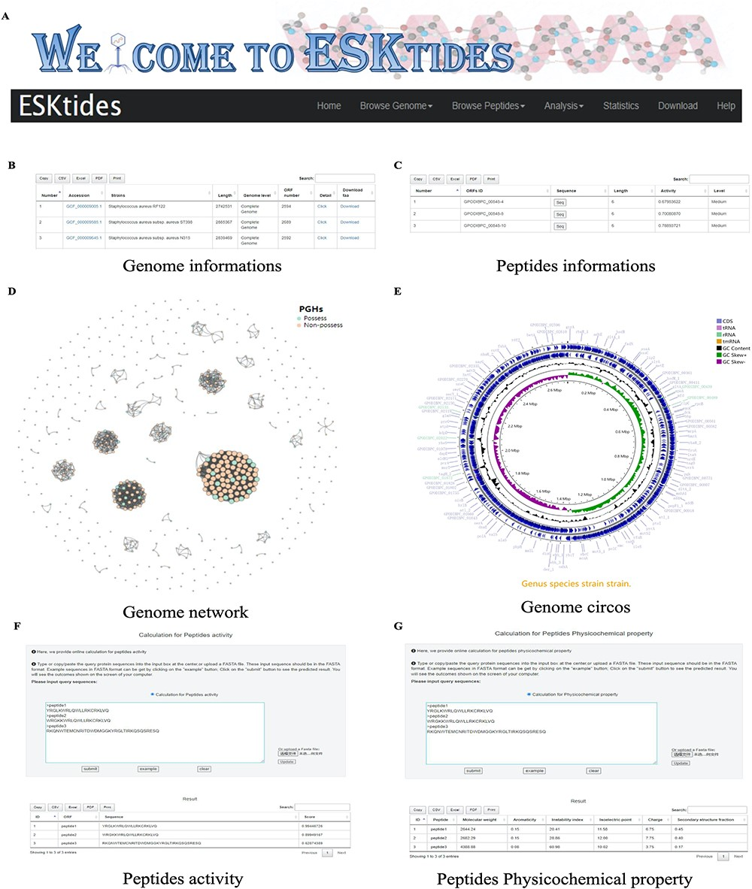
Figure 3. Overview of ESKtides. (A) Main functions of ESKtides, including the ‘Browse Genome’, ‘Browse Peptides’, ...
Notes:
Figure 3. Overview of ESKtides. (A) Main functions of ESKtides, including the ‘Browse Genome’, ‘Browse Peptides’, ‘Analysis’, ‘Statistic’, ‘Download’ and ‘Help’ modules. (B) A table of queried strains or phages information in the ‘Browse Genome’ module. (C) A table of queried ESKAPE-derived peptides information in the ‘Browse Peptides’ module. (D) A graph of queried PGH distribution in the ‘Browse Genome’ module. (E) The annotation circos graph of queried strain. (F) Submit peptides sequences to score the bactericidal activity of the peptide. (G) Calculate peptides sequences physicochemical property.
Unless provided in the caption above, the following copyright applies to the content of this slide: © The Author(s) 2024. Published by Oxford University Press.This is an Open Access article distributed under the terms of the Creative Commons Attribution License (https://creativecommons.org/licenses/by/4.0/), which permits unrestricted reuse, distribution, and reproduction in any medium, provided the original work is properly cited.

