Slide 1
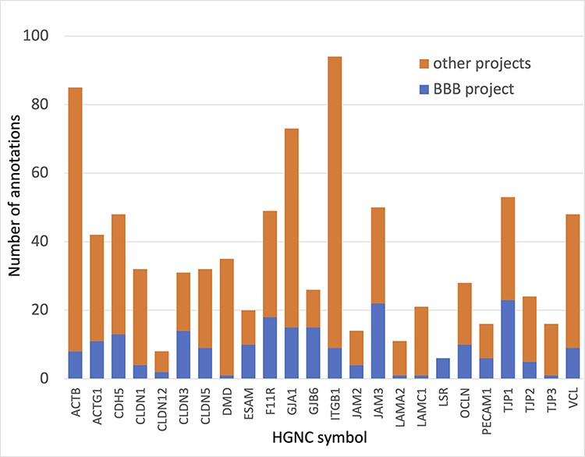
Figure 4. Annotation of proteins involved maintenance of cell junctions at the BBB. The number of BBB-relevant ...
Notes:
Figure 4. Annotation of proteins involved maintenance of cell junctions at the BBB. The number of BBB-relevant annotations created for each of the cell junction priority proteins as part of the BBB-focused annotation project (BBB project), compared to the total number of annotations associated with these proteins. A BBB slim (Supplementary Table S5) was used to download potentially BBB-relevant annotations from QuickGO (11) (28 May 2021). All annotations are associated with these proteins and can be viewed online using the following link: https://tinyurl.com/y59y8e7c.
Unless provided in the caption above, the following copyright applies to the content of this slide: © The Author(s) 2021. Published by Oxford University Press.This is an Open Access article distributed under the terms of the Creative Commons Attribution License (https://creativecommons.org/licenses/by/4.0/), which permits unrestricted reuse, distribution, and reproduction in any medium, provided the original work is properly cited.

