Slide 1
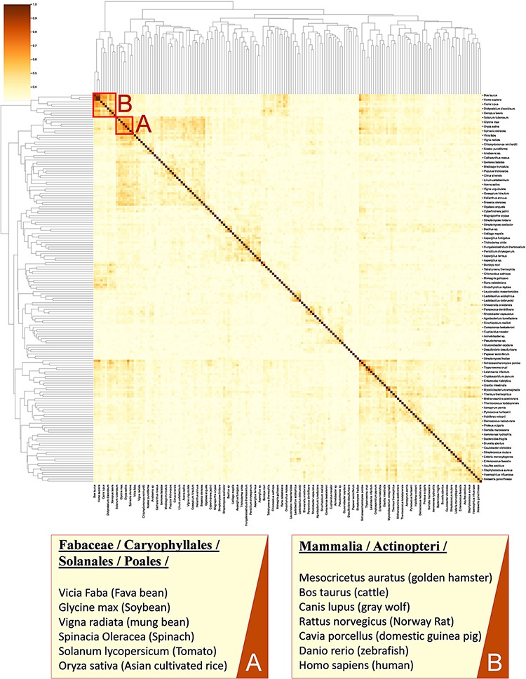
Figure 8. A cluster map of a random sample of 174 models based on their similarity in functional metabolism. Red box A ...
Notes:
Figure 8. A cluster map of a random sample of 174 models based on their similarity in functional metabolism. Red box A contains species belonging to Magnoliopsida (flowering plants) class. Box B include species of class Mammalia and Actinopteri.
Unless provided in the caption above, the following copyright applies to the content of this slide: © The Author(s) 2022. Published by Oxford University Press.This is an Open Access article distributed under the terms of the Creative Commons Attribution-NonCommercial License (https://creativecommons.org/licenses/by-nc/4.0/), which permits non-commercial re-use, distribution, and reproduction in any medium, provided the original work is properly cited. For commercial re-use, please contact journals.permissions@oup.com

