Slide 1
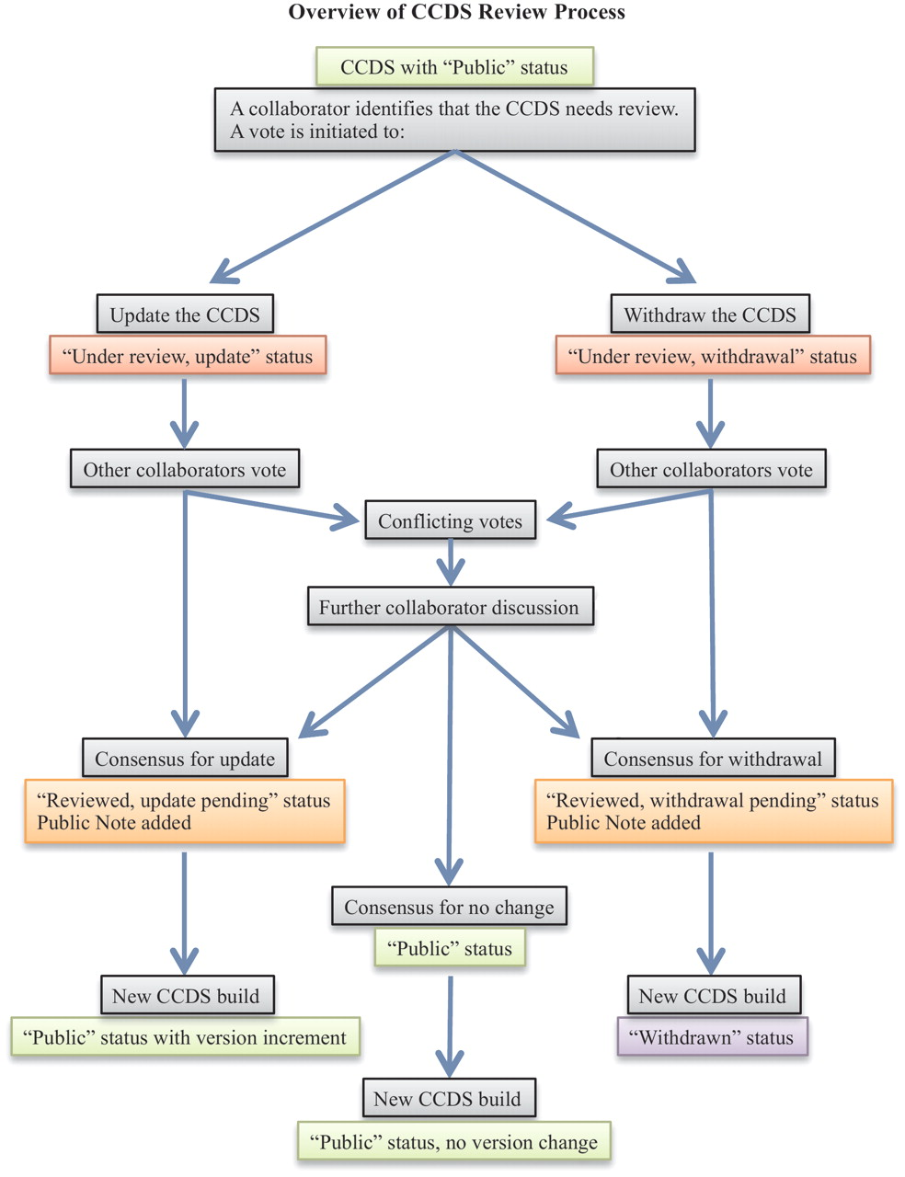
Figure 1. The flowchart outlines the CCDS review process (light gray boxes). CCDS IDs undergo status changes during and ...
Notes:
Figure 1. The flowchart outlines the CCDS review process (light gray boxes). CCDS IDs undergo status changes during and following the review process, as indicated by the colored boxes, where light green indicates ‘Public’ status, red indicates an ongoing review that has not yet reached consensus, orange indicates a pending update or withdrawal that has reached consensus, and purple indicates ‘Withdrawn’ status.
Unless provided in the caption above, the following copyright applies to the content of this slide: Published by Oxford University Press on behalf of US Government 2012.This is an Open Access article distributed under the terms of the Creative Commons Attribution Non-Commercial License (http://creativecommons.org/licenses/by-nc/3.0), which permits unrestricted non-commercial use, distribution, and reproduction in any medium, provided the original work is properly cited.

