Slide 1
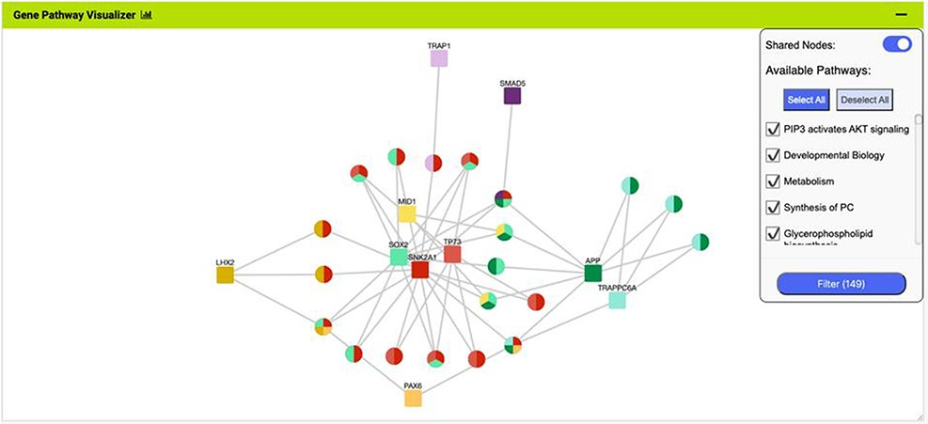
Figure 8. The Gene Pathway Visualizer on the list analysis page, showing Gene–Pathway associations for the 14 ...
Notes:
Figure 8. The Gene Pathway Visualizer on the list analysis page, showing Gene–Pathway associations for the 14 upregulated small cell lung cancer genes that interact with PAX6. A number of potentially important cancer genes including SOX2, CSNK2A1, LMX2, SMAD5, APP and TP73 can be seen. Only genes that have two or more pathway connections are shown (this option can be toggled on the menu panel).
Unless provided in the caption above, the following copyright applies to the content of this slide: © The Author(s) 2022. Published by Oxford University Press.This is an Open Access article distributed under the terms of the Creative Commons Attribution-NonCommercial License (https://creativecommons.org/licenses/by-nc/4.0/), which permits non-commercial re-use, distribution, and reproduction in any medium, provided the original work is properly cited. For commercial re-use, please contact journals.permissions@oup.com

