Slide 1
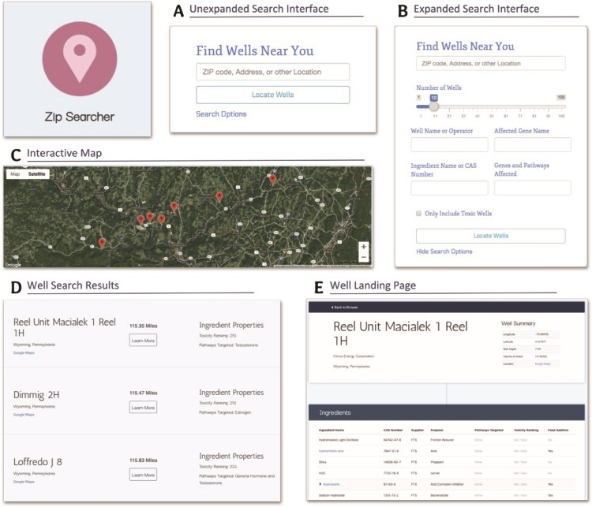
Figure 4 Screenshots from Zip Searcher and well landing pages detailing the different functionalities, fields and ...
Notes:
Figure 4 Screenshots from Zip Searcher and well landing pages detailing the different functionalities, fields and information contained on these pages. (A) The simple, collapsed search interface. (B) The more detailed, expanded search interface. (C) The interactive map displayed at the top of the results list. (D) The well search results containing the well and operator name, a summary of the well’s ingredient properties, the absolute distance from the entered location to the well, and a ‘learn more’ button. (E) The well landing page, displaying more in-depth information about the well as well as a comprehensive list of the well’s ingredients and the properties of these ingredients. We made these pages specifically with interpretability in mind—the search fields are easy to understand, and most of the information displayed is self-explanatory and does not require much background knowledge to interpret.
Unless provided in the caption above, the following copyright applies to the content of this slide: © The Author(s) 2020. Published by Oxford University Press.This is an Open Access article distributed under the terms of the Creative Commons Attribution License (http://creativecommons.org/licenses/by/4.0/), which permits unrestricted reuse, distribution, and reproduction in any medium, provided the original work is properly cited.

