Slide 1
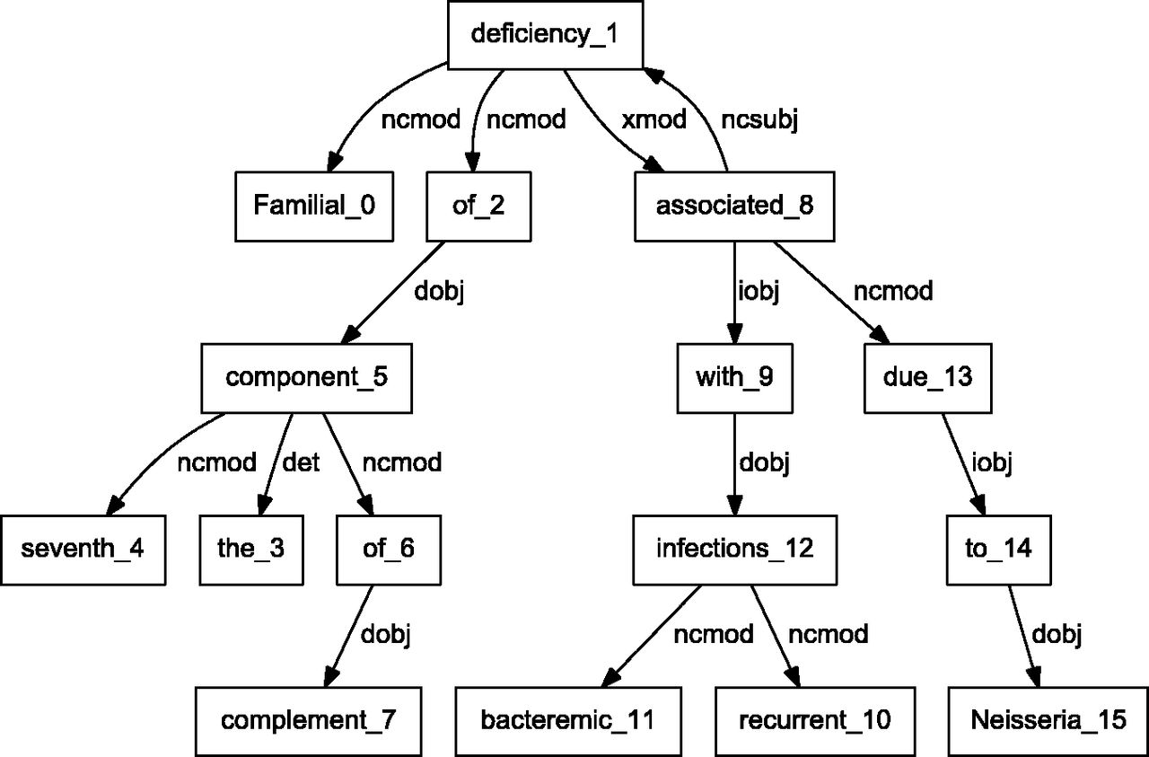
Figure 3. Dependency graph of ‘Familial deficiency of the seventh component of complement associated with recurrent ...
Notes:
Figure 3. Dependency graph of ‘Familial deficiency of the seventh component of complement associated with recurrent bacteremic infections due to Neisseria’ using C&C parser.
Unless provided in the caption above, the following copyright applies to the content of this slide: Published by Oxford University Press. This work is written by US Government employees and is in the public domain in the US.

