Slide 1
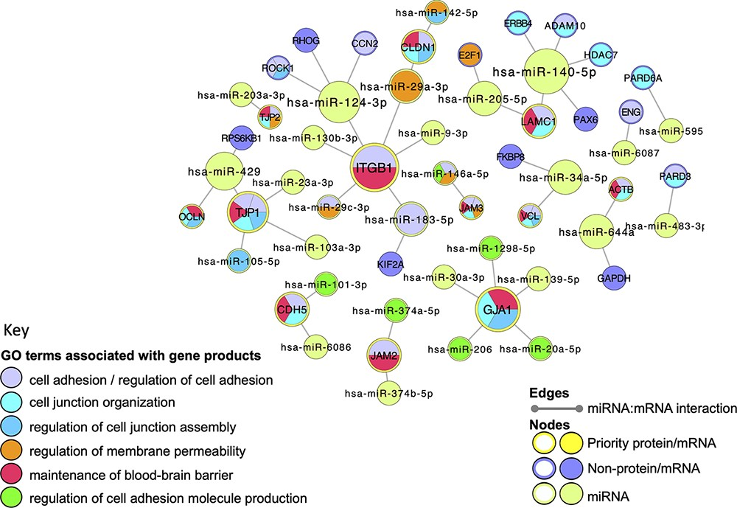
Figure 5. Cell junction focused miRNA:target network. The miRNA:target network was constructed in Cytoscape (41) by ...
Notes:
Figure 5. Cell junction focused miRNA:target network. The miRNA:target network was constructed in Cytoscape (41) by seeding with 27 human proteins, identified as miRNA:targets during the BBB-focused annotation project, and the molecular interaction data were extracted from the EBI-GOA-miRNA file (25). The size of each node represents the number of interactions included in the network; the edges represent the miRNA:target interactions. Following a GO enrichment analysis of the network, GO terms relevant to formation and maintenance of cell junctions (Table 4) were overlaid on the gene product nodes using GOlorize and BiNGO (43, 44). Molecular interaction data accessed 24 August 2020, GO association and ontology files accessed 22 March 2021.
Unless provided in the caption above, the following copyright applies to the content of this slide: © The Author(s) 2021. Published by Oxford University Press.This is an Open Access article distributed under the terms of the Creative Commons Attribution License (https://creativecommons.org/licenses/by/4.0/), which permits unrestricted reuse, distribution, and reproduction in any medium, provided the original work is properly cited.

