Slide 1
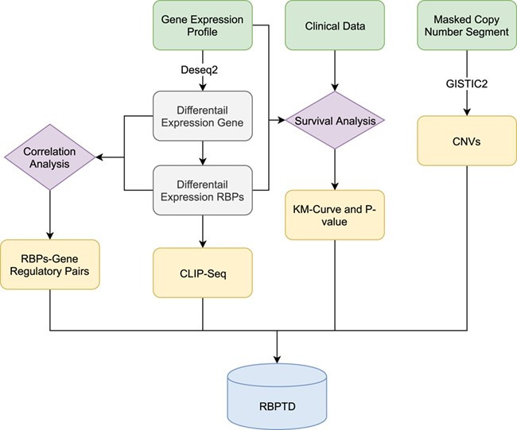
Figure 1 Workflow of RBPTD development. Expression profiles, prognostic information and copy number variation (CNV) ...
Notes:
Figure 1 Workflow of RBPTD development. Expression profiles, prognostic information and copy number variation (CNV) data were downloaded from The Cancer Genome Atlas (TCGA). To find the cancer-related RBPs, we used the DESeq2 package in the R software environment to analyse differentially expressed genes (DEGs), and the survival package of R software was used for survival analysis. To reveal the causes of abnormality of dysregulated RBPs, the genomic identification of significant targets in cancer (GISTIC) was used for CNV analysis. We also predicted the function of RBPs by CLIP-Seq experimental data and co-expression analysis. Finally, we then developed a database using the obtained RNA binding protein (RBP) results.
Unless provided in the caption above, the following copyright applies to the content of this slide: © The Author(s) 2020. Published by Oxford University Press.This is an Open Access article distributed under the terms of the Creative Commons Attribution License (http://creativecommons.org/licenses/by/4.0/), which permits unrestricted reuse, distribution, and reproduction in any medium, provided the original work is properly cited.

