Slide 1
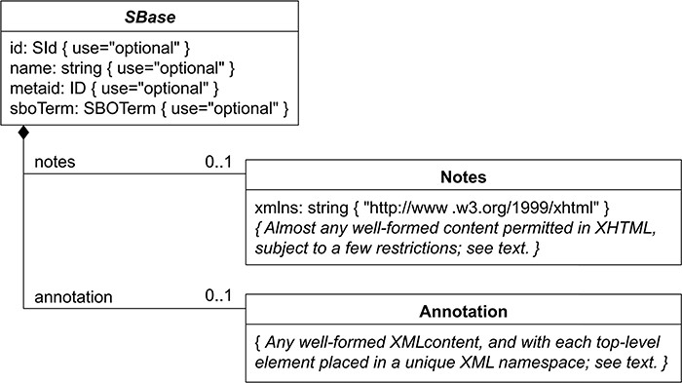
Figure 6. Nearly every object composing an SBML Level 3 model definition has a specific data type that is derived ...
Notes:
Figure 6. Nearly every object composing an SBML Level 3 model definition has a specific data type that is derived directly or indirectly from a single abstract type called SBase. See Section 3.2 from SBML Specification for Level 3 Version 2 Core. BioKC follows the same structure for all SBML elements composing a fact so that they can be annotated.
Unless provided in the caption above, the following copyright applies to the content of this slide: © The Author(s) 2024. Published by Oxford University Press.This is an Open Access article distributed under the terms of the Creative Commons Attribution License (https://creativecommons.org/licenses/by/4.0/), which permits unrestricted reuse, distribution, and reproduction in any medium, provided the original work is properly cited.

